Slide 1
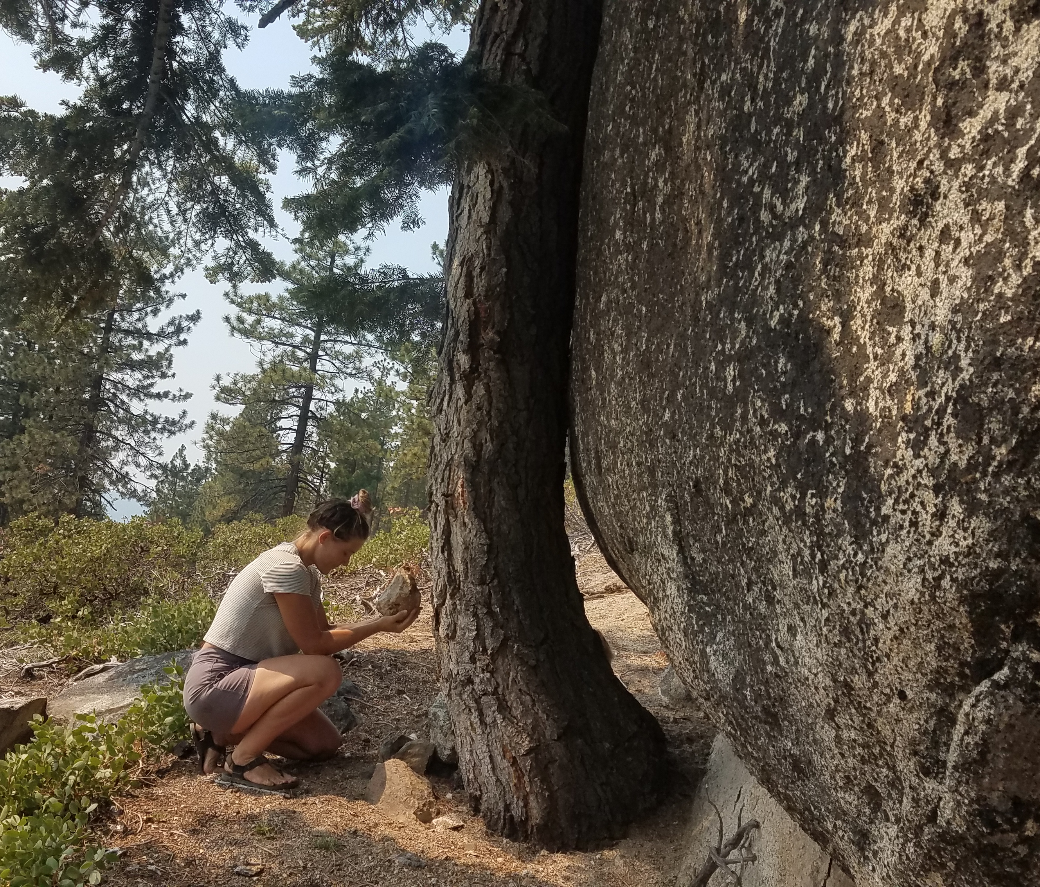
Connect to Care
Sustainable Tourism
8 Worlds
TriNomics
Currency of Caring
Presenter: Jacquie Chandler
Executive Director Sustain Tahoe.org

Slide 2
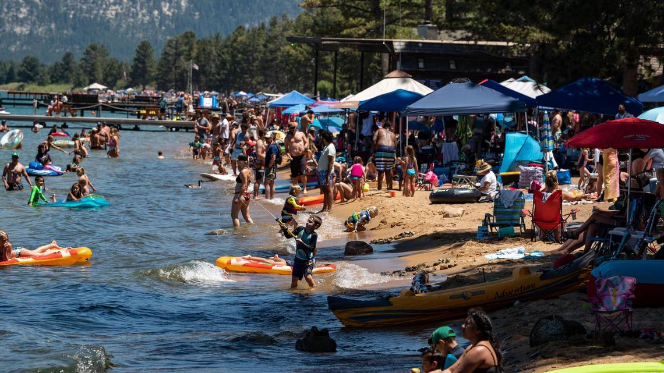
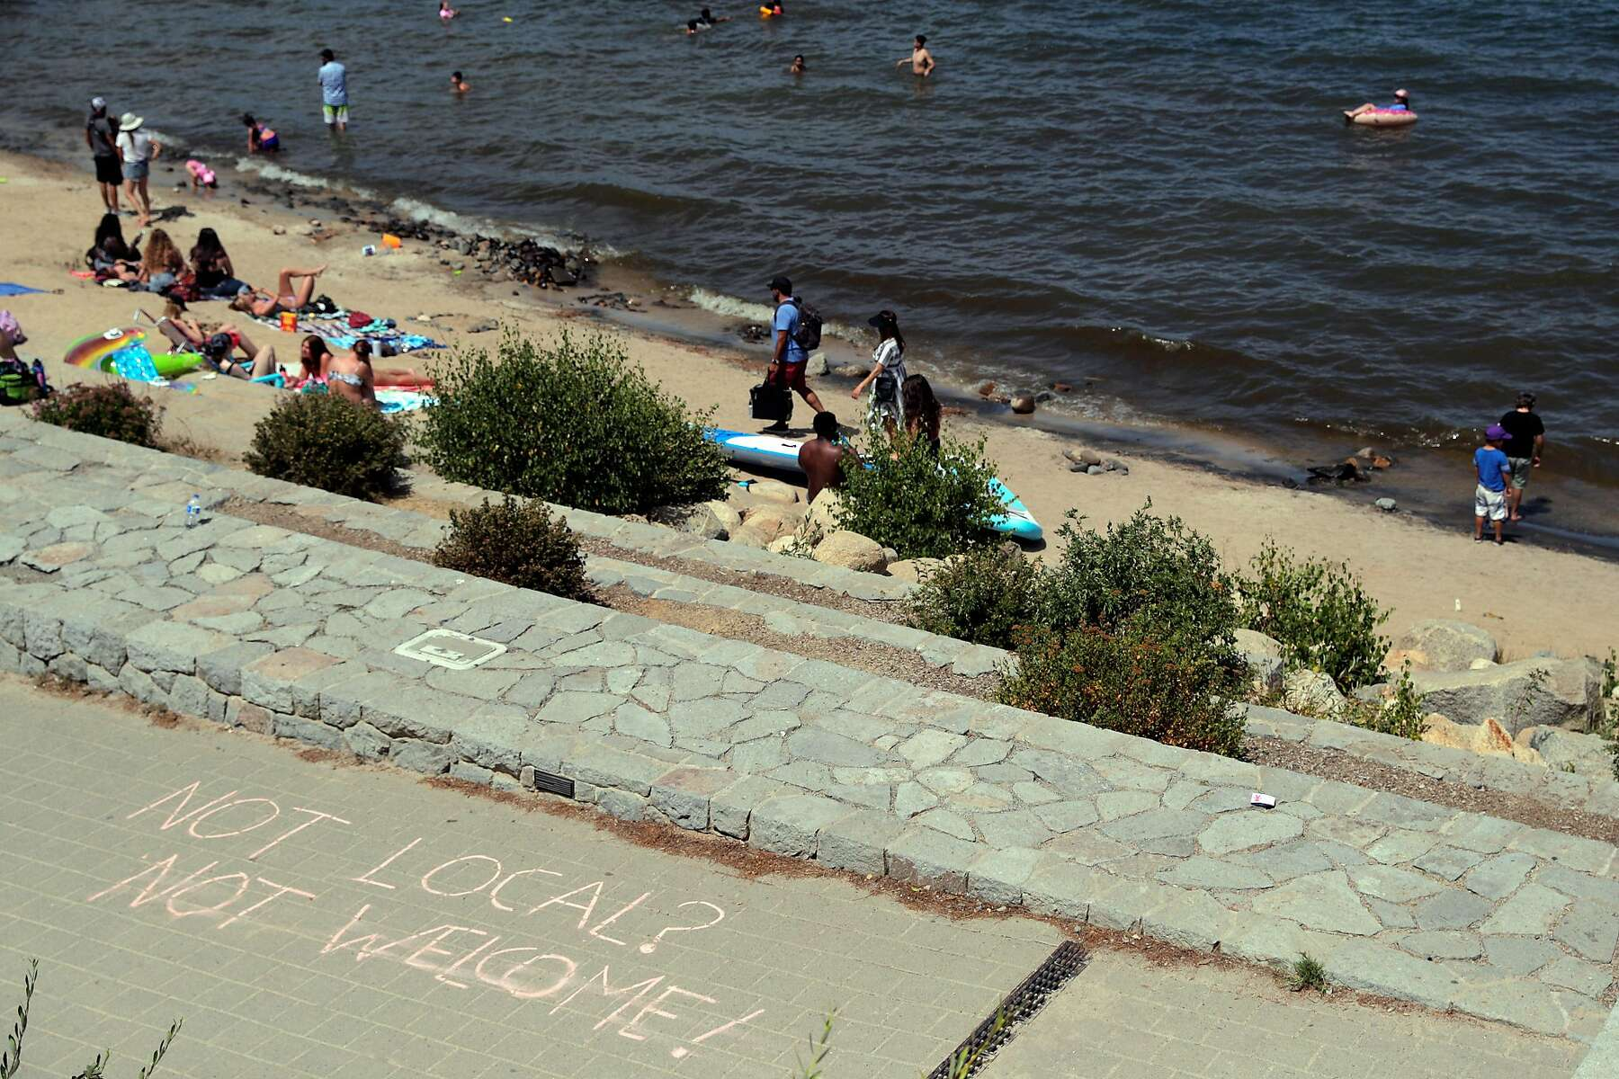
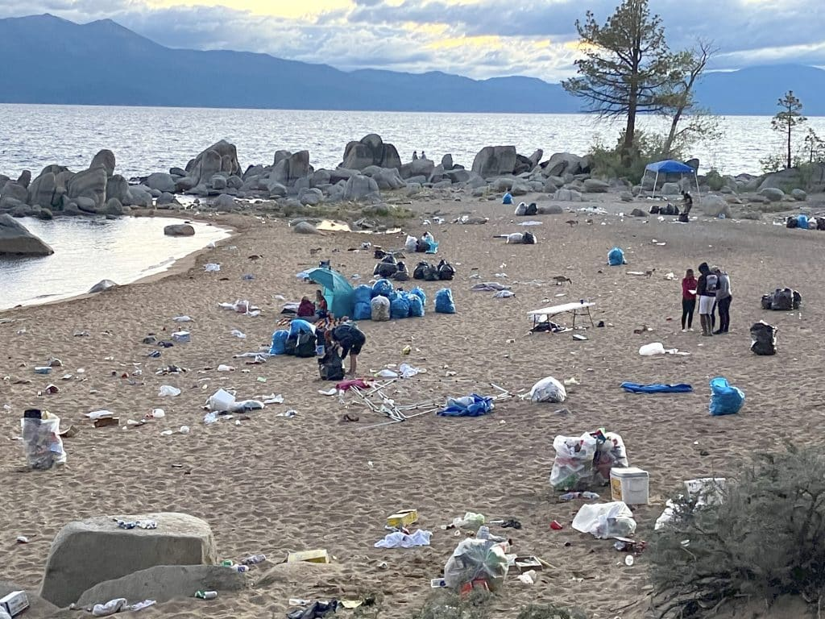

Slide 3
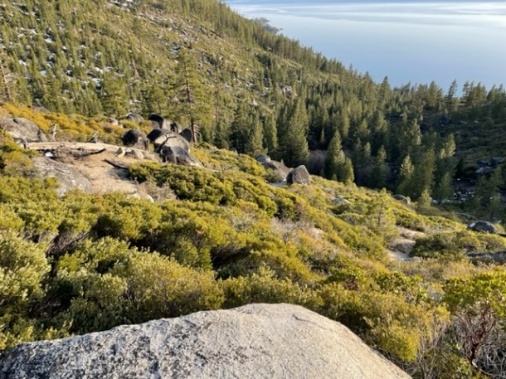
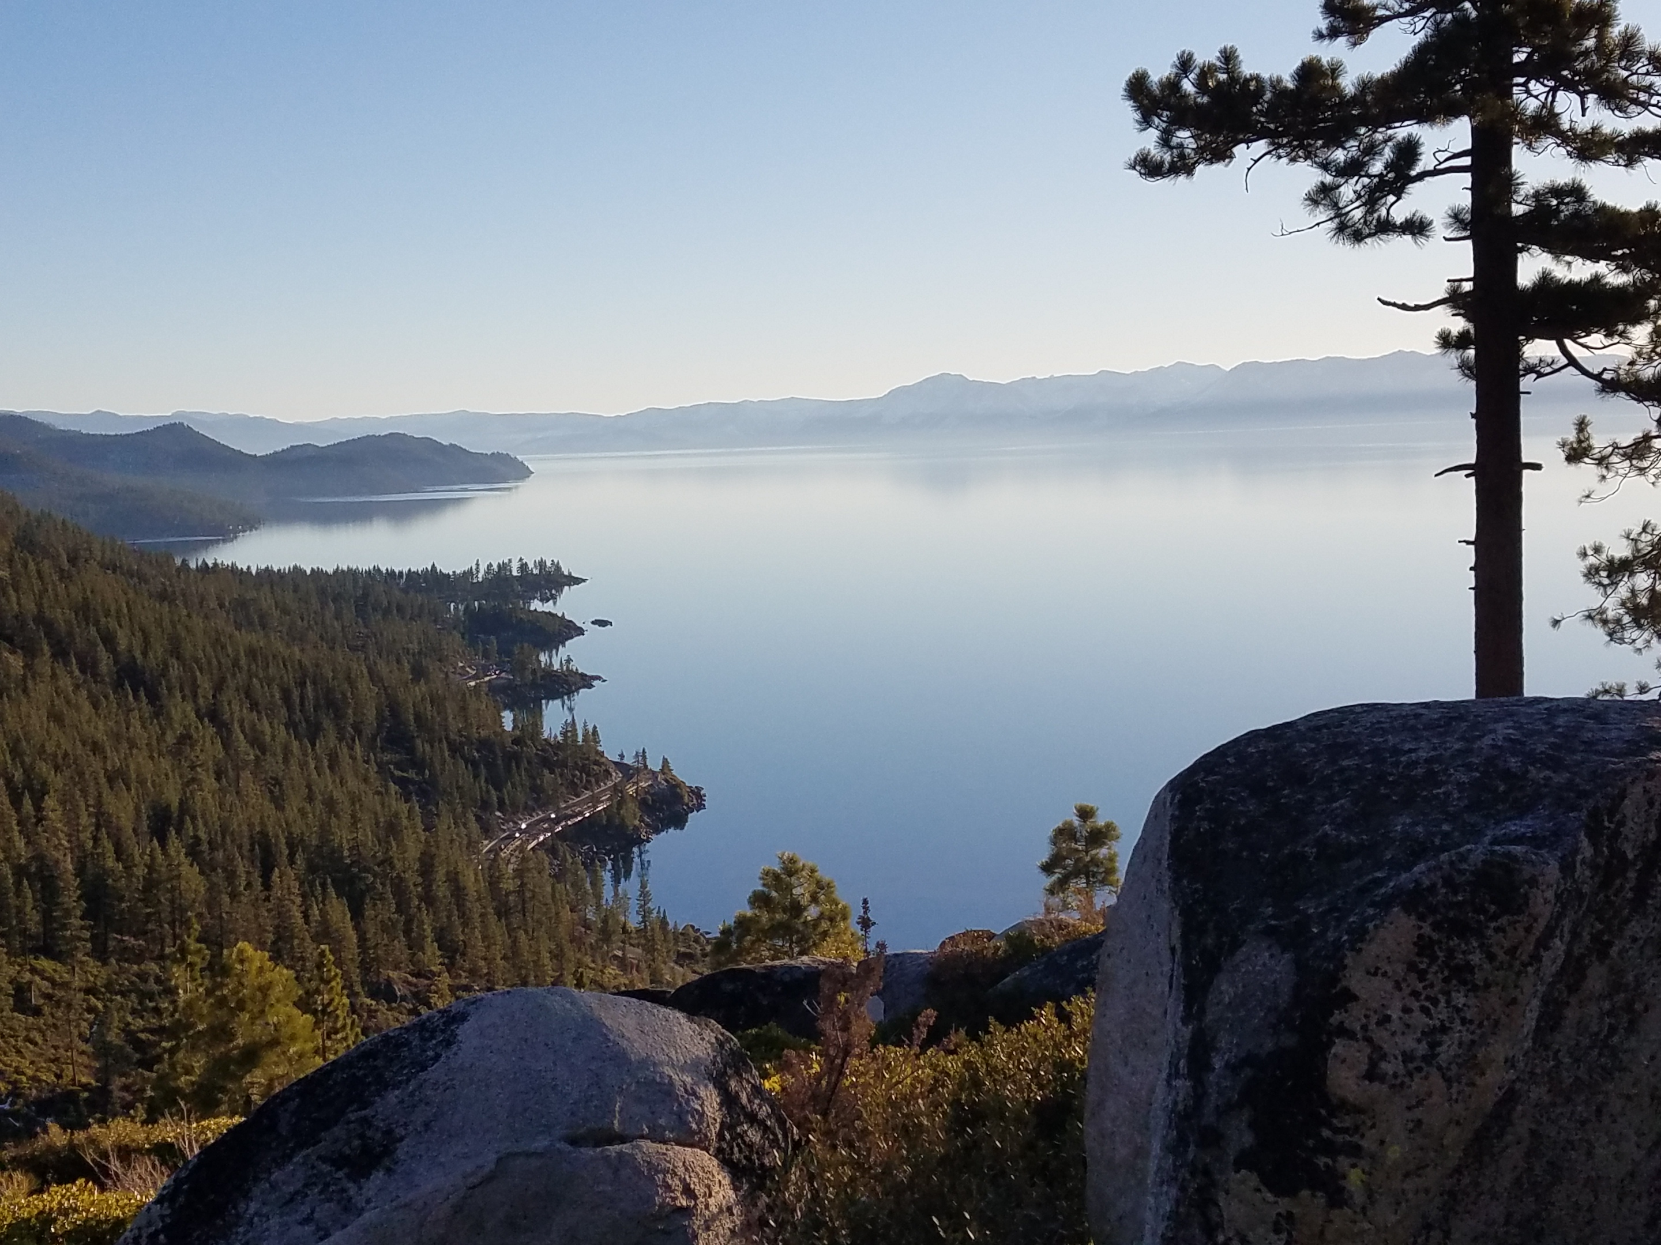
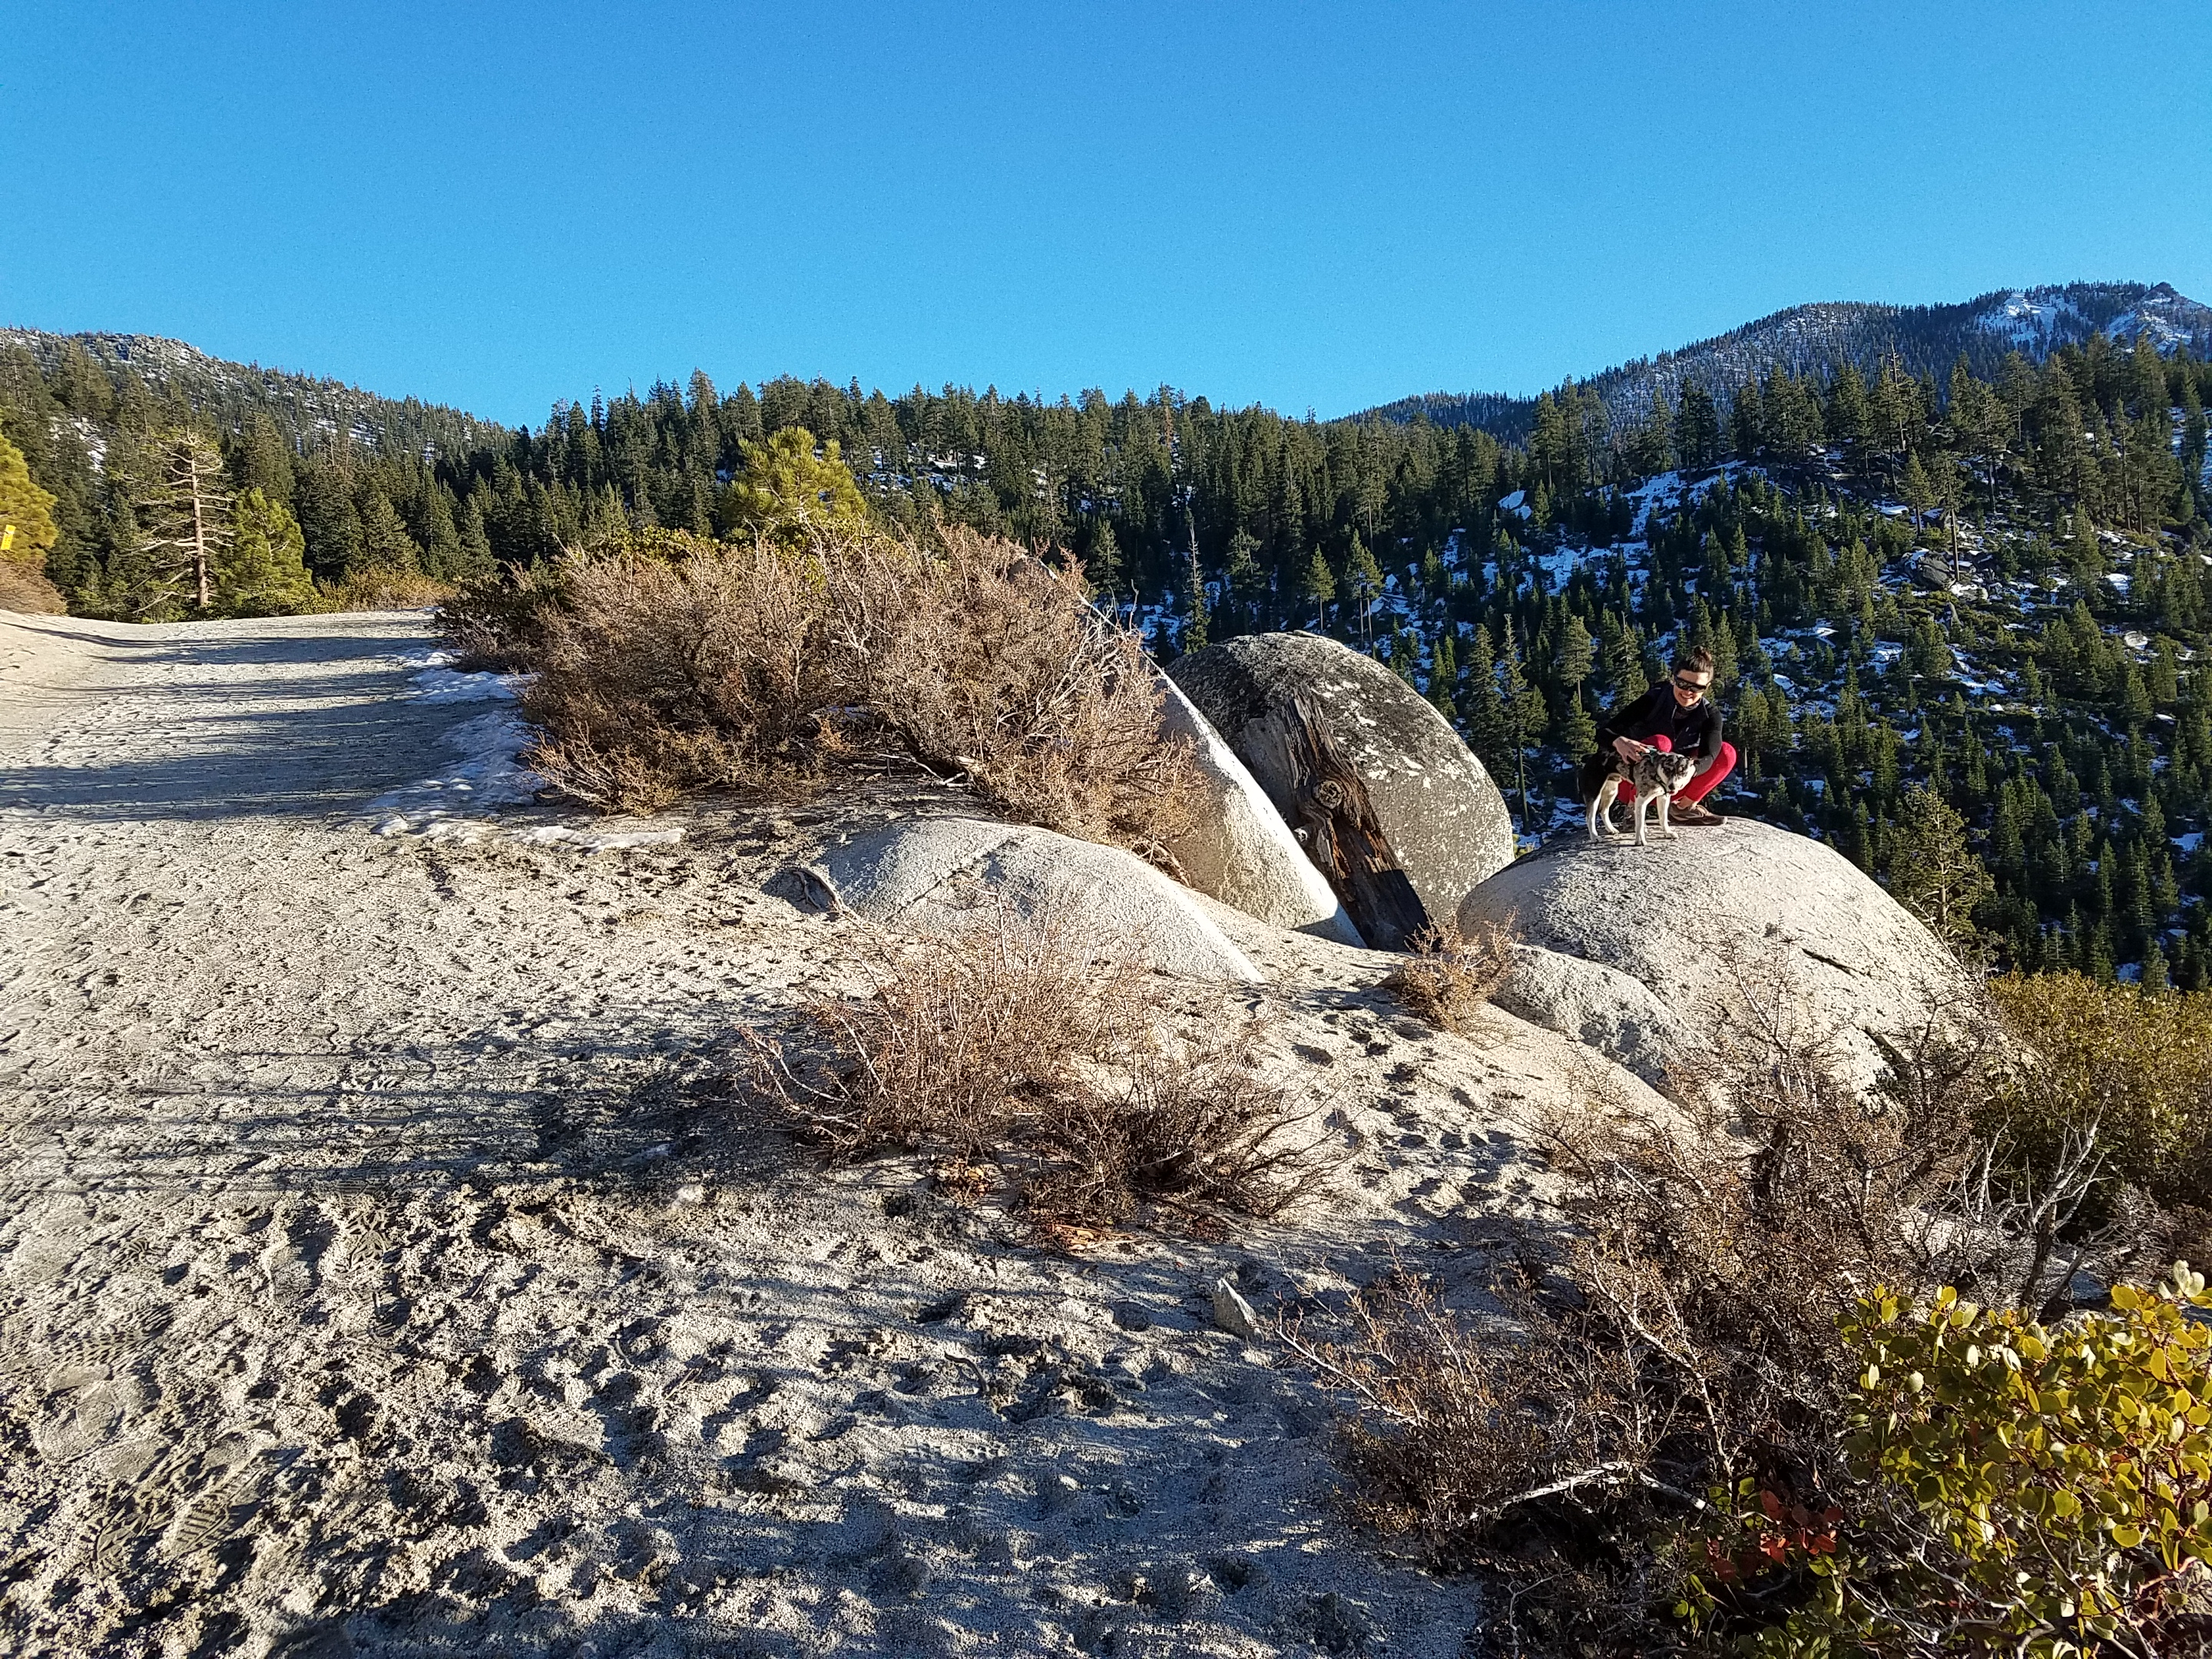
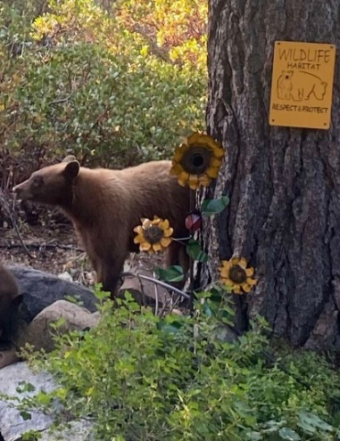

Slide 4

Geotourism - tourism pays to protect … not destroy
Wildlife viewing
Cultural tourism
Local cuisine
ECOTOURISM:
nature
Heritage tourism
Agri-tourism
Indigenous tourism

Slide 5
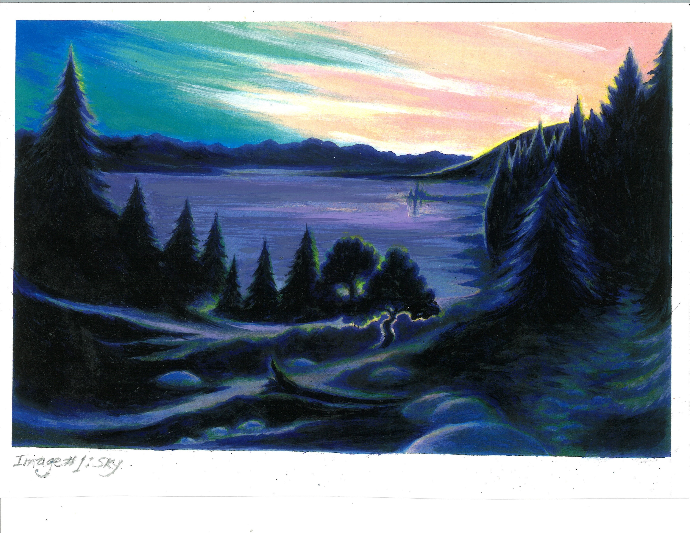

1-Sky
8 Worlds

Slide 6
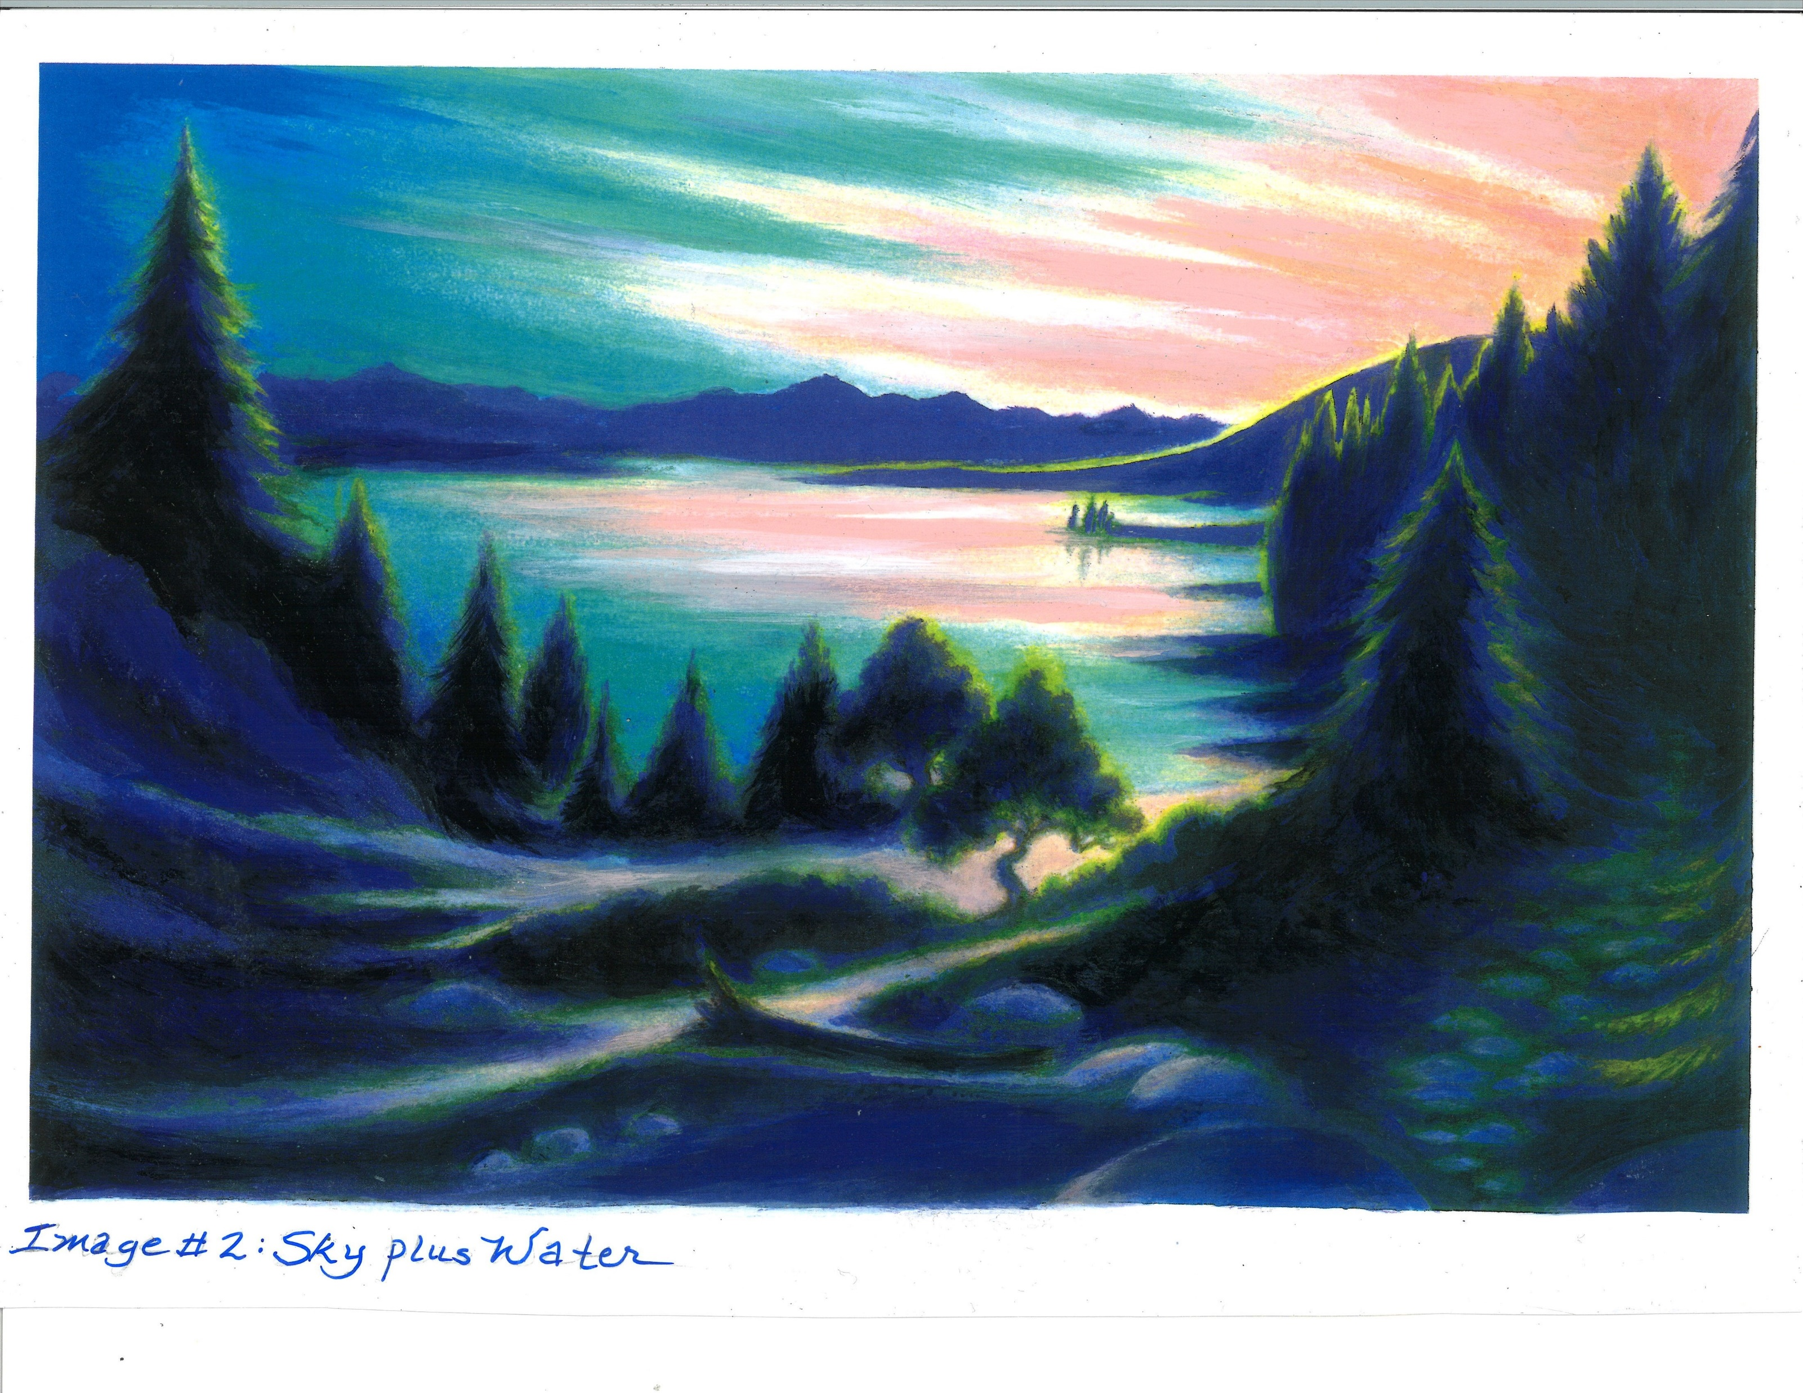
2-Water
8 Worlds

Slide 7
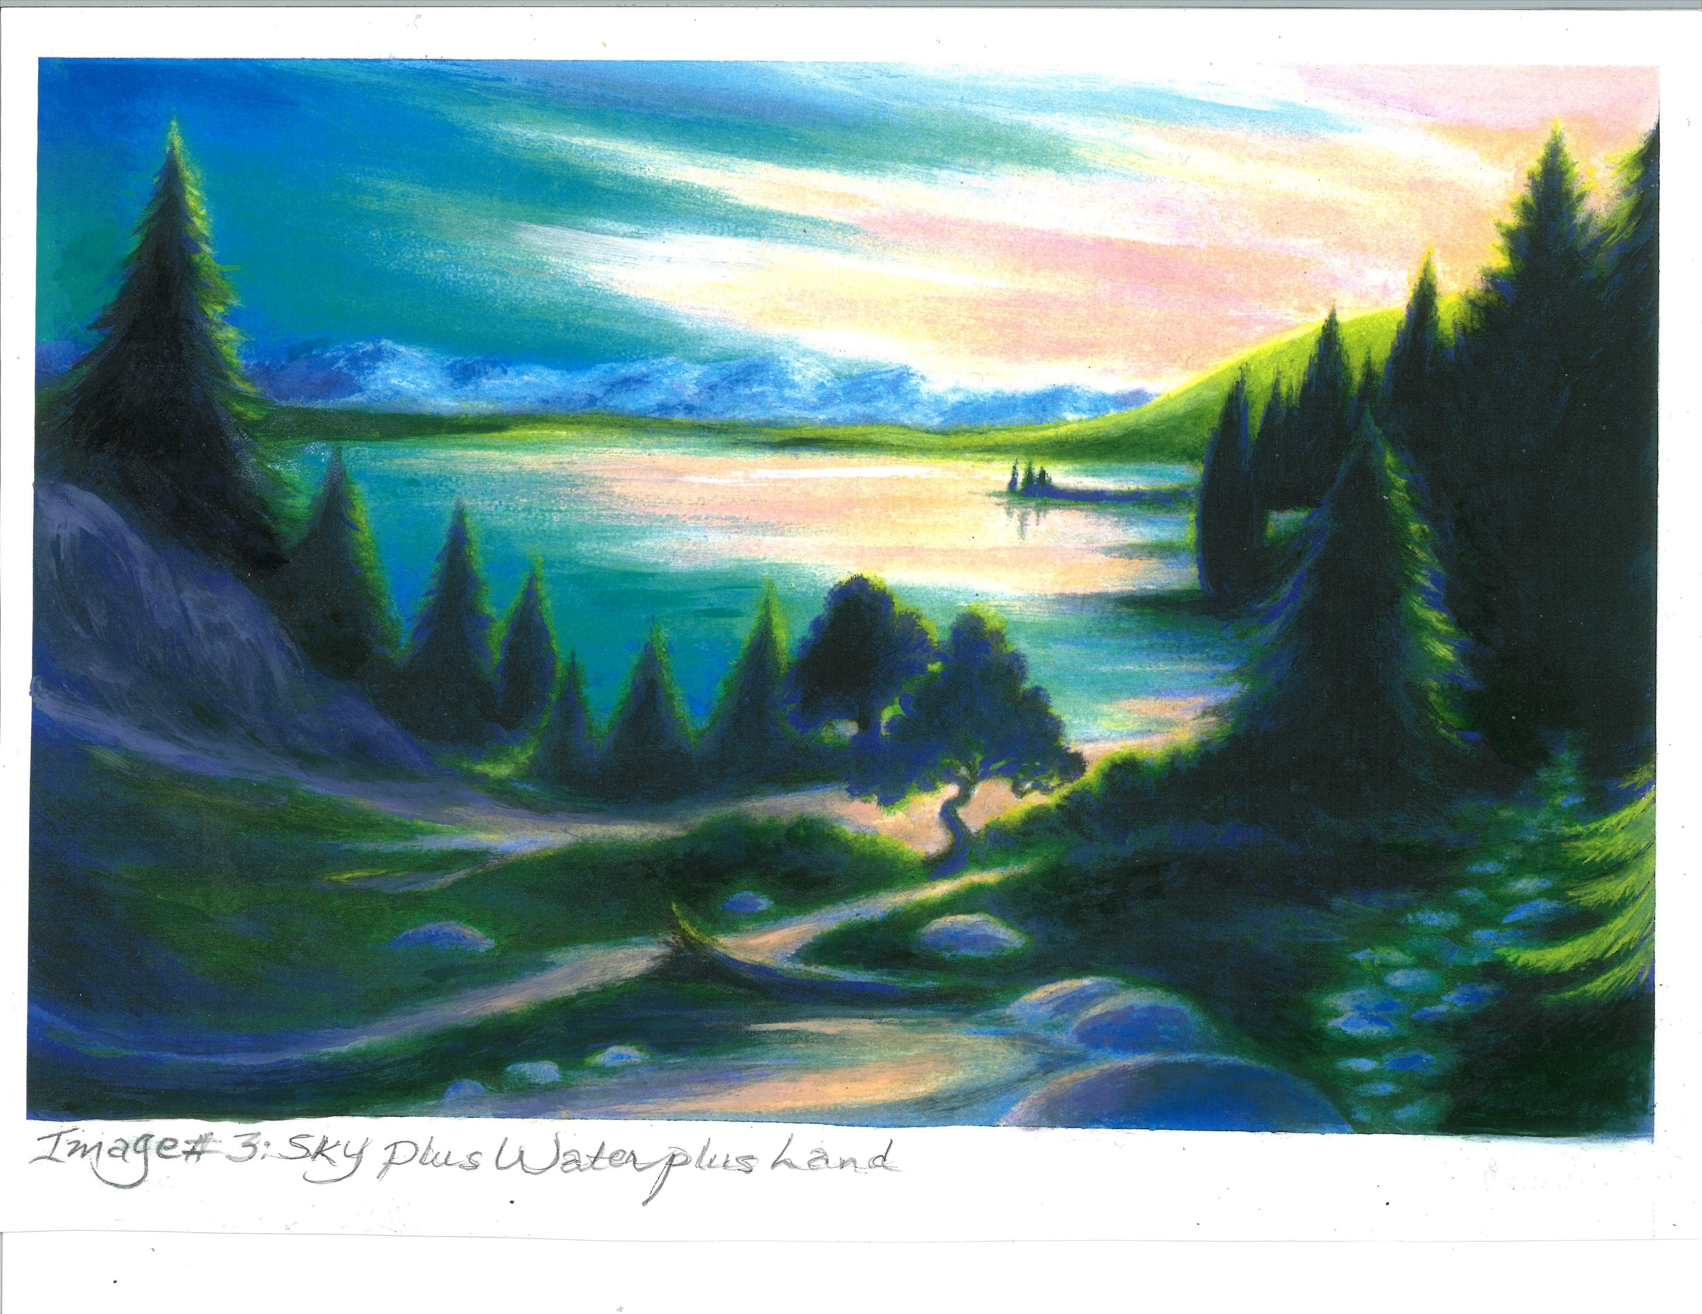
3-Land
8 Worlds

Slide 8
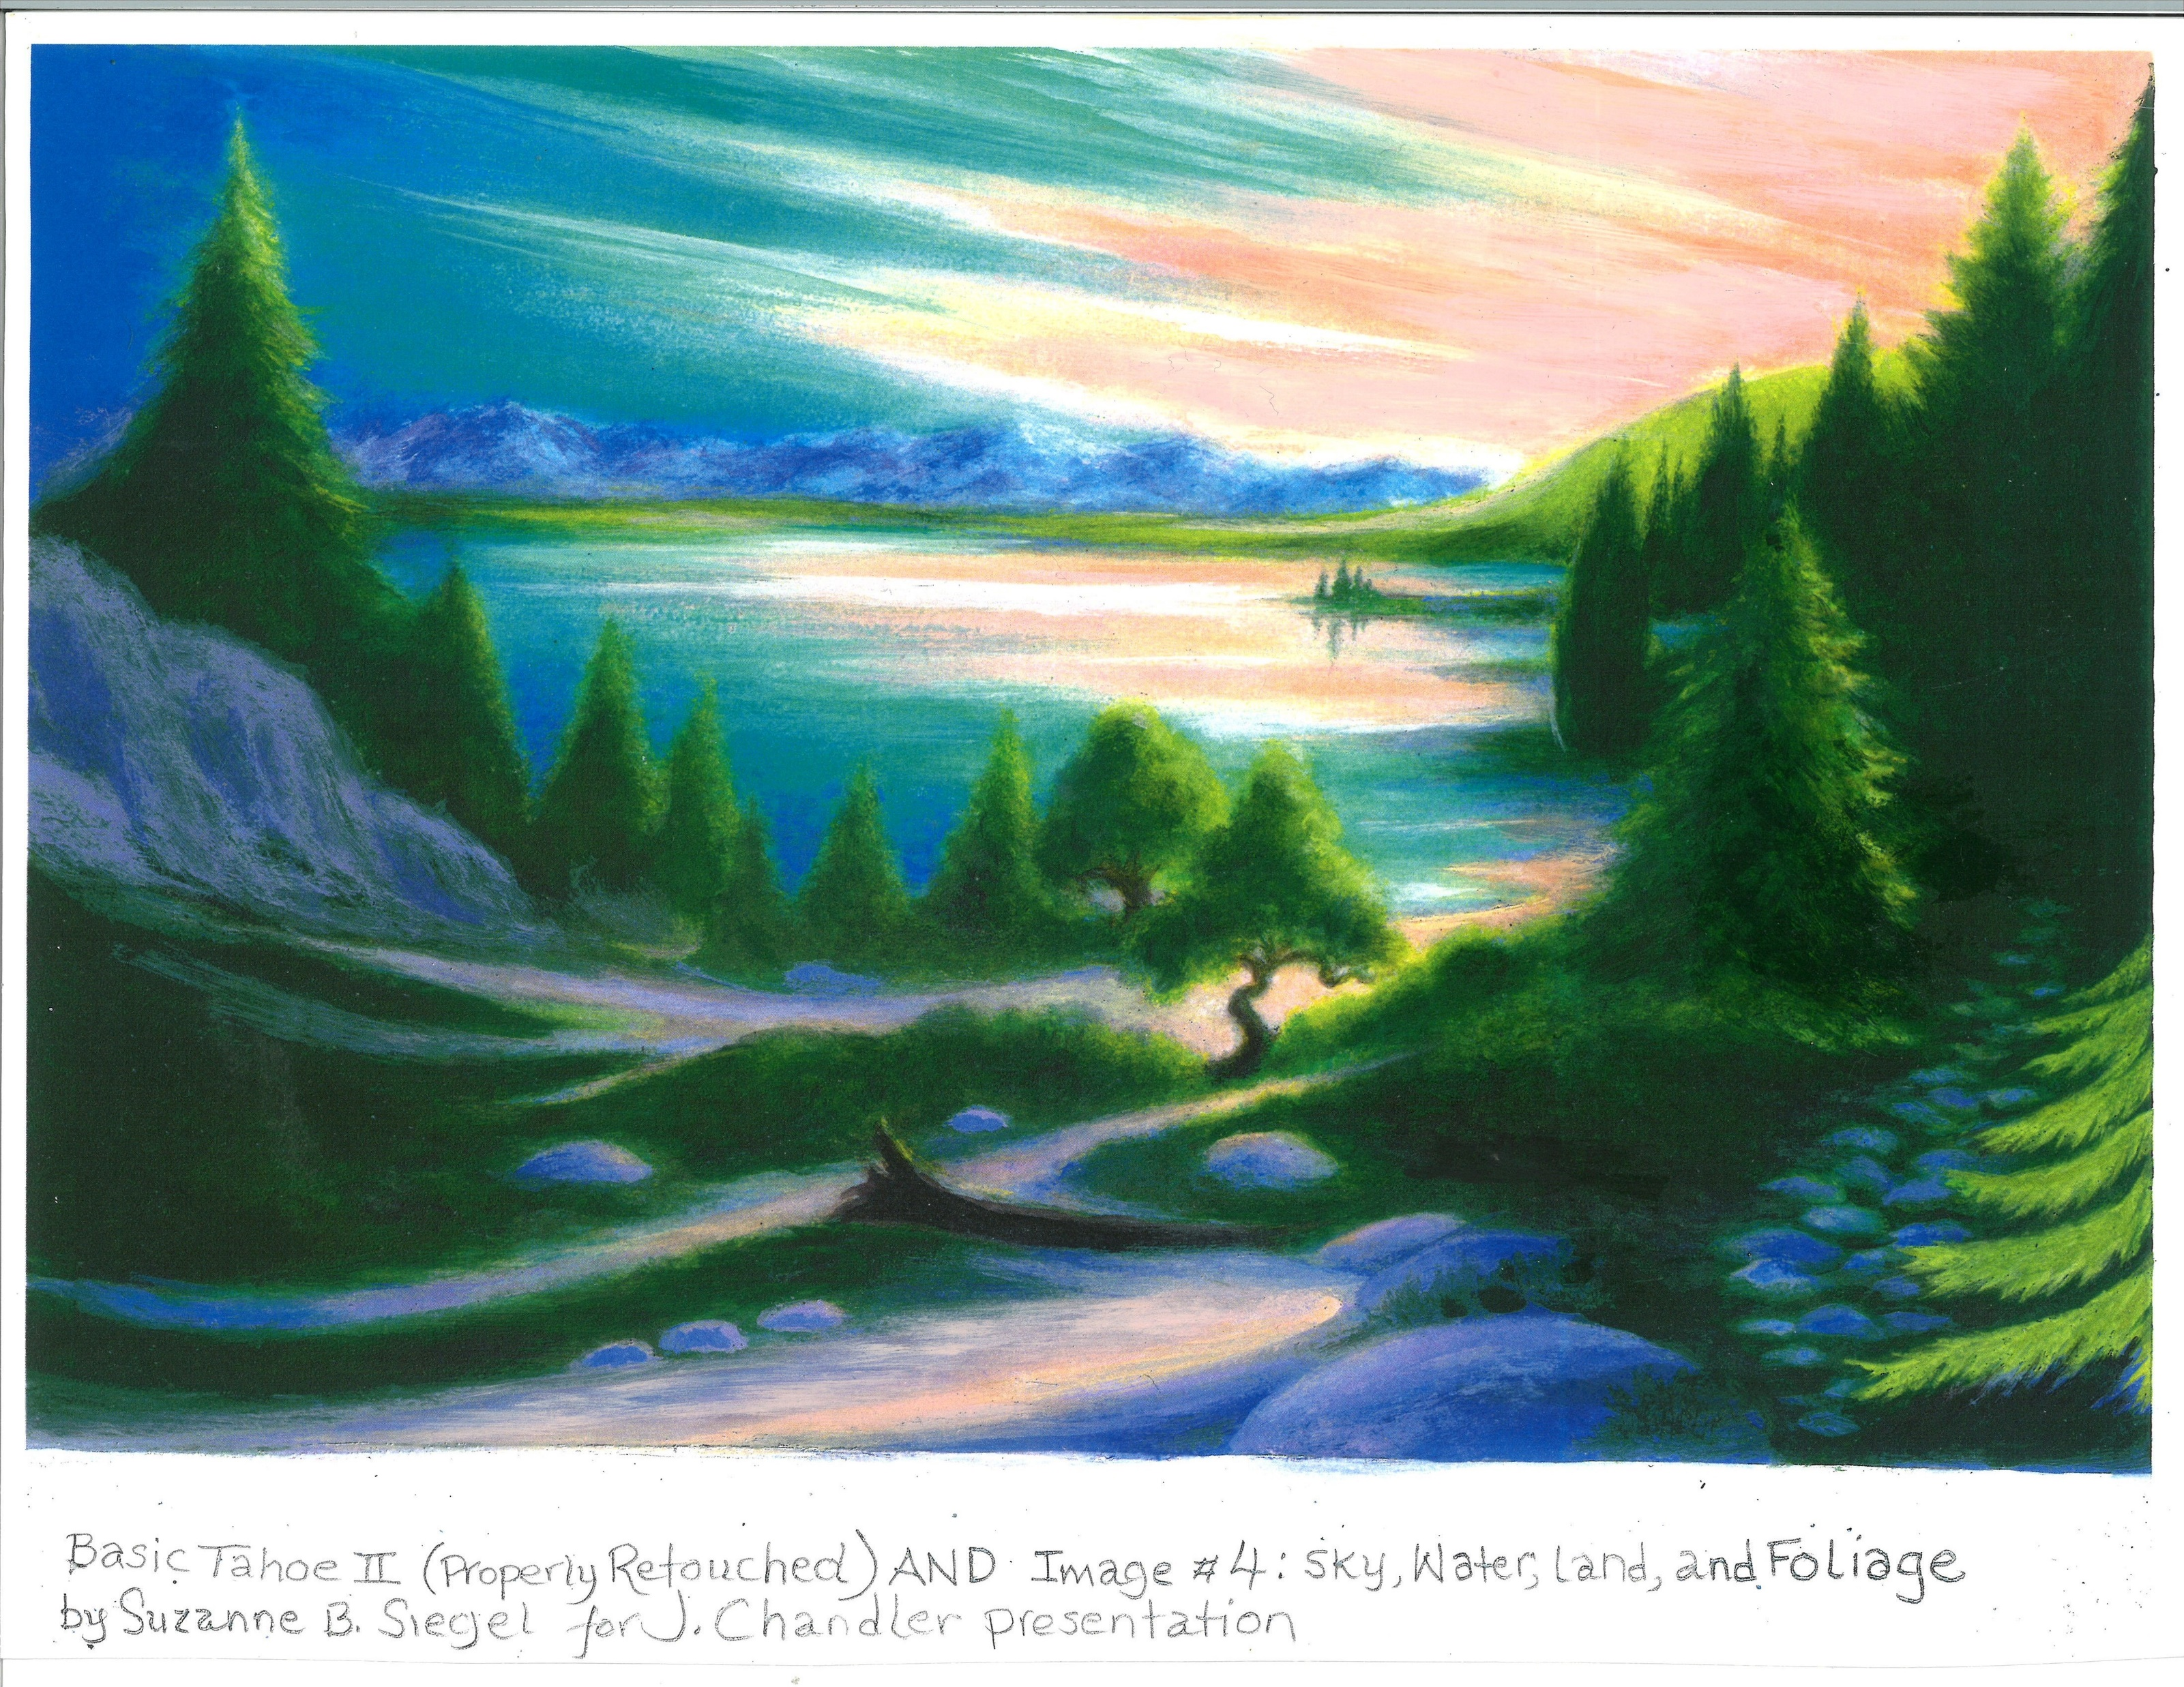
4-Plant/Foliage
8 Worlds

Slide 9
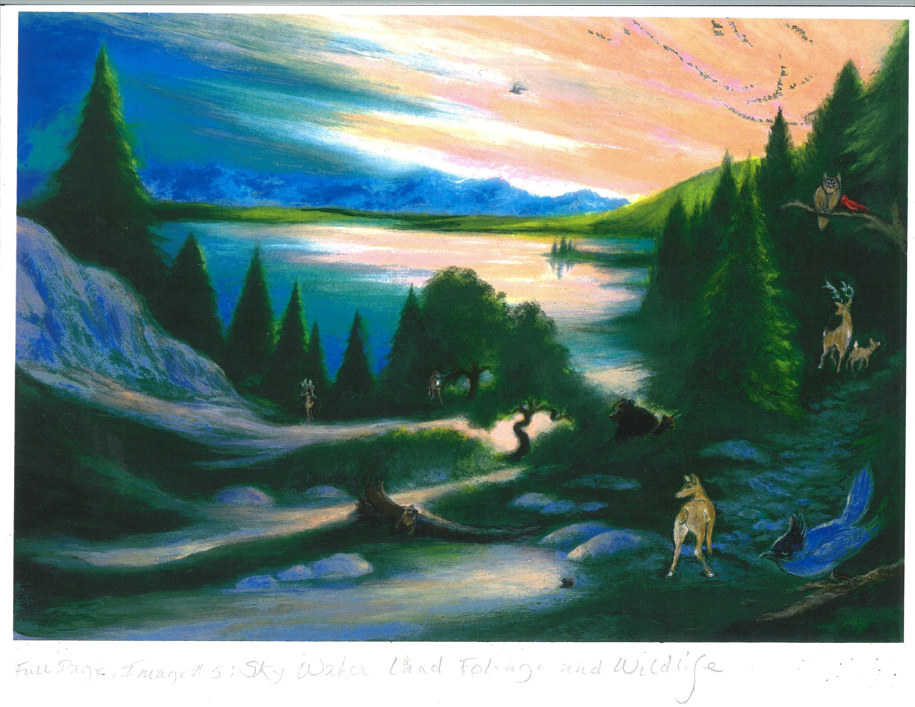
5 Wildlife
8 Worlds

Slide 10
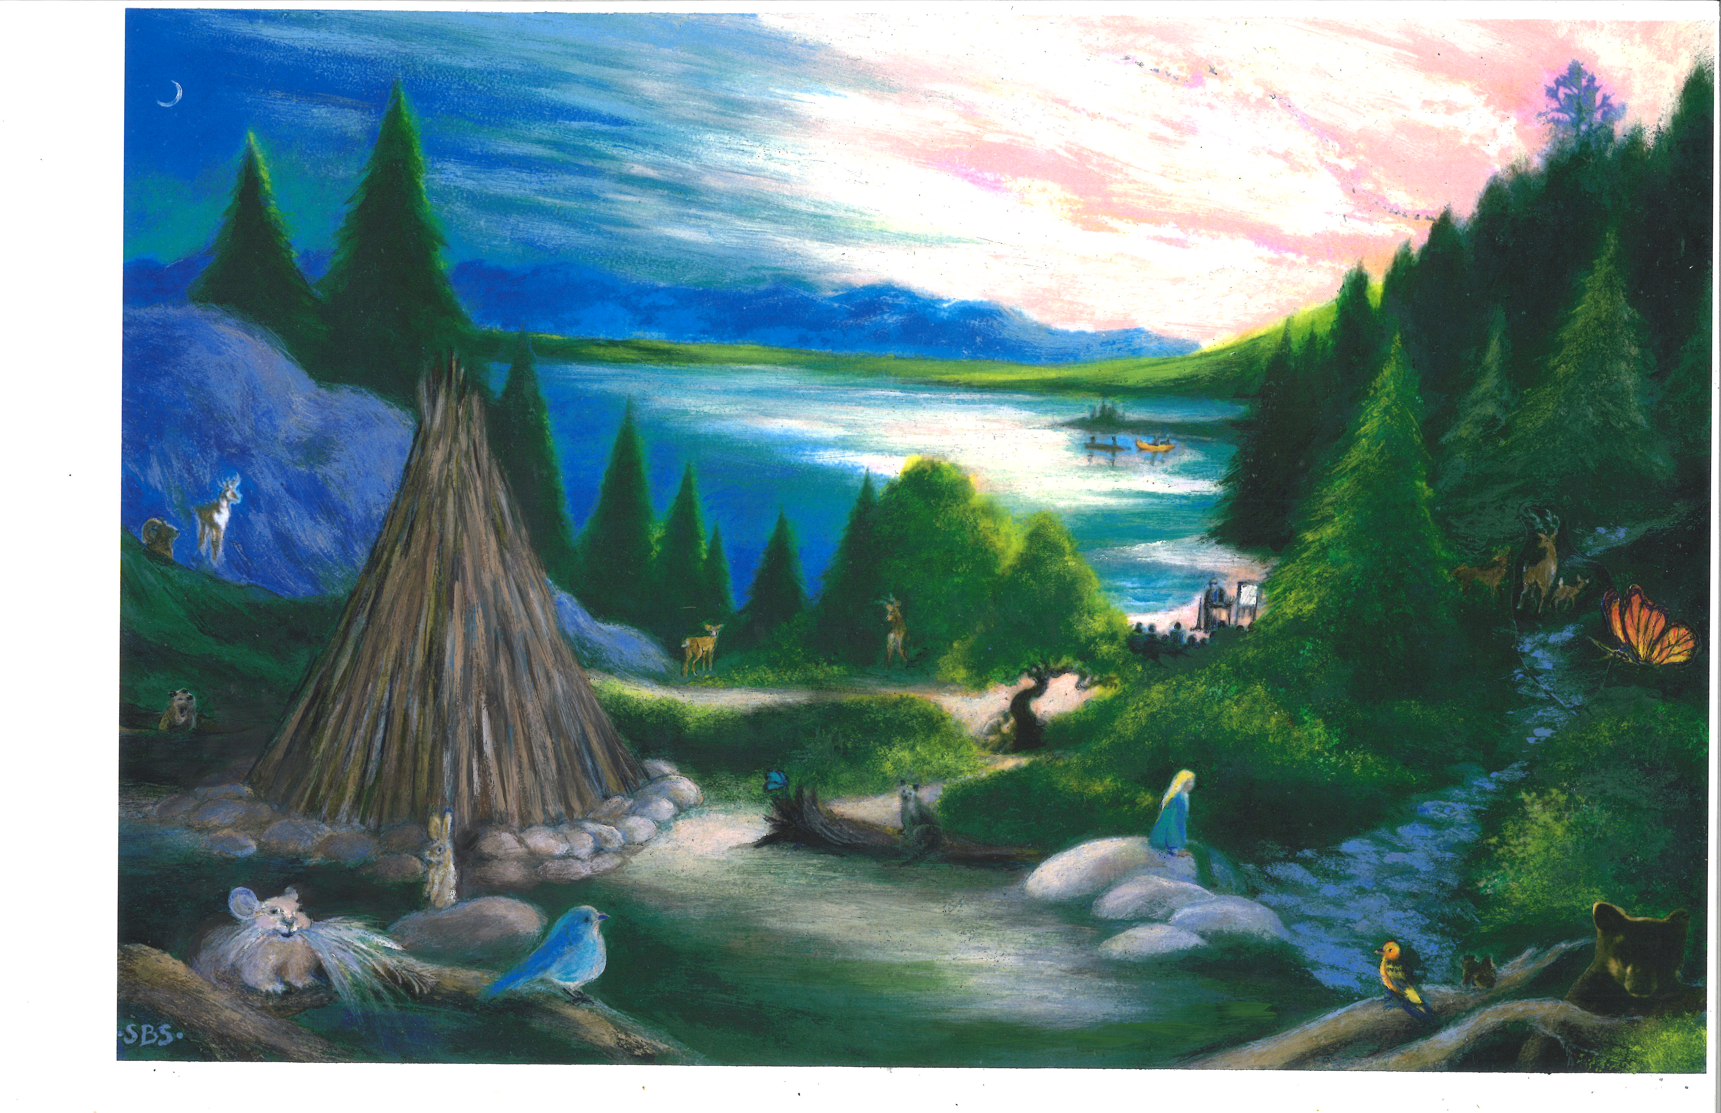
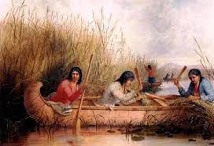
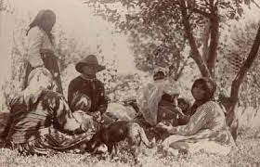
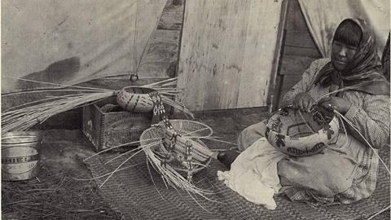
6-Community
7-Culture
8 Worlds

Slide 11
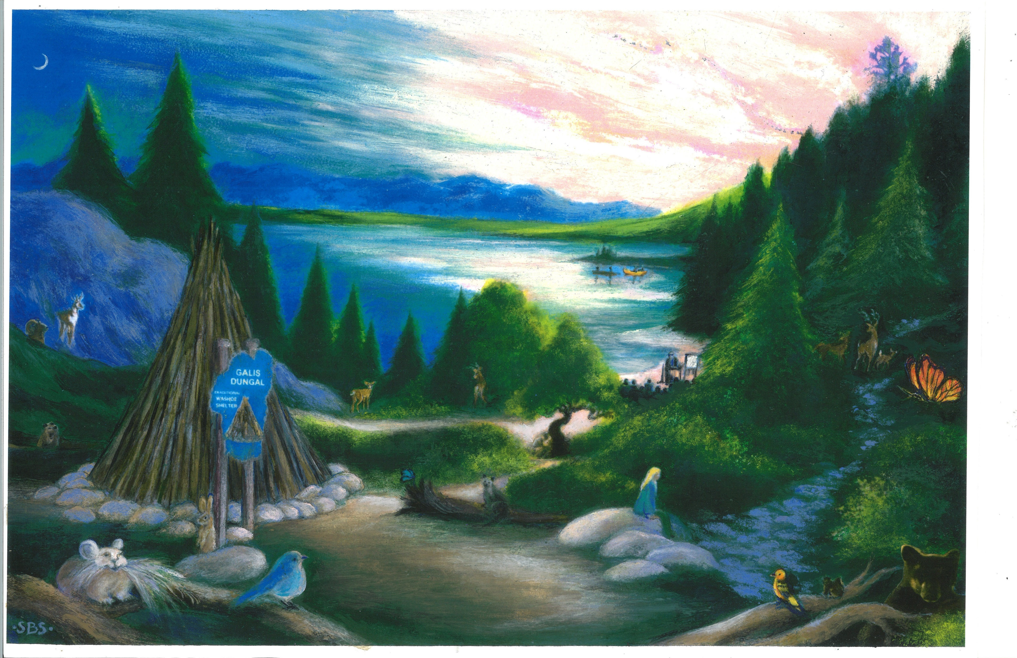
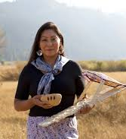
8-Heritage
8 Worlds

Slide 12
4- step Geotourism Strategy
• Identify
• Sustain
• Develop
• Promote
Geotourism assets
Notes:
Destinations can pursue the four tracks of a geotourism strategy; all should be ongoing.
We’ll look at these tracks, and just some of the principles as they apply (not in Charter order).

Slide 13
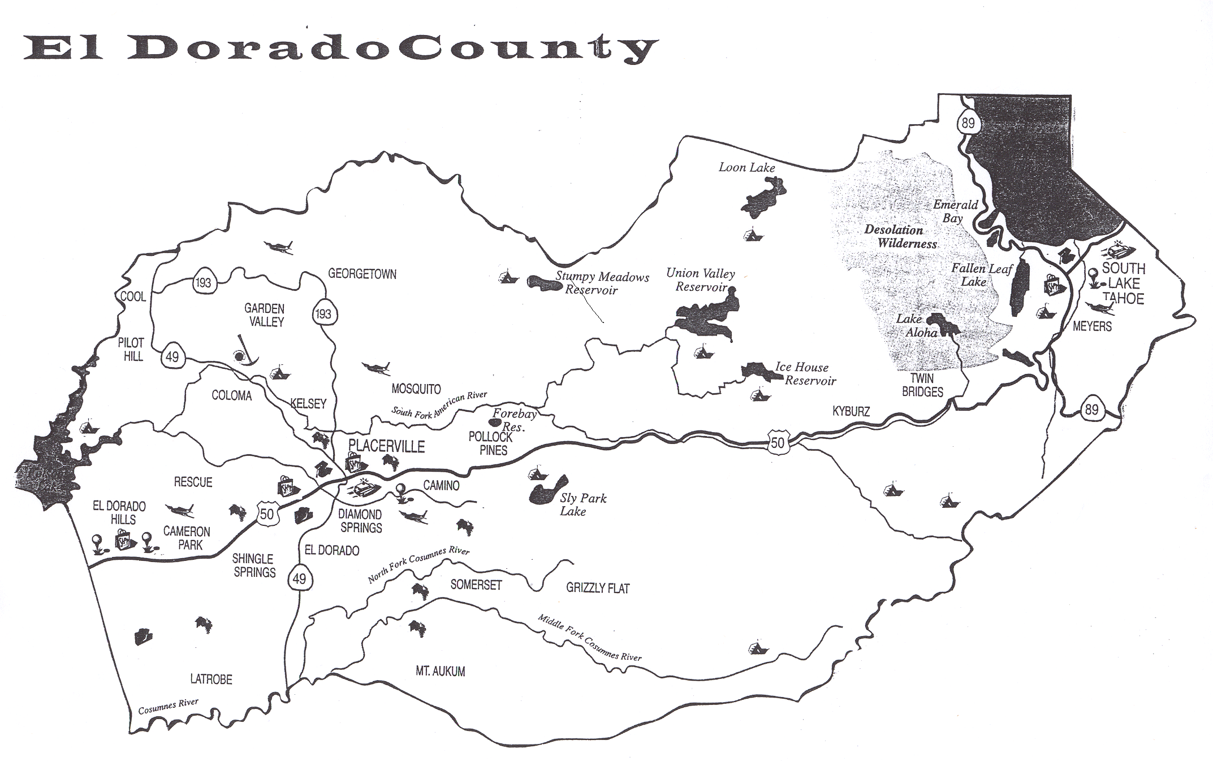
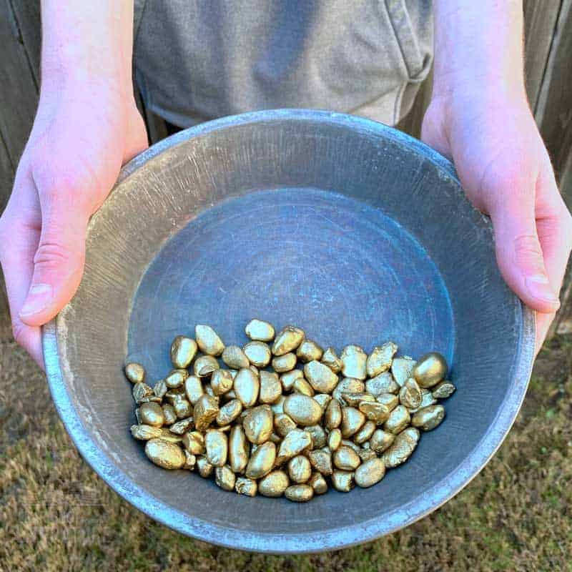
1) Identify Geotourism assets

Slide 14
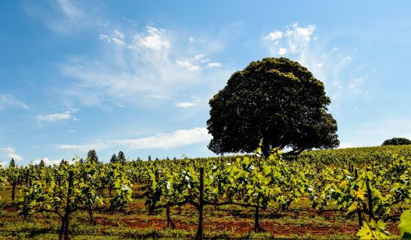


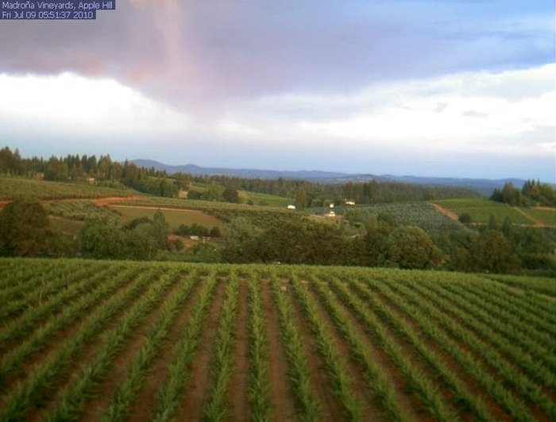
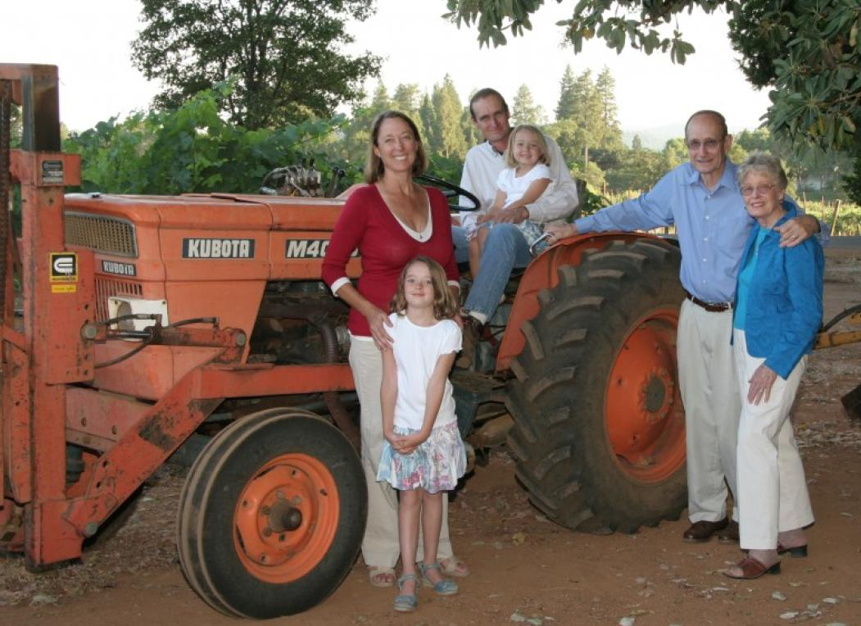
1) Identify Geotourism assets

Slide 15
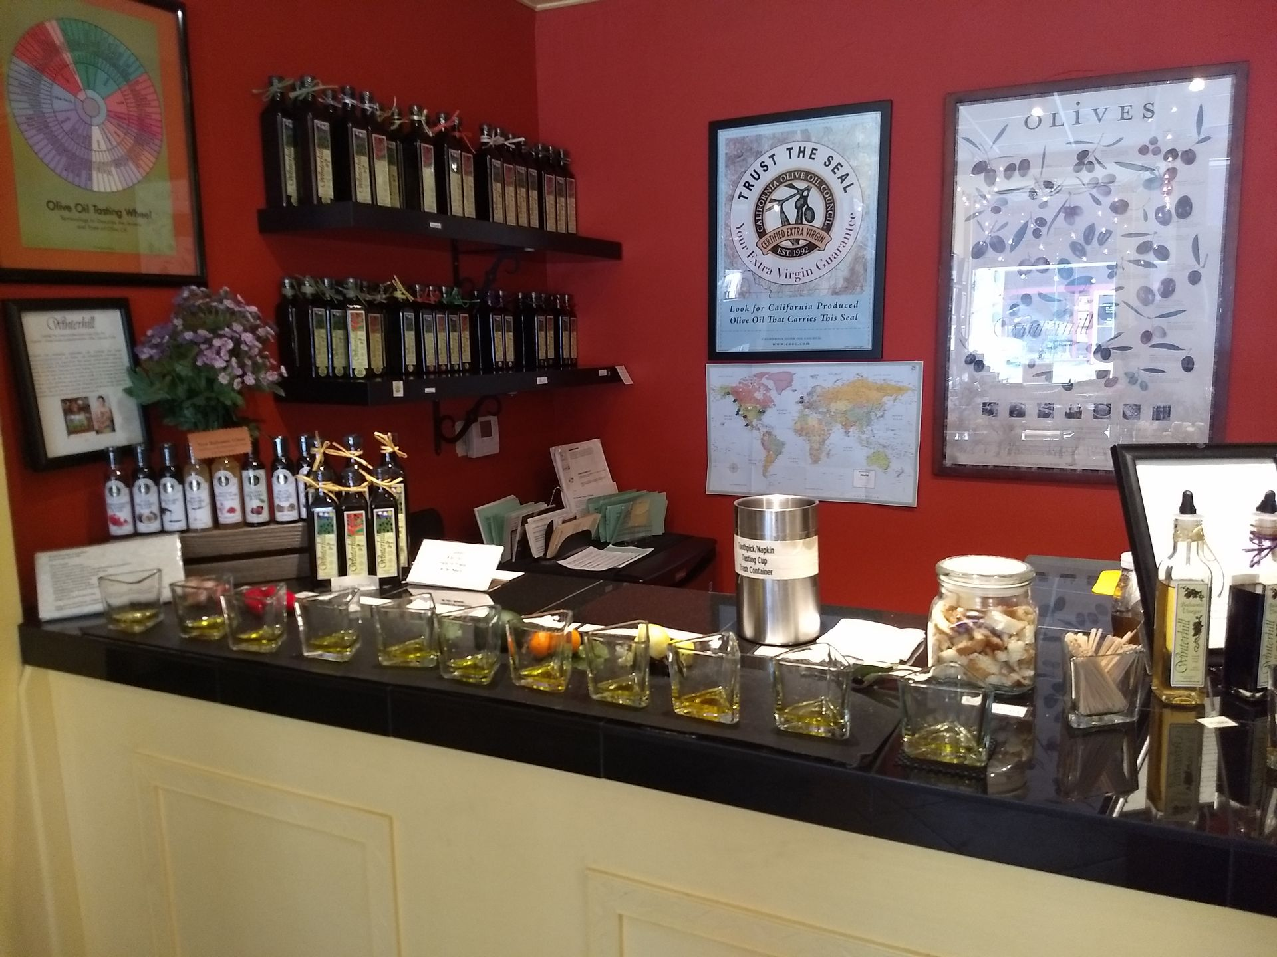
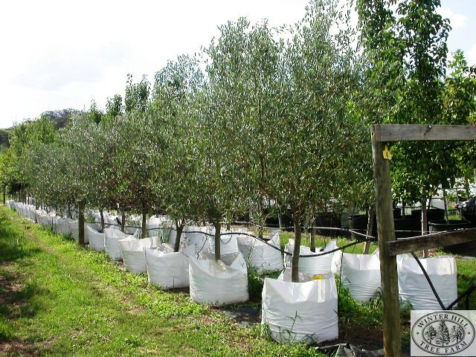
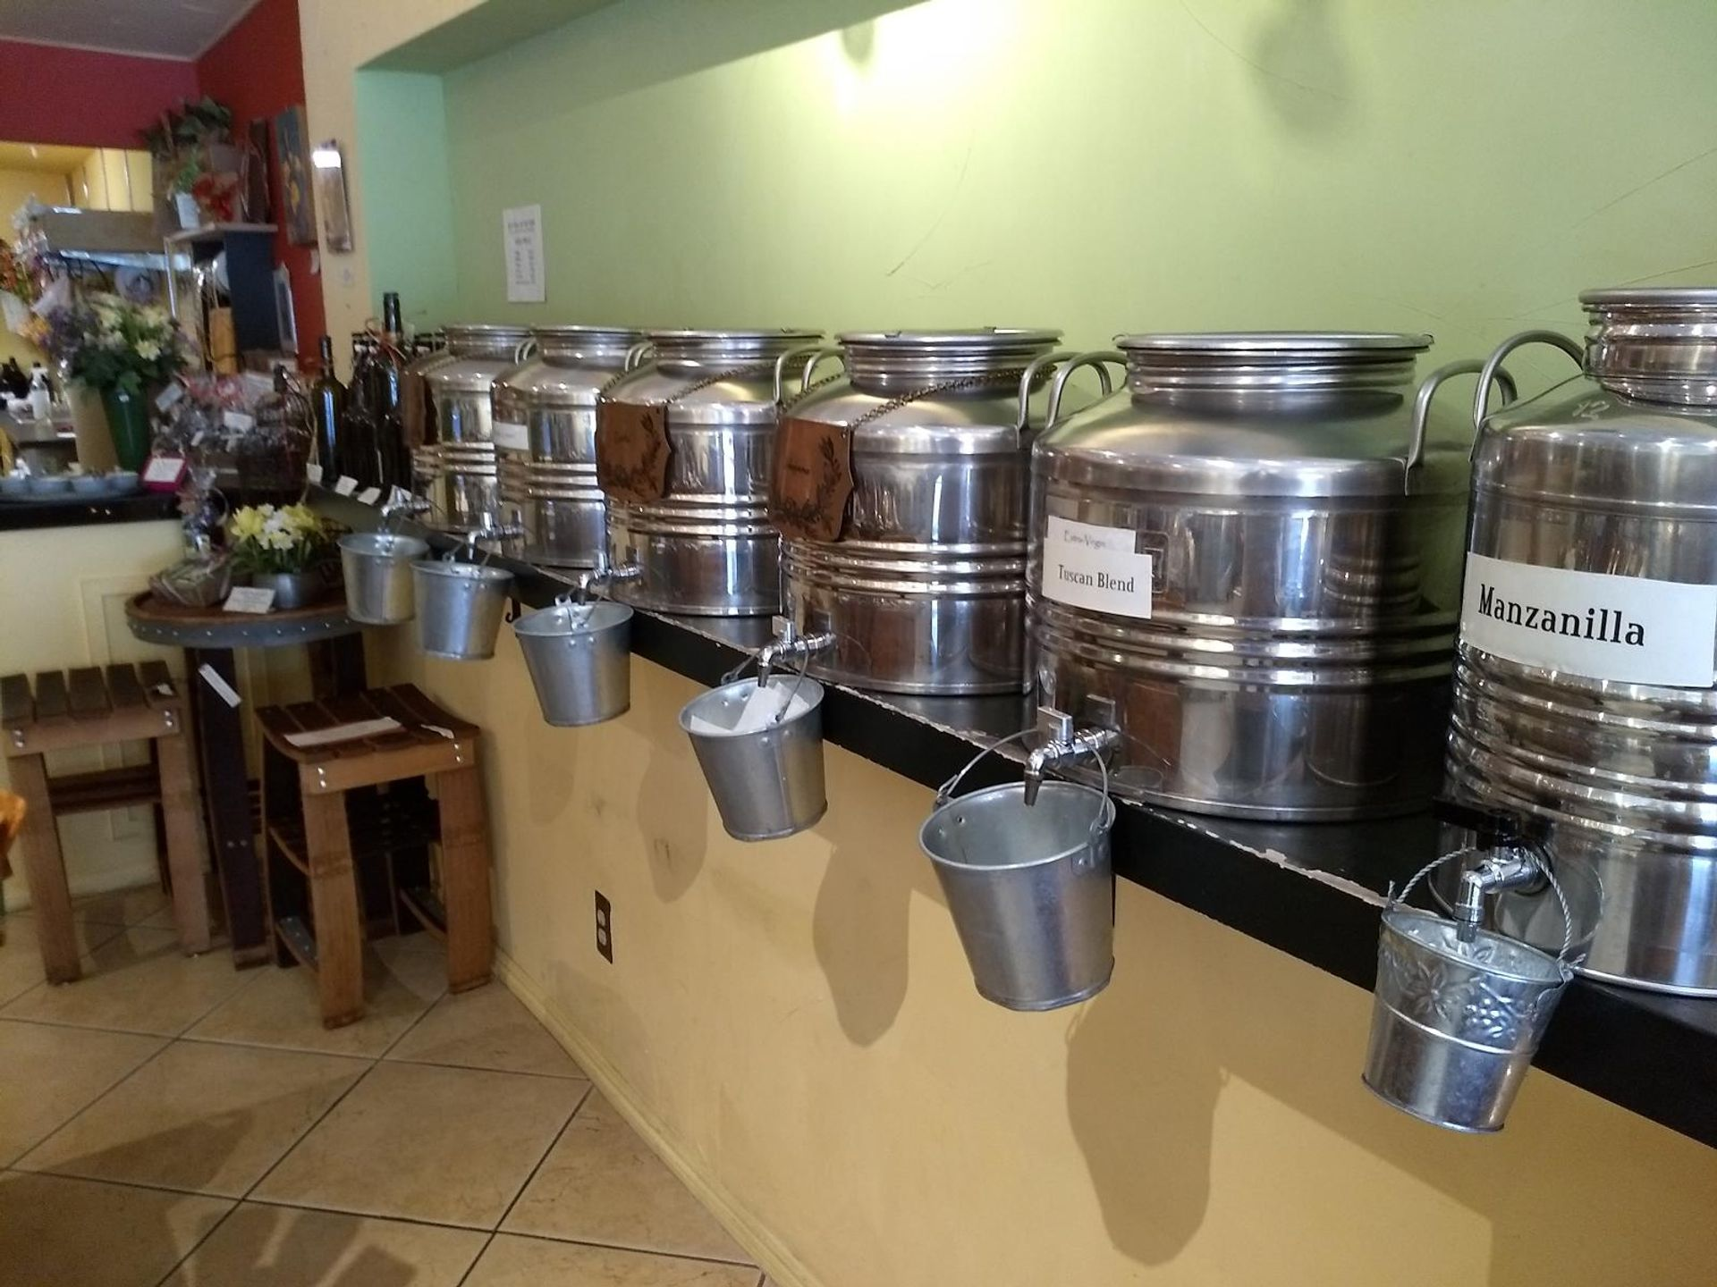

1) Identify
Geotourism
unique assets

Slide 16
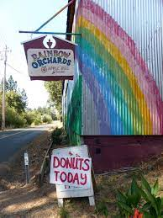
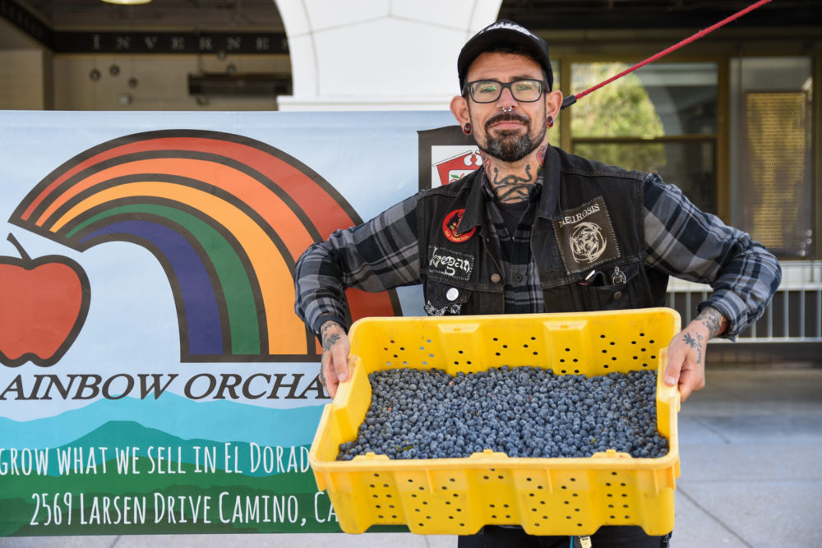
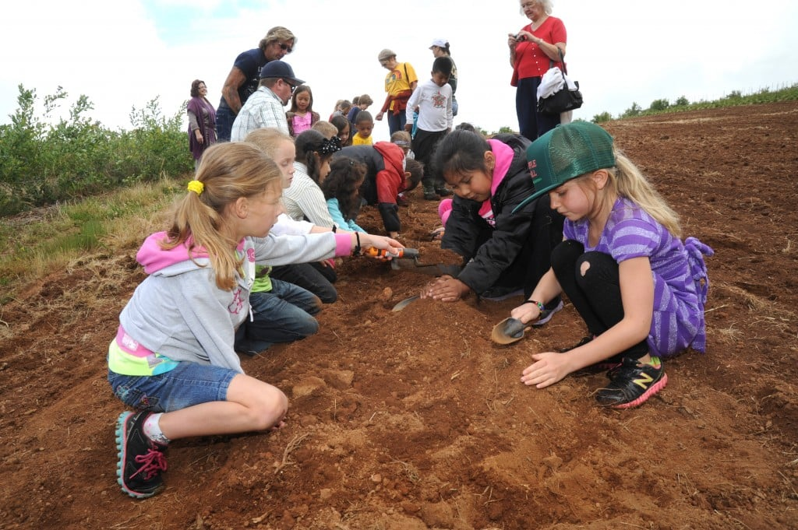
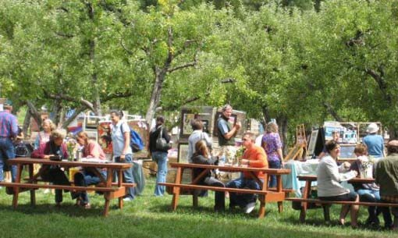
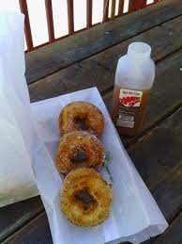
1) Identify

Slide 17
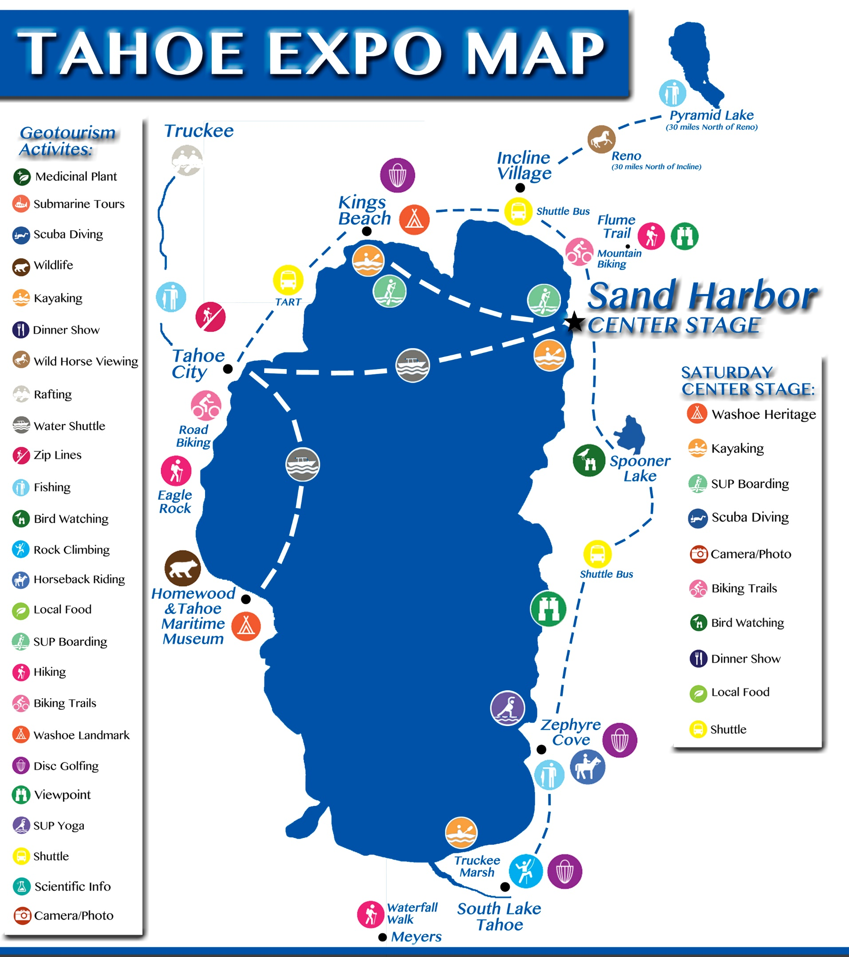
TriNomic hosting demonstrated by Sustain Tahoe
2) Develop
.gov
.org
Compliance
Resources
Access
Stewards
Docents
Educate
.com
Customers
Funds
Pivot for $
What do they want?
What do they have?
What are they willing to do?
Notes:
3) IMPLEMENTATION
"Trinomic“ (.org – NonProfits, .gov – Public agencies, .com – Business community) buy-in to support this pivot.
Leave one out? See you in court. Which I guess makes some people a lot of money, but locals (including wildlife), environment, commerce and travelers pay the price
Offer future generations an immersive field based study course stake in co-creating a visitor guidance system that will guide travelers toward activities that will not harm the Lake or quality of life for residents - including wildlife.
SustainTahoe.org demonstrated the value of hosting visitors to fun, meaningful immersive adventures: https://www.slideshare.net/jacquiechandler/2014-tahoe-geotourism-expo-2014-report

Slide 18
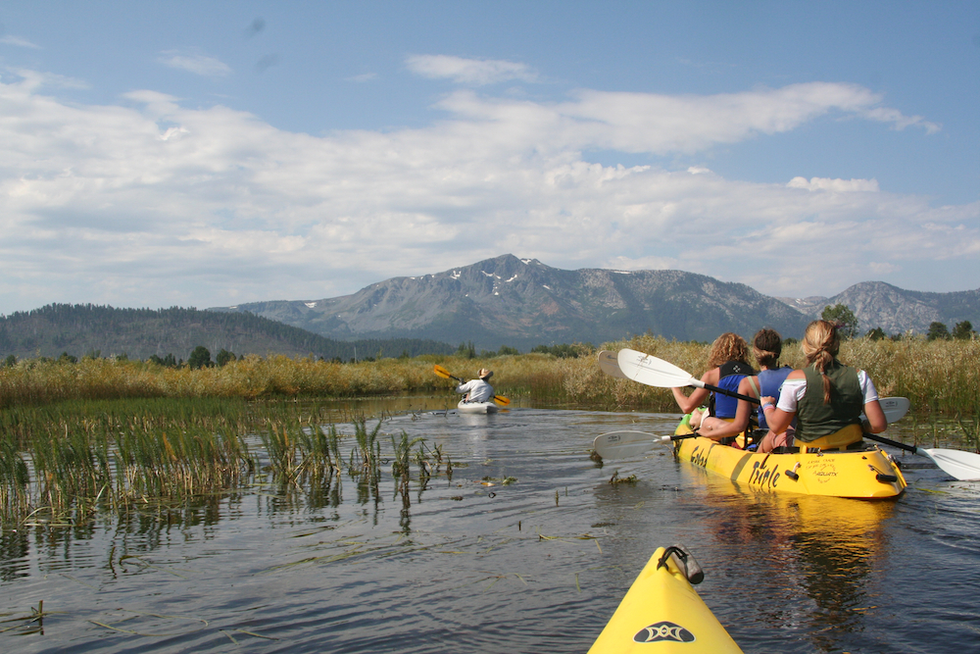
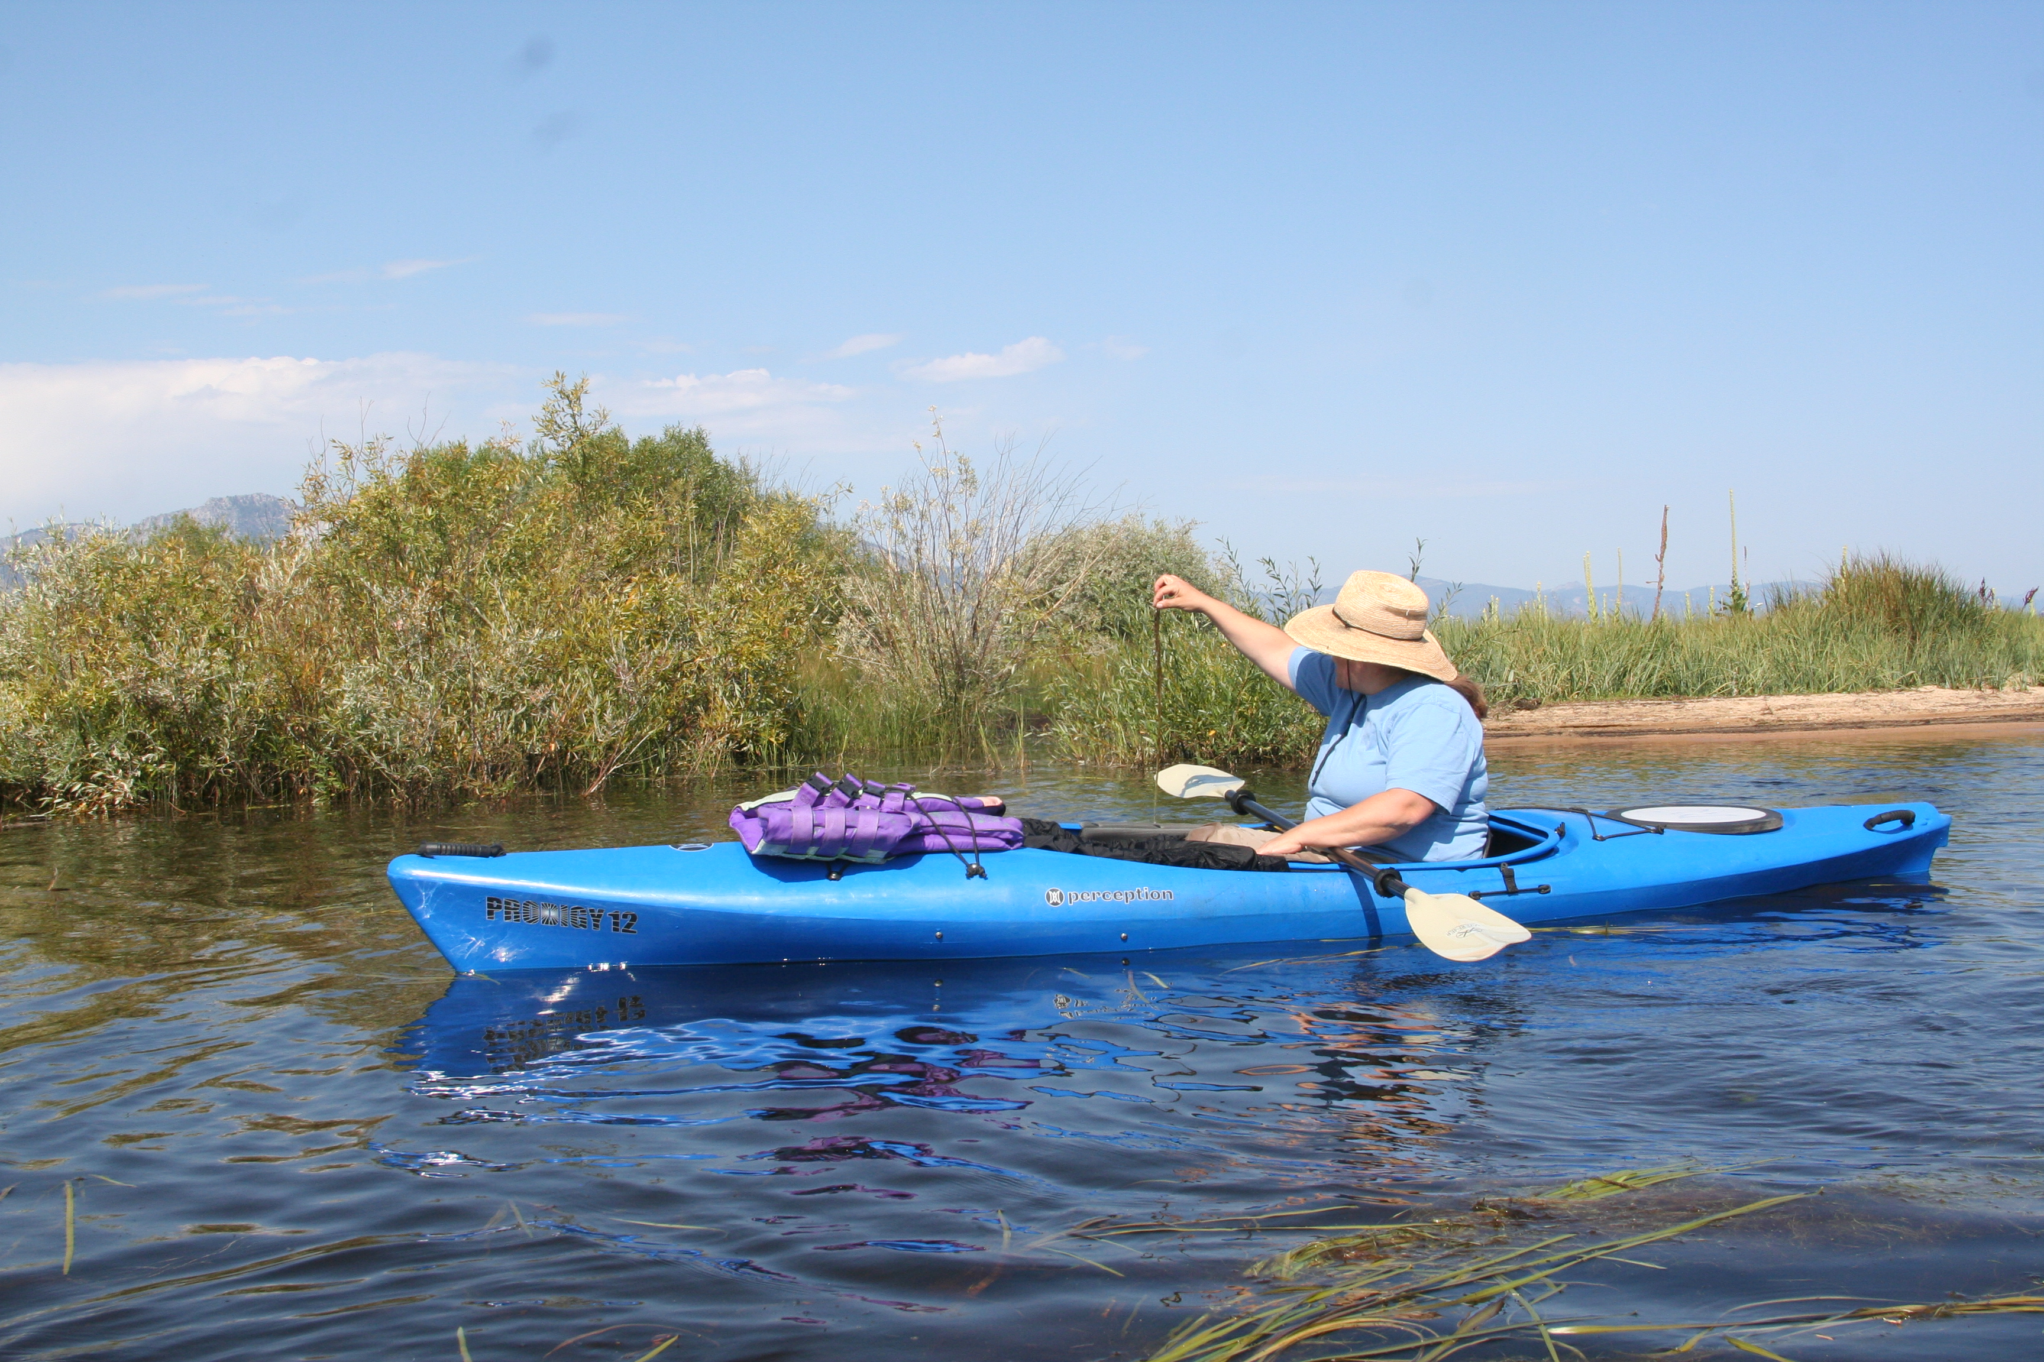
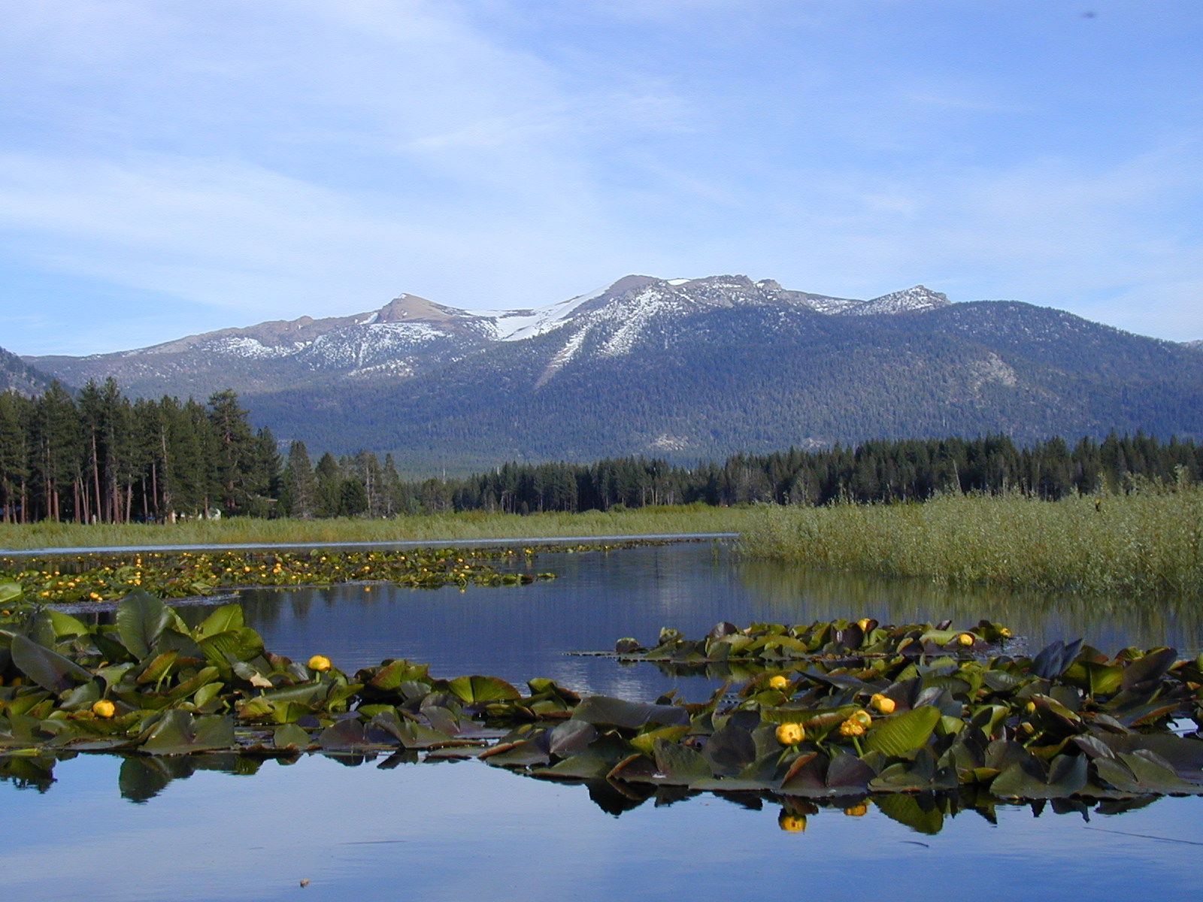
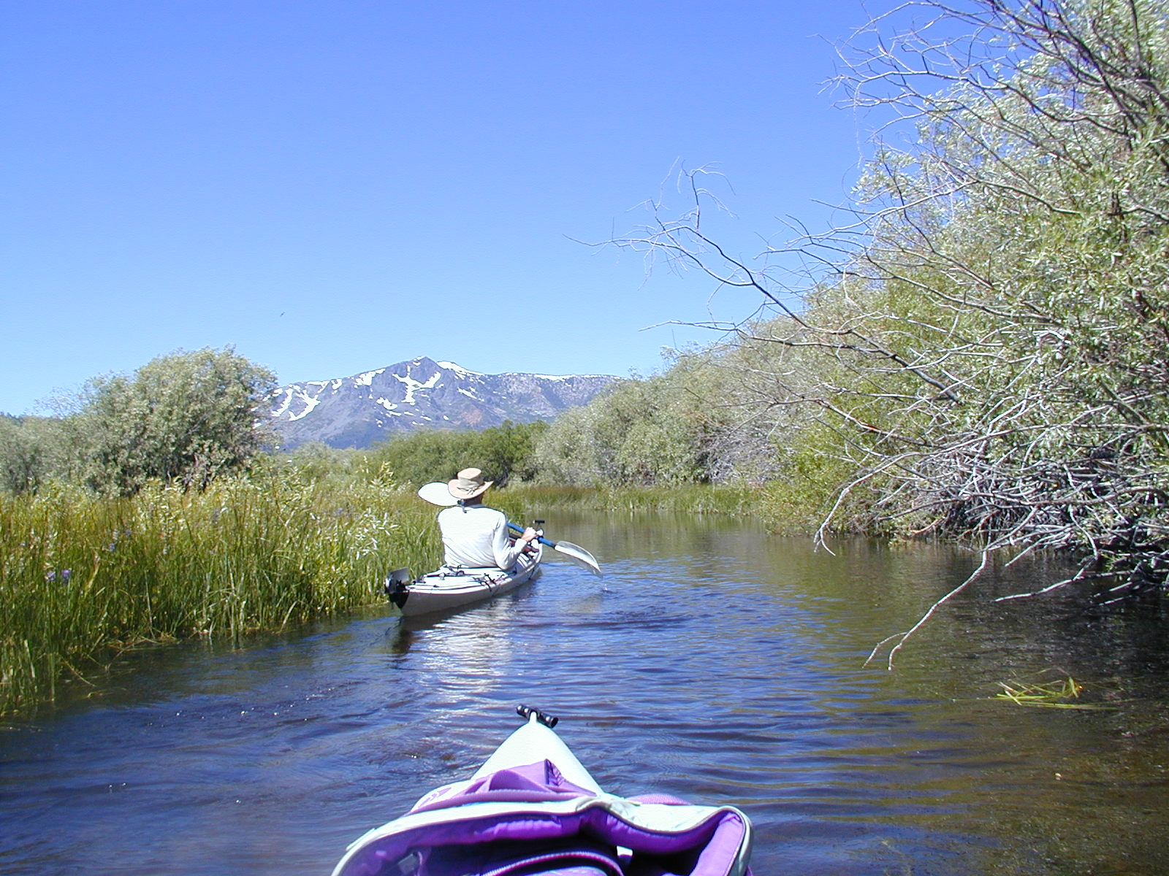
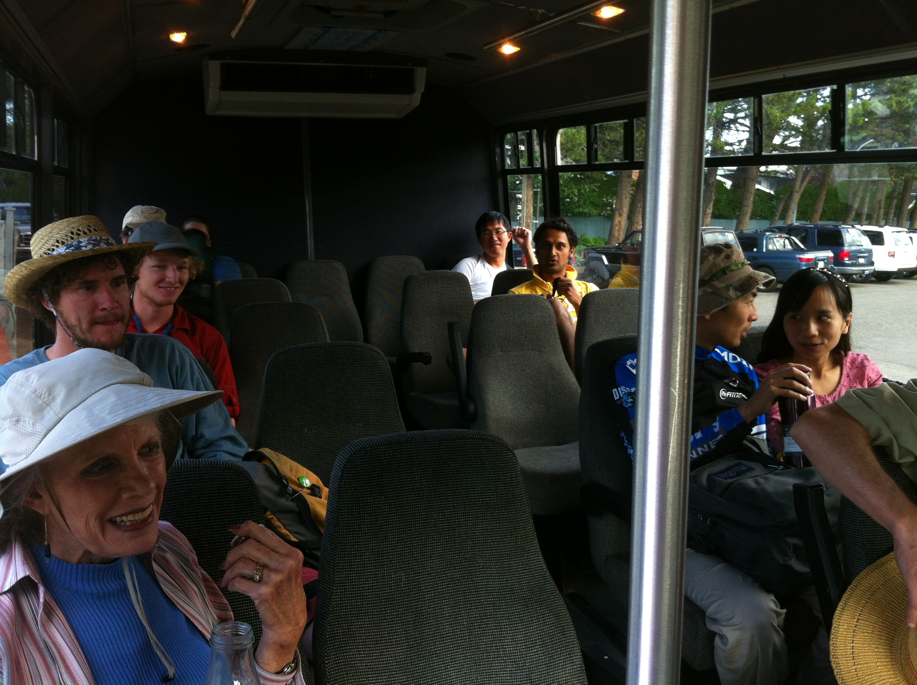
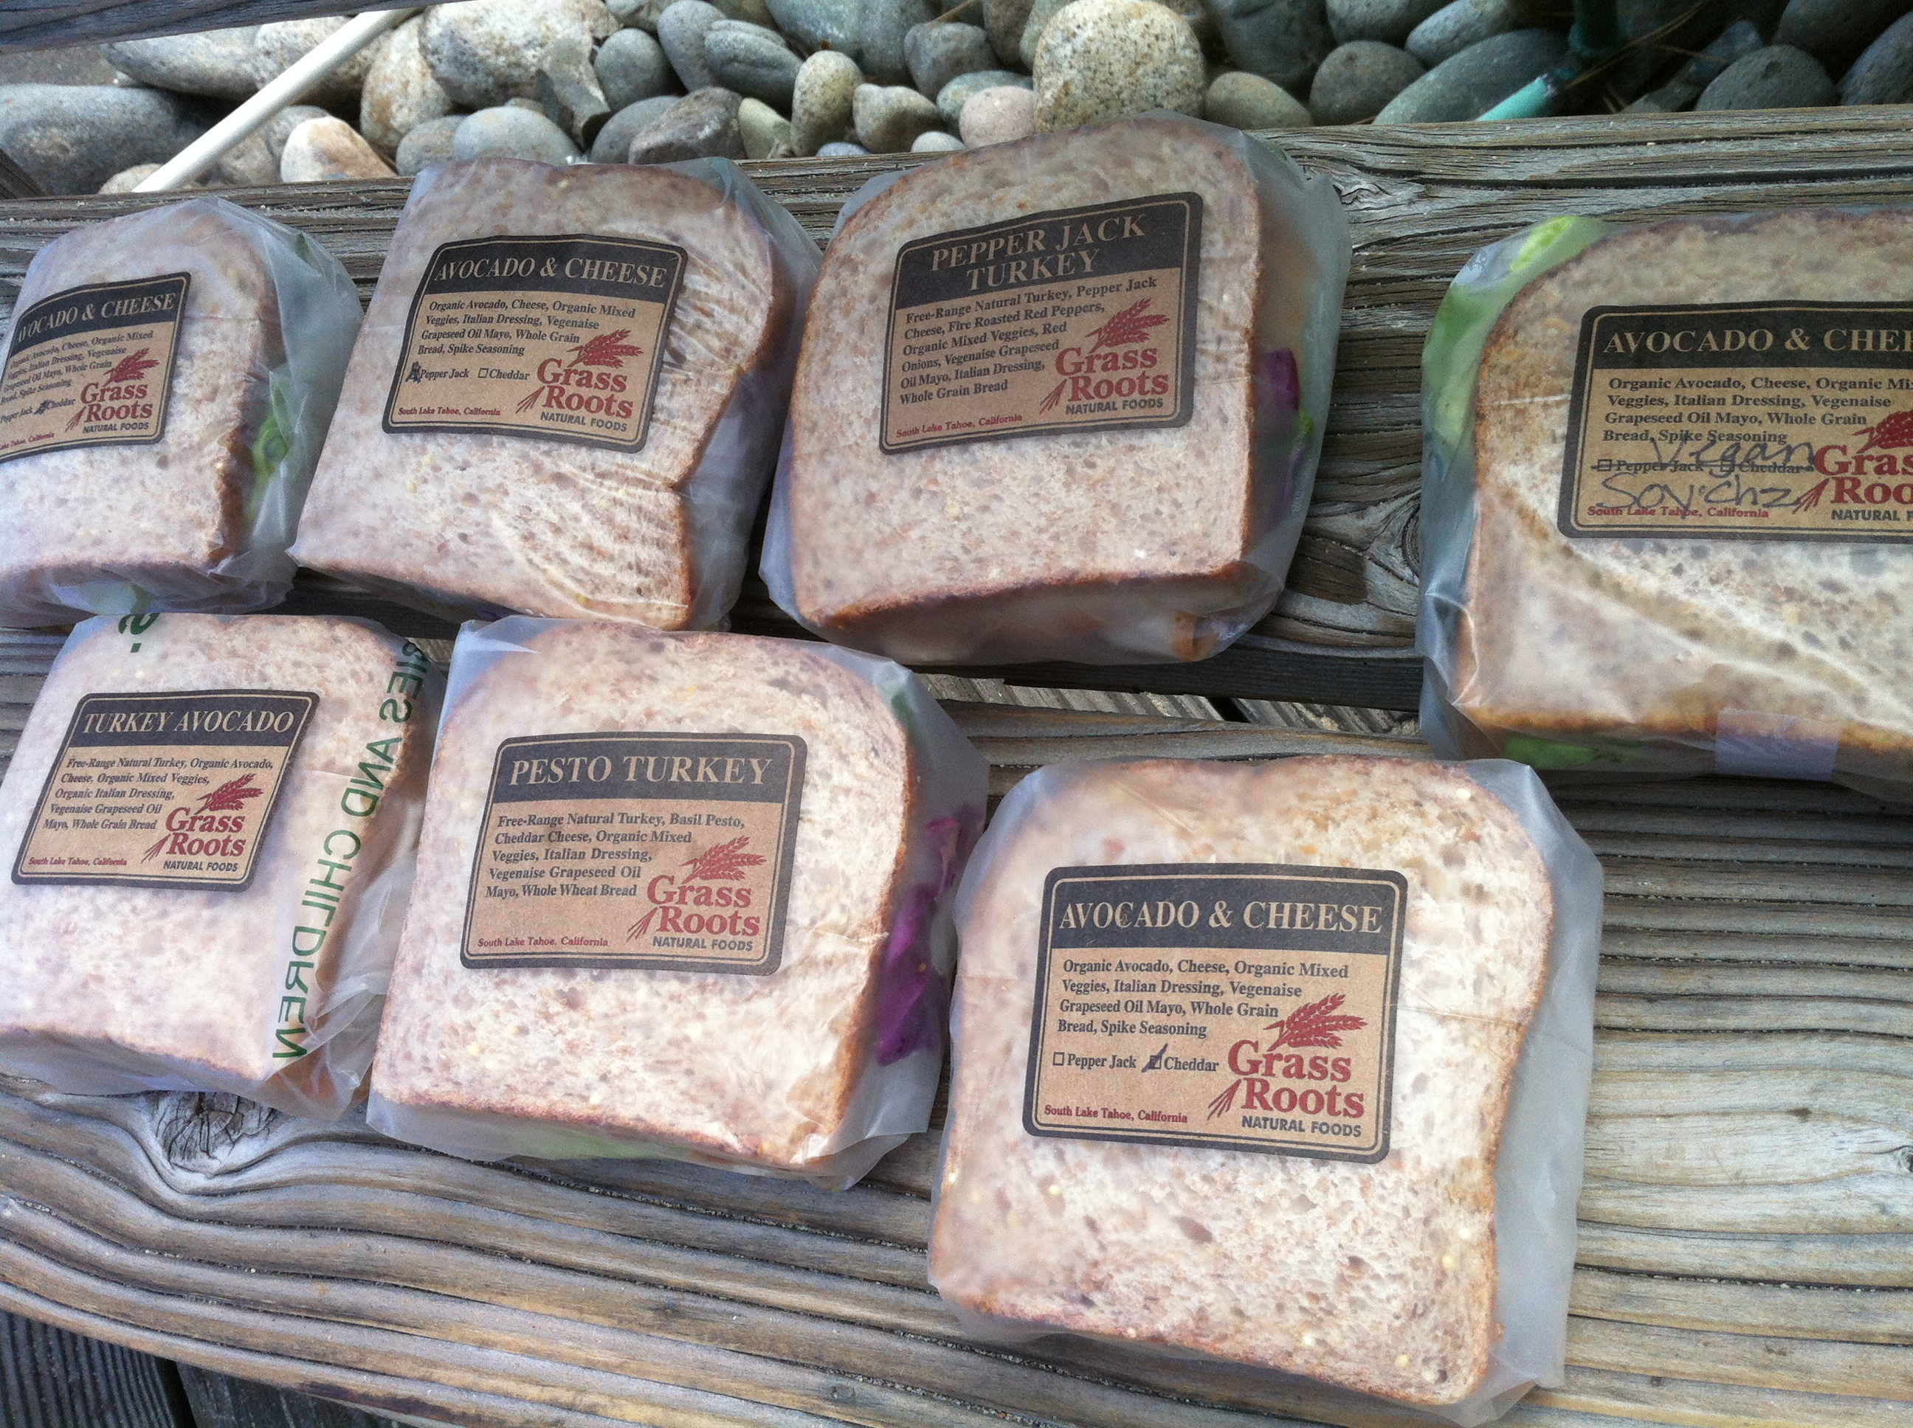
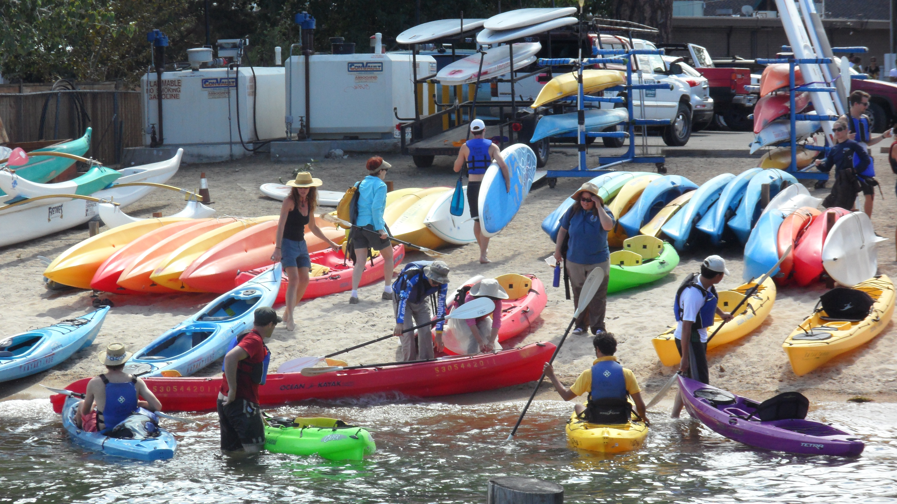
.gov
.org
.com

Slide 19
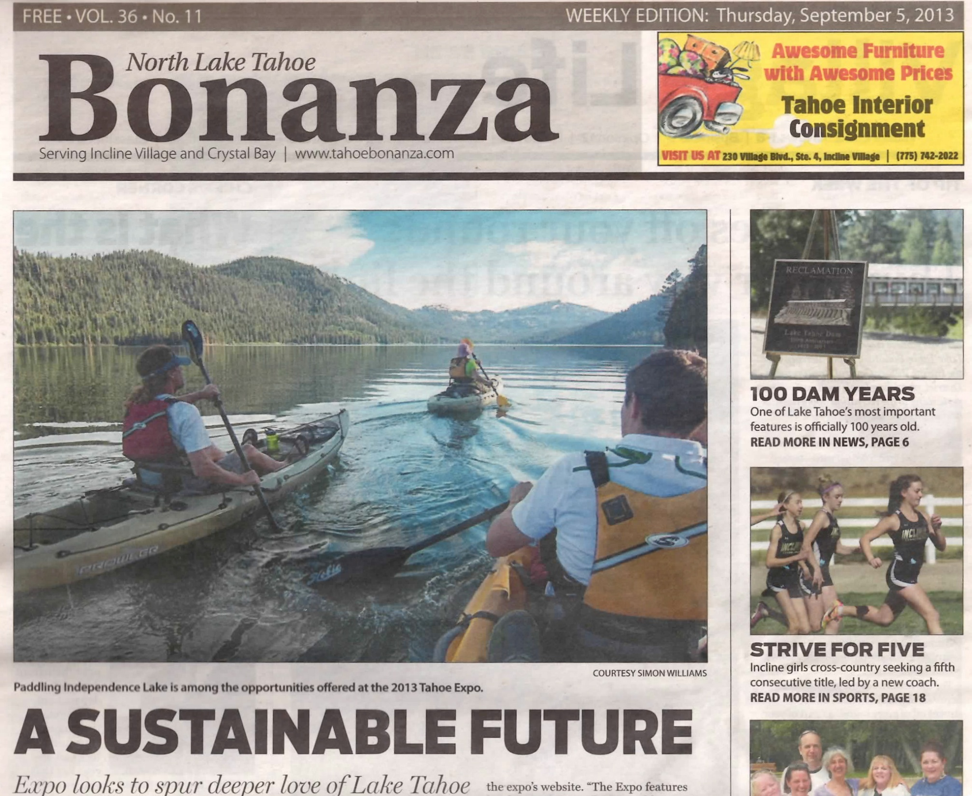
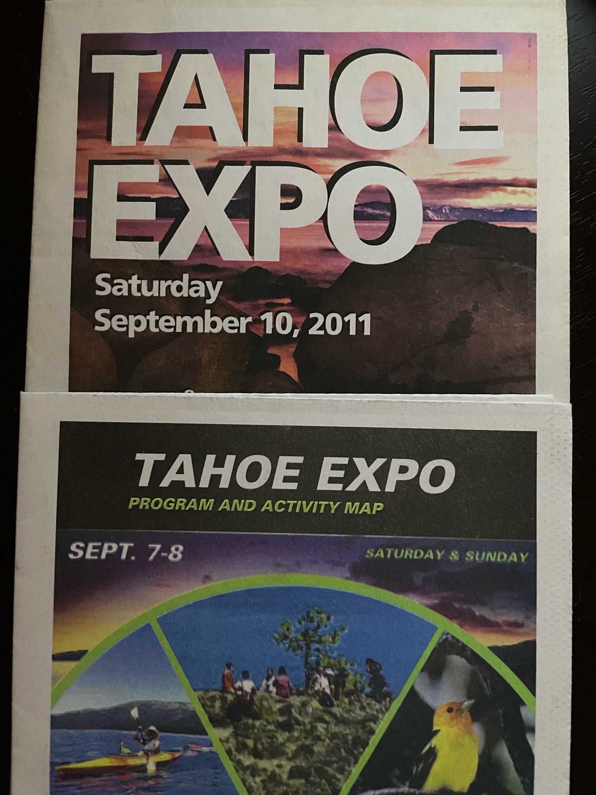
3) Promote

Slide 20
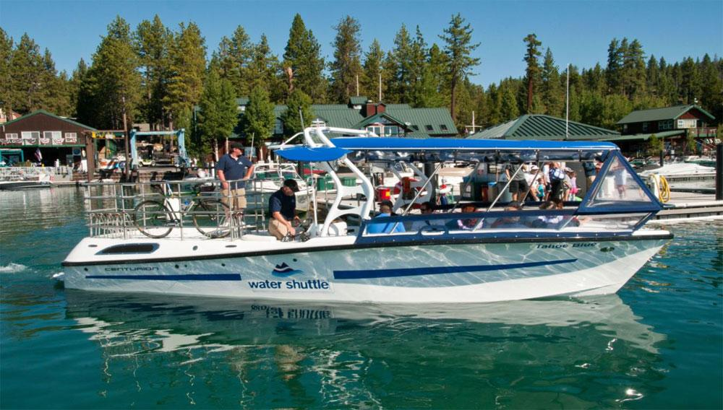
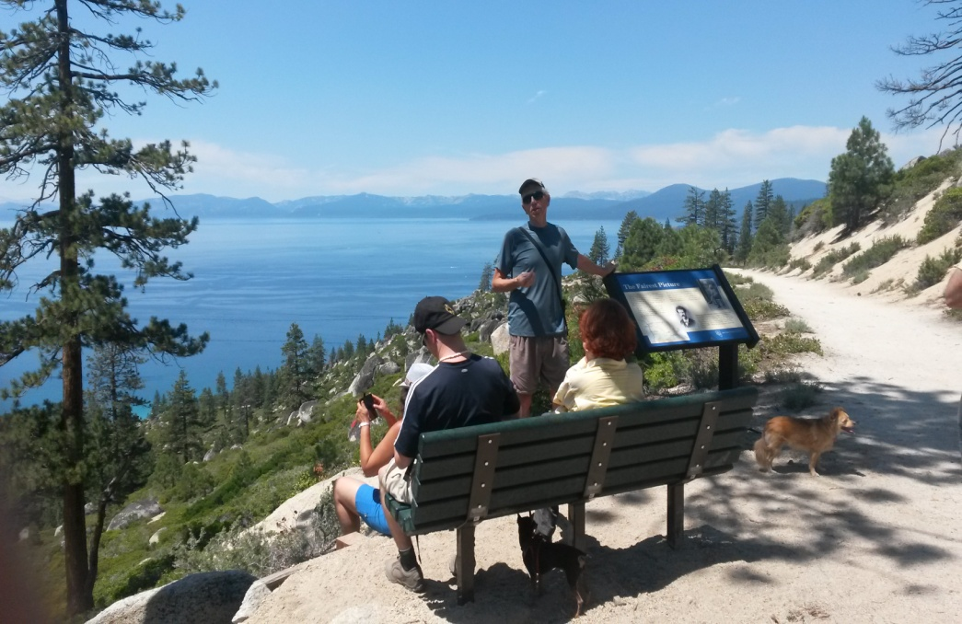
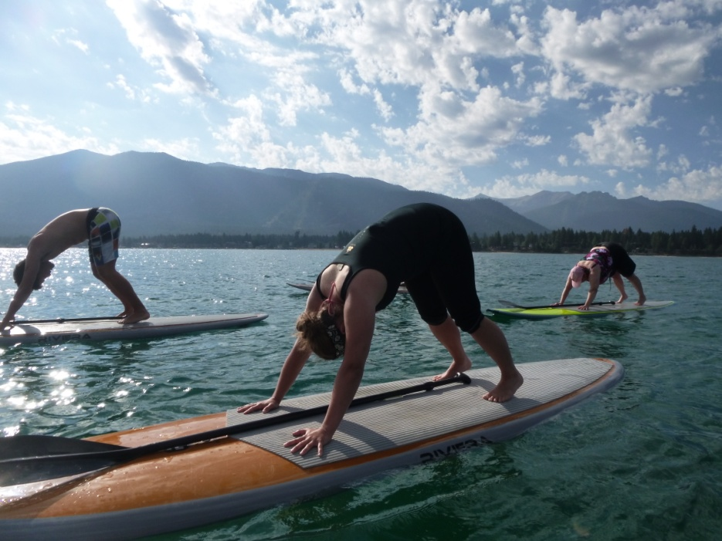
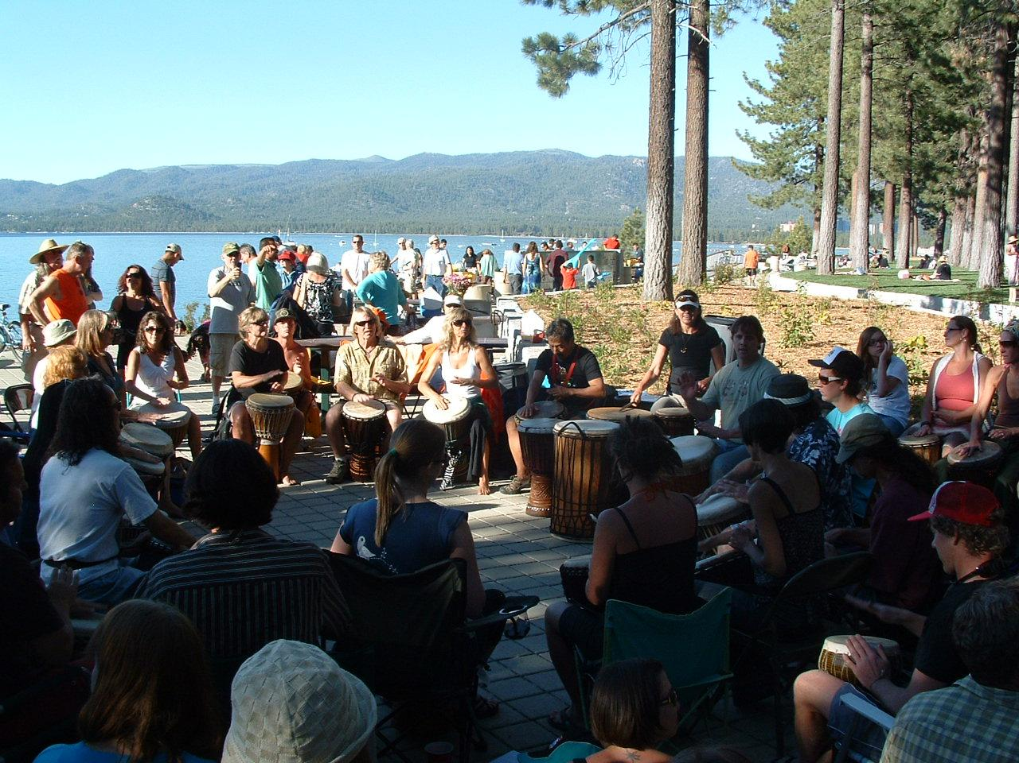
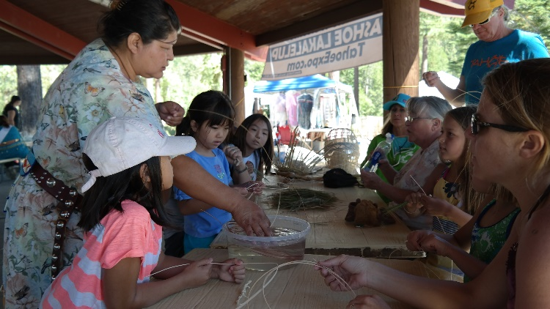

Slide 21
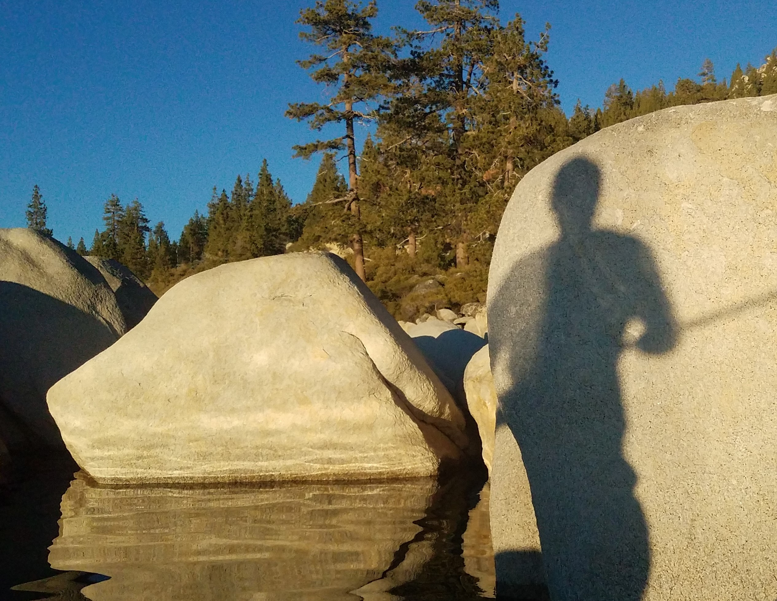
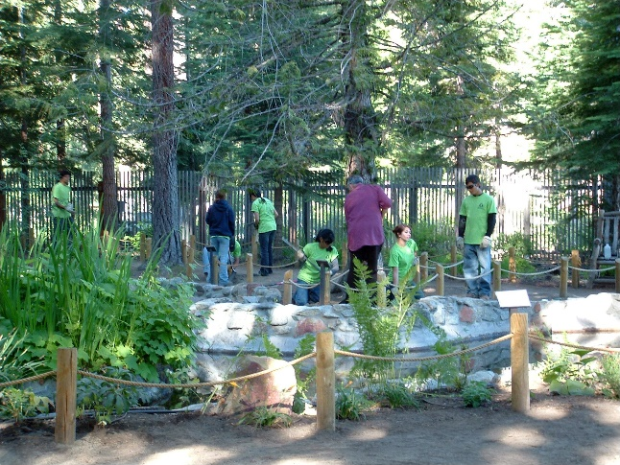
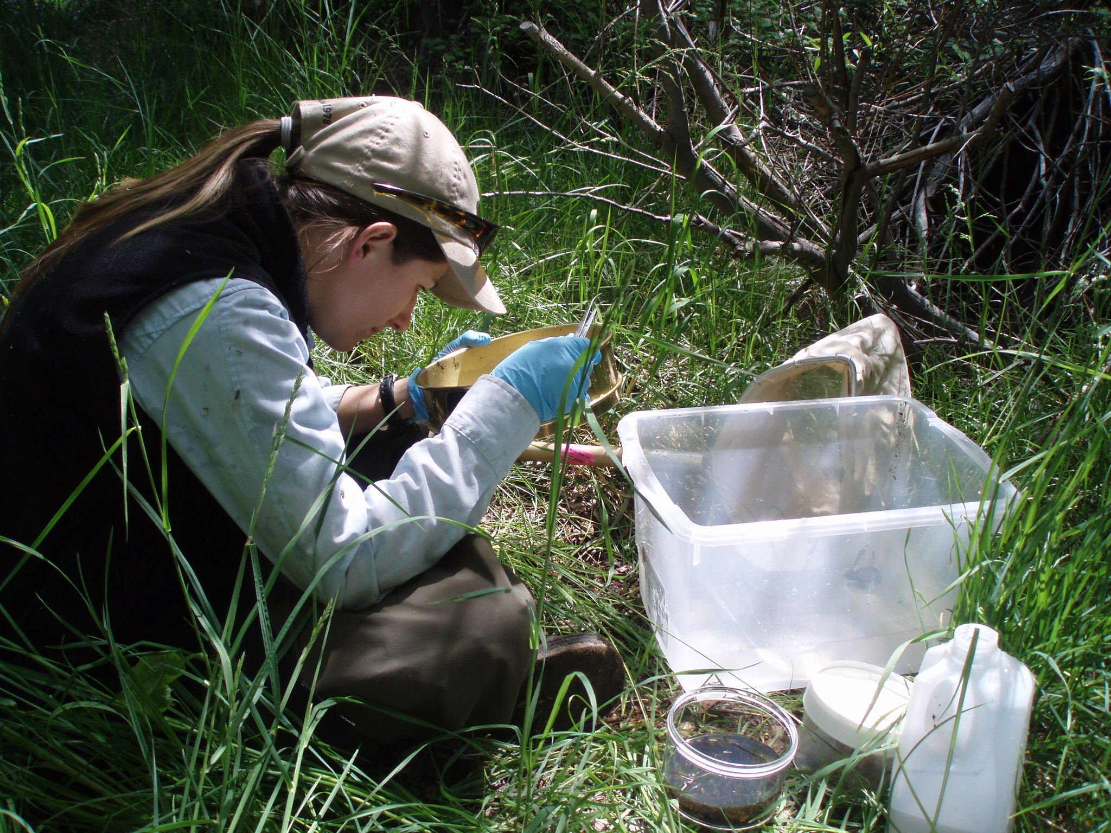



4) Sustain

Slide 22










Slide 23


Slide 24







EARTH WALK – mindful walking to connect

Slide 25



Slide 26



