Slide 1
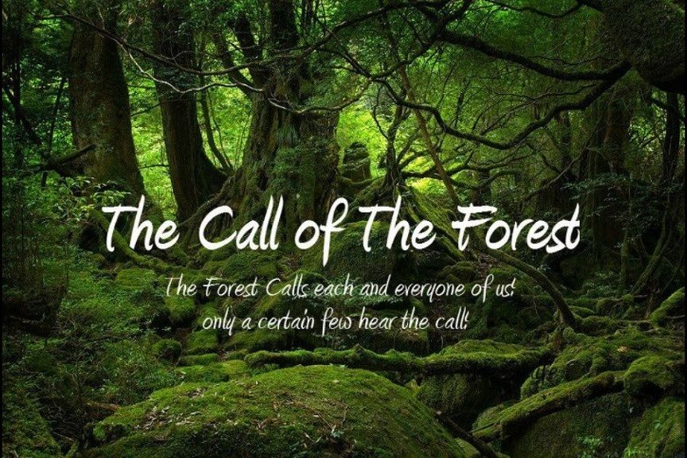

Slide 2
Earth Walk & Shrine
Create your own Call of the Forest

Slide 3
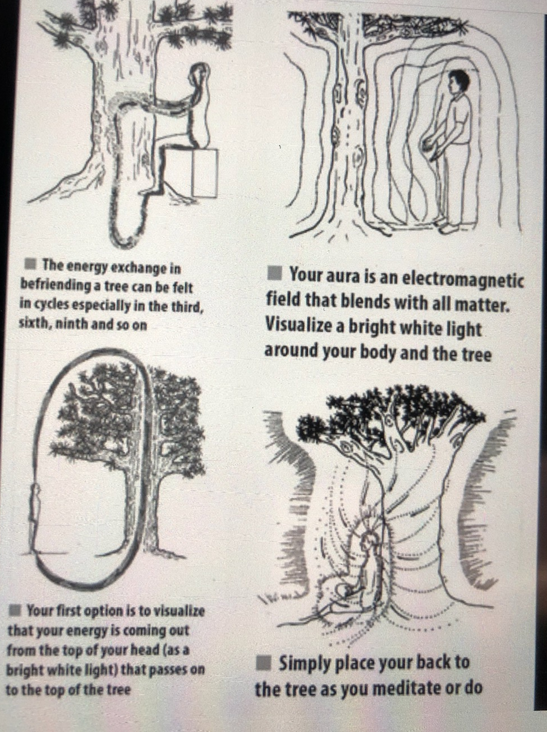
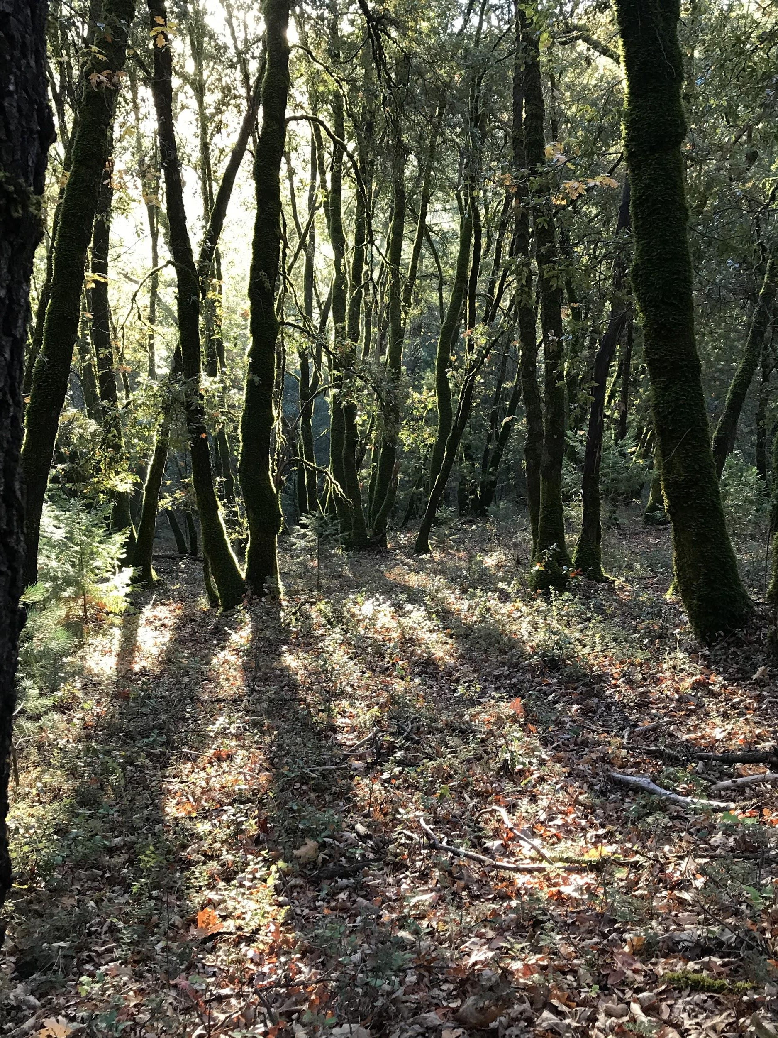
Aerosols from trees:
Reduce blood pressure
reduces cortisol
Boost immune
Improves sleep
Notes:
When you enter a forest one for the first things you do, unconsciously, is to take in a very deep breath. At that moment you are breathing in the good health producing aerosols emitted by the surrounding trees and plants.
Then as you slowly meander through the trees, breathing in the aerosols, you are boosting your immune system that then helps to reduce your blood pressure and your stress levels, as well as improve your feelings of happiness. When this happens you are able to be more creative.
In Japan, this activity is called Shinrin Yoku or Forest Bathing. Forest Bathing activities are supported by their healthcare insurance policies.

Slide 4
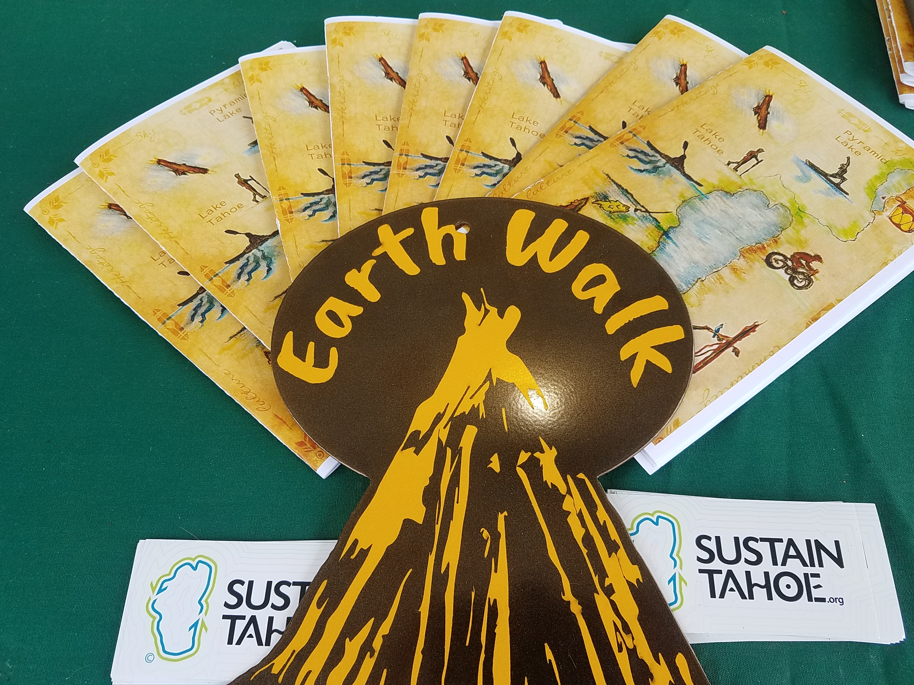
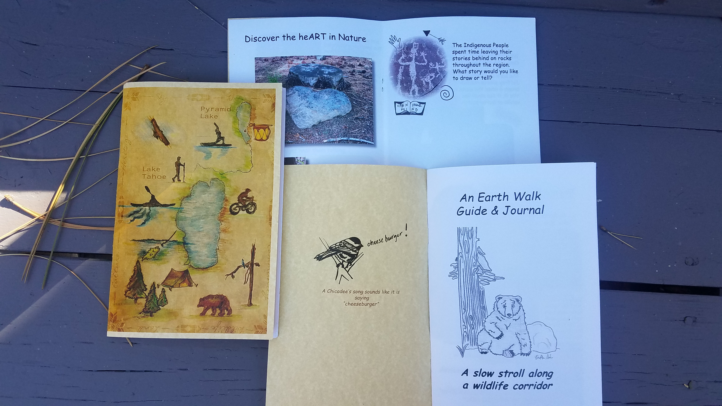

Slide 5
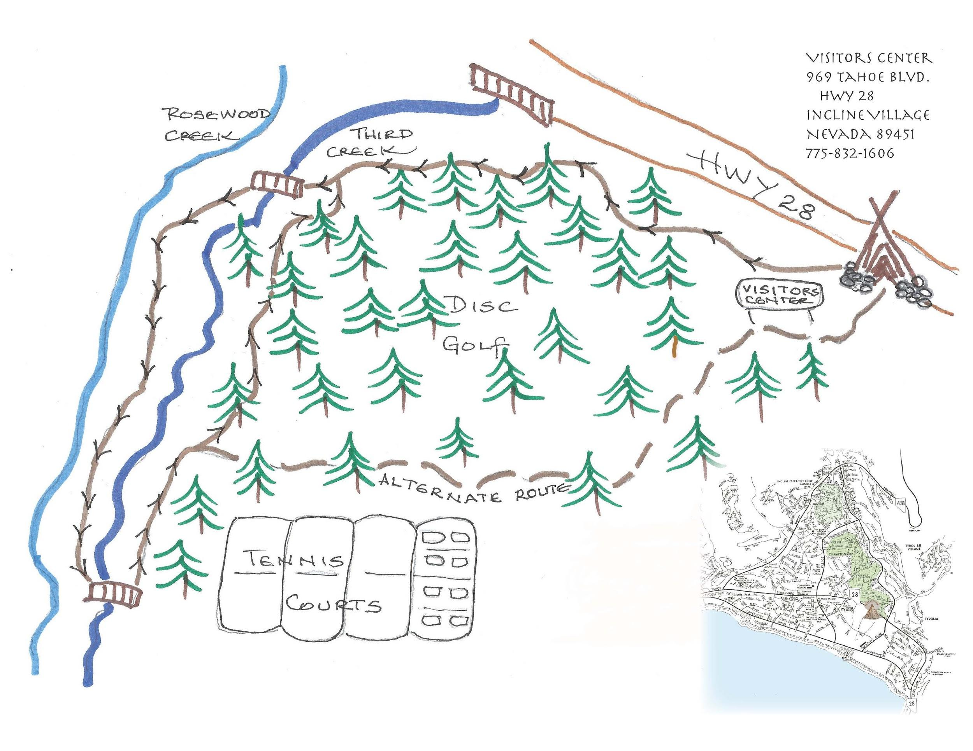
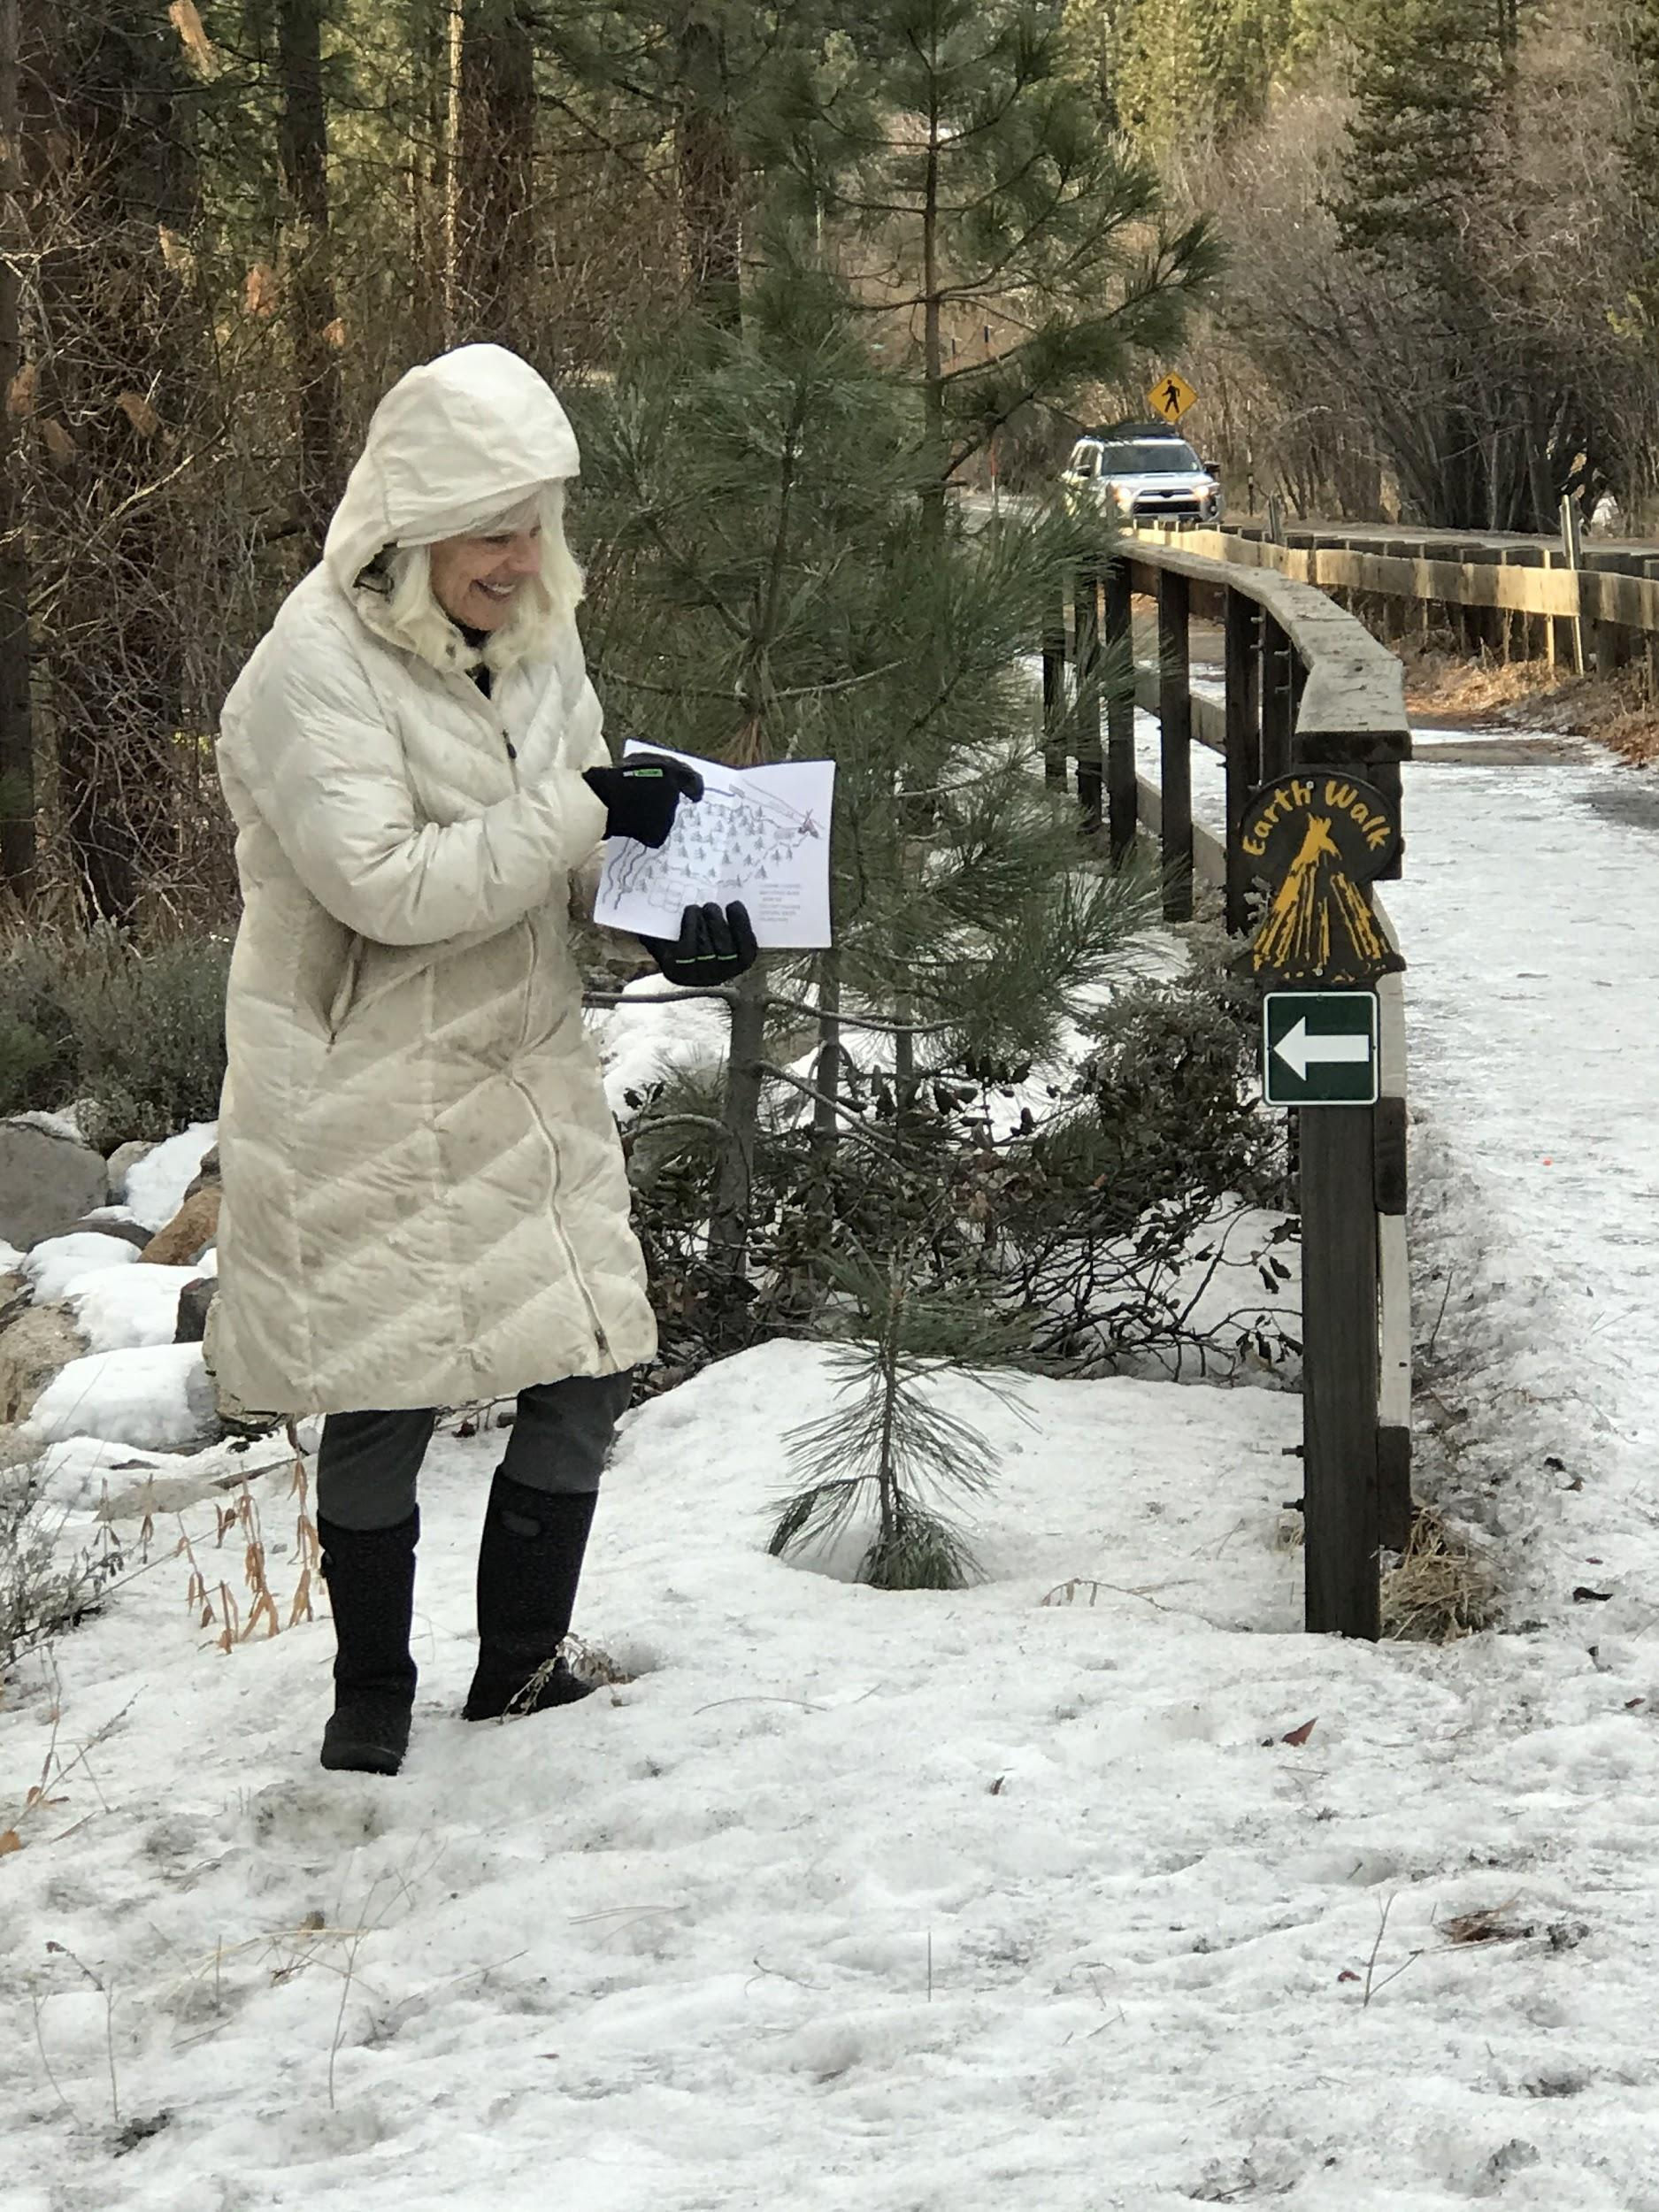
Begin:
Incline Village Visitors Center
follow the signs that correspond to the arrows on map

Slide 6
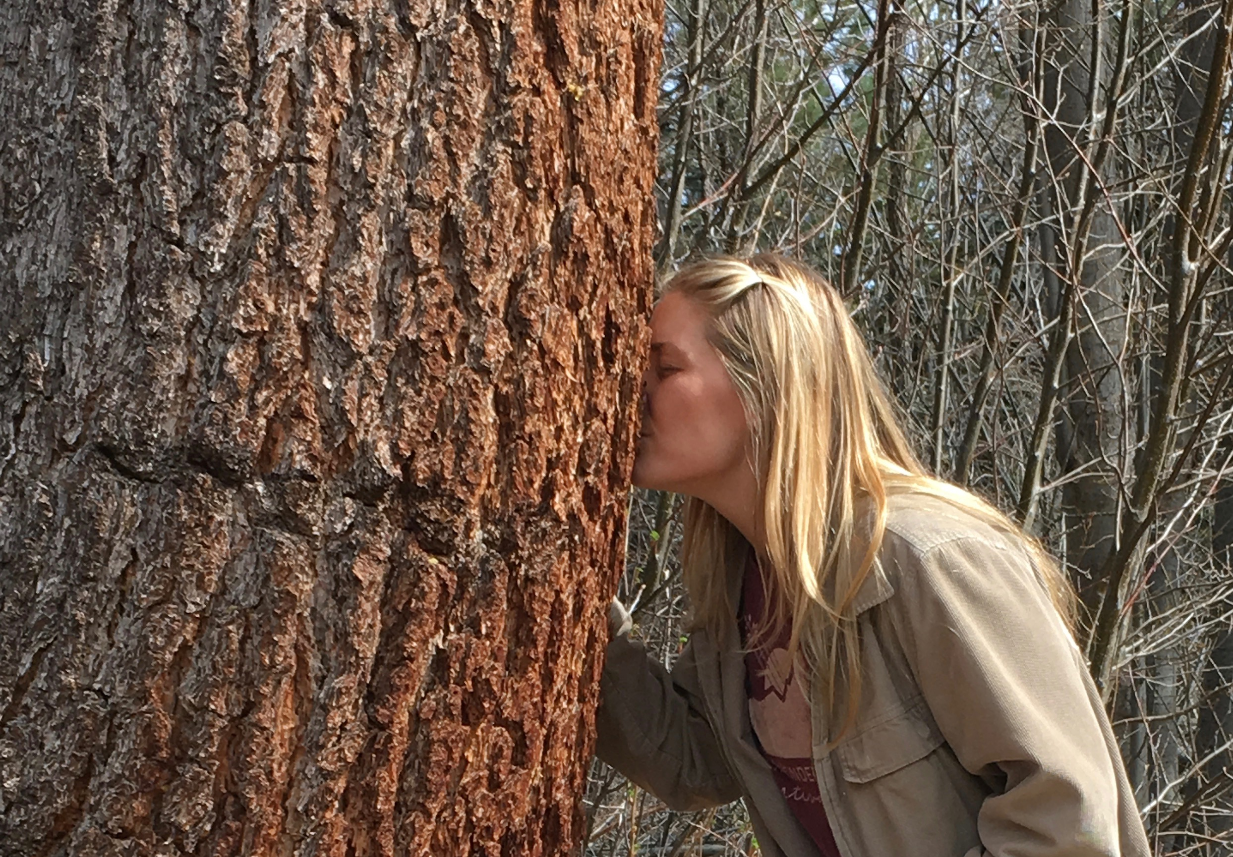
Meanader…pause…move in close…wonder…quiet yourself and listen
What do you smell?
What do you hear?

Slide 7
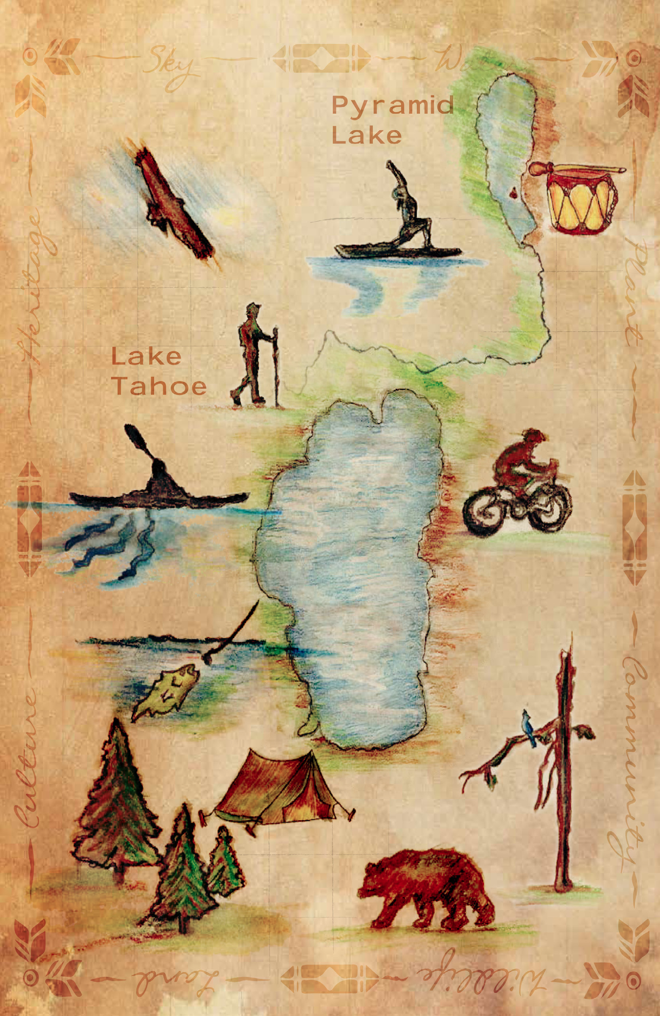
How did the Earth Walk inspire you?
Did the Forest call to you?
Your inspirations are ingredients for your shrine!
Notes:
Written in your journal...
Picked up a few mementos, like a rock, pinecone, leaf, or you just have your
photos.
Now look at the pieces of your shrine
box.
How did the Earth Walk inspire you?
Did the Forest call to you?
Your inspirations from your Earth Walk are the ingredients for your shrine!

Slide 8
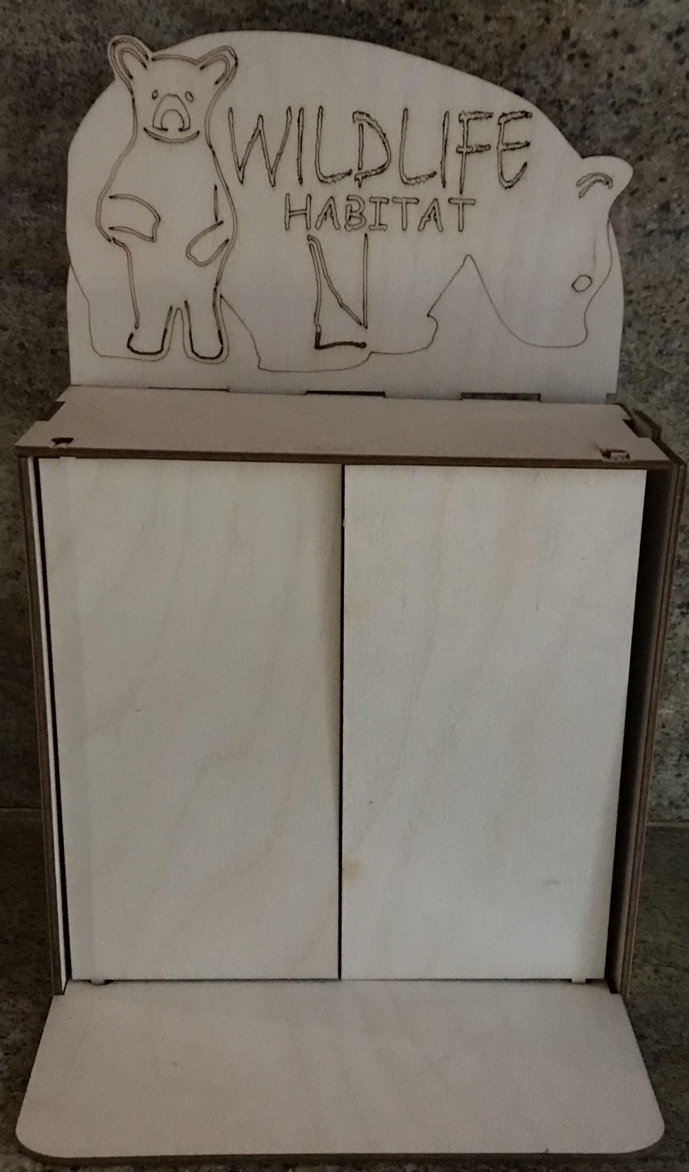
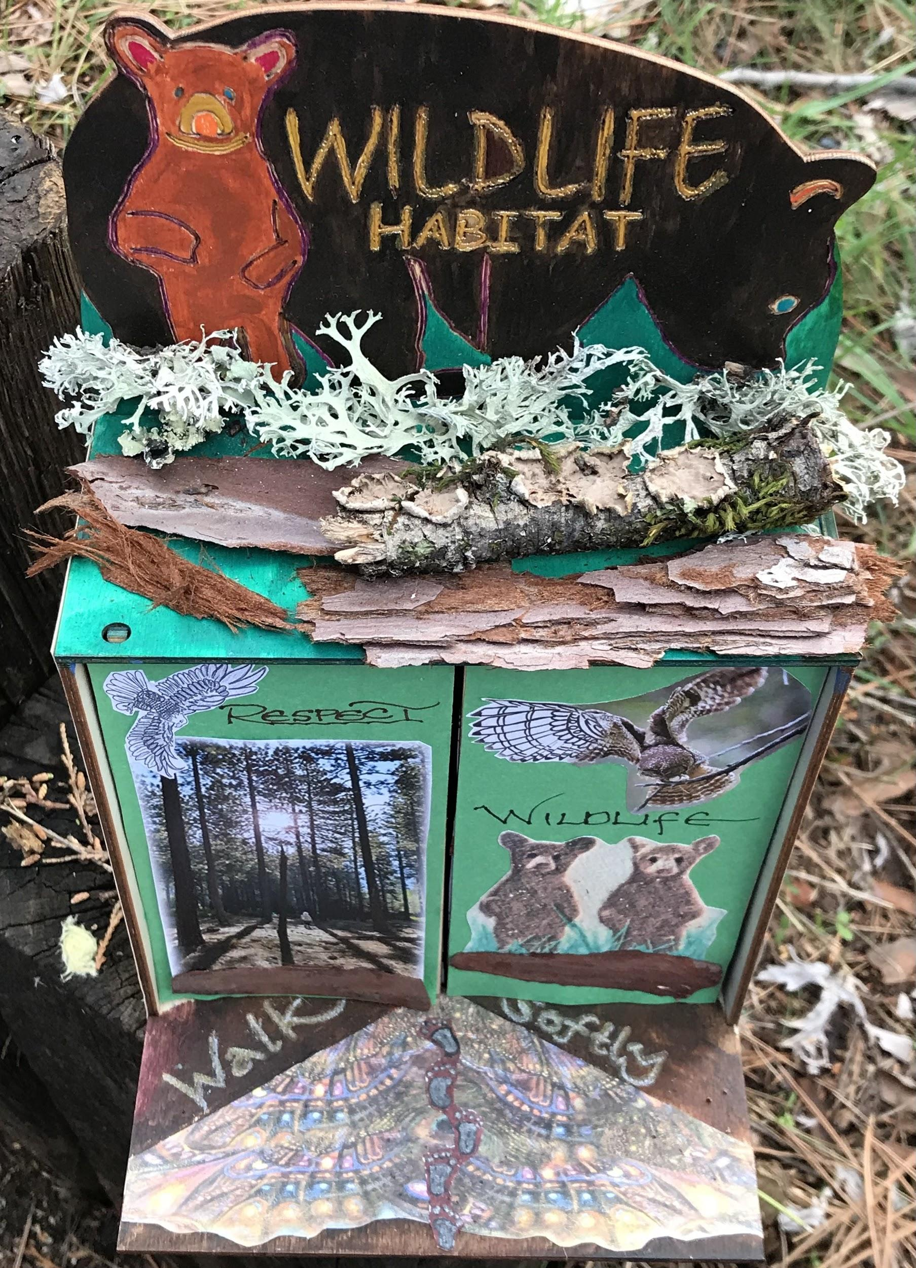
…..assembly kit
Your customized Shrine…

Slide 9
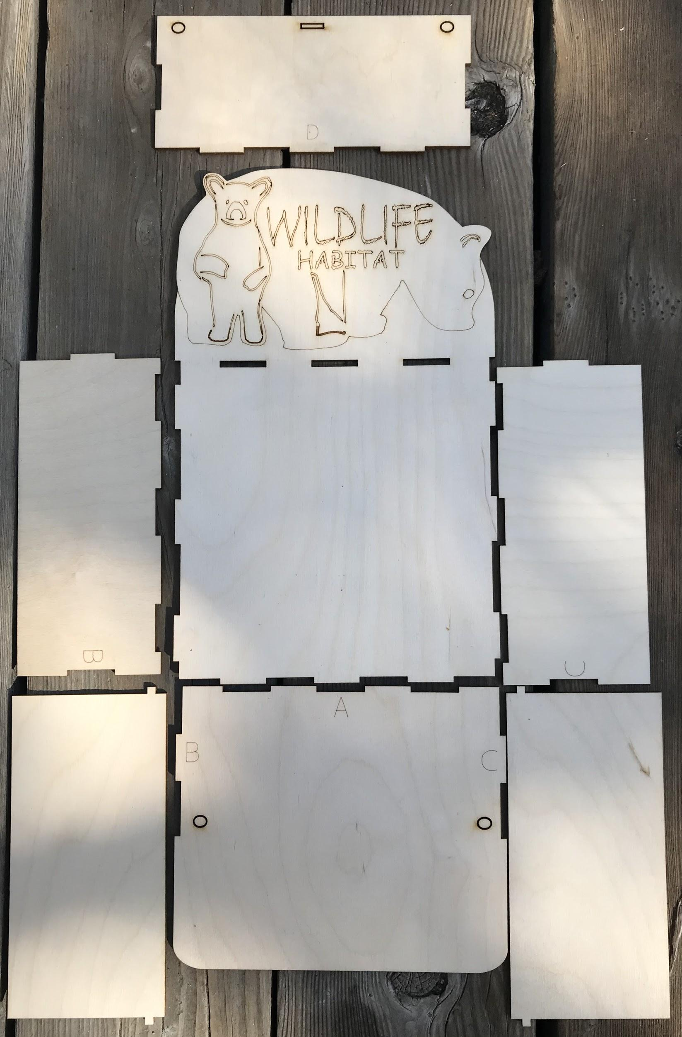
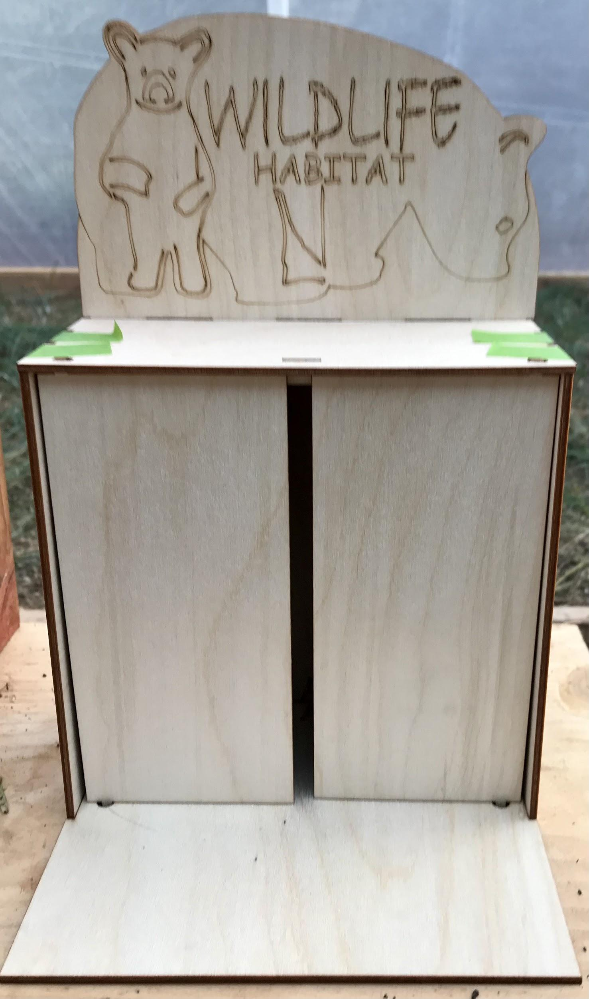
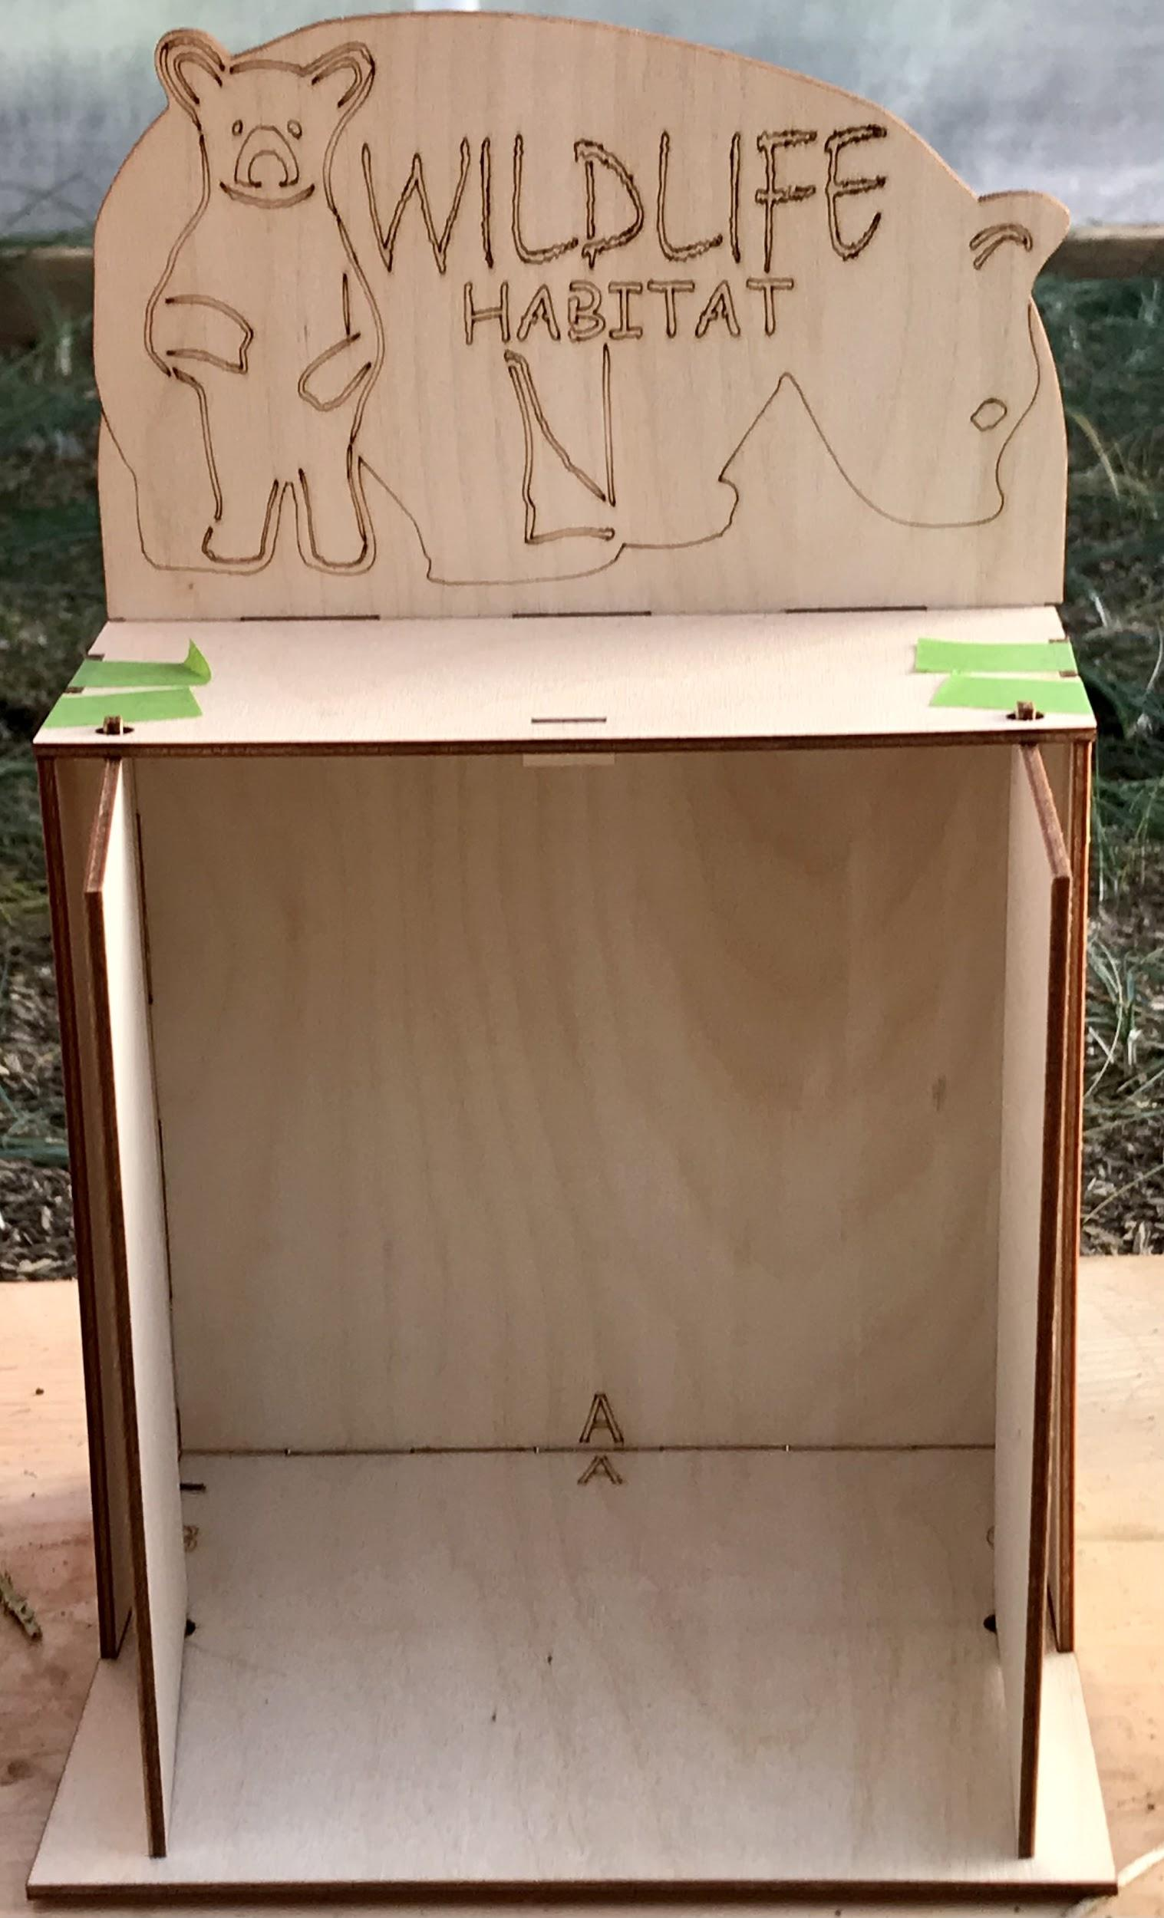

Slide 10
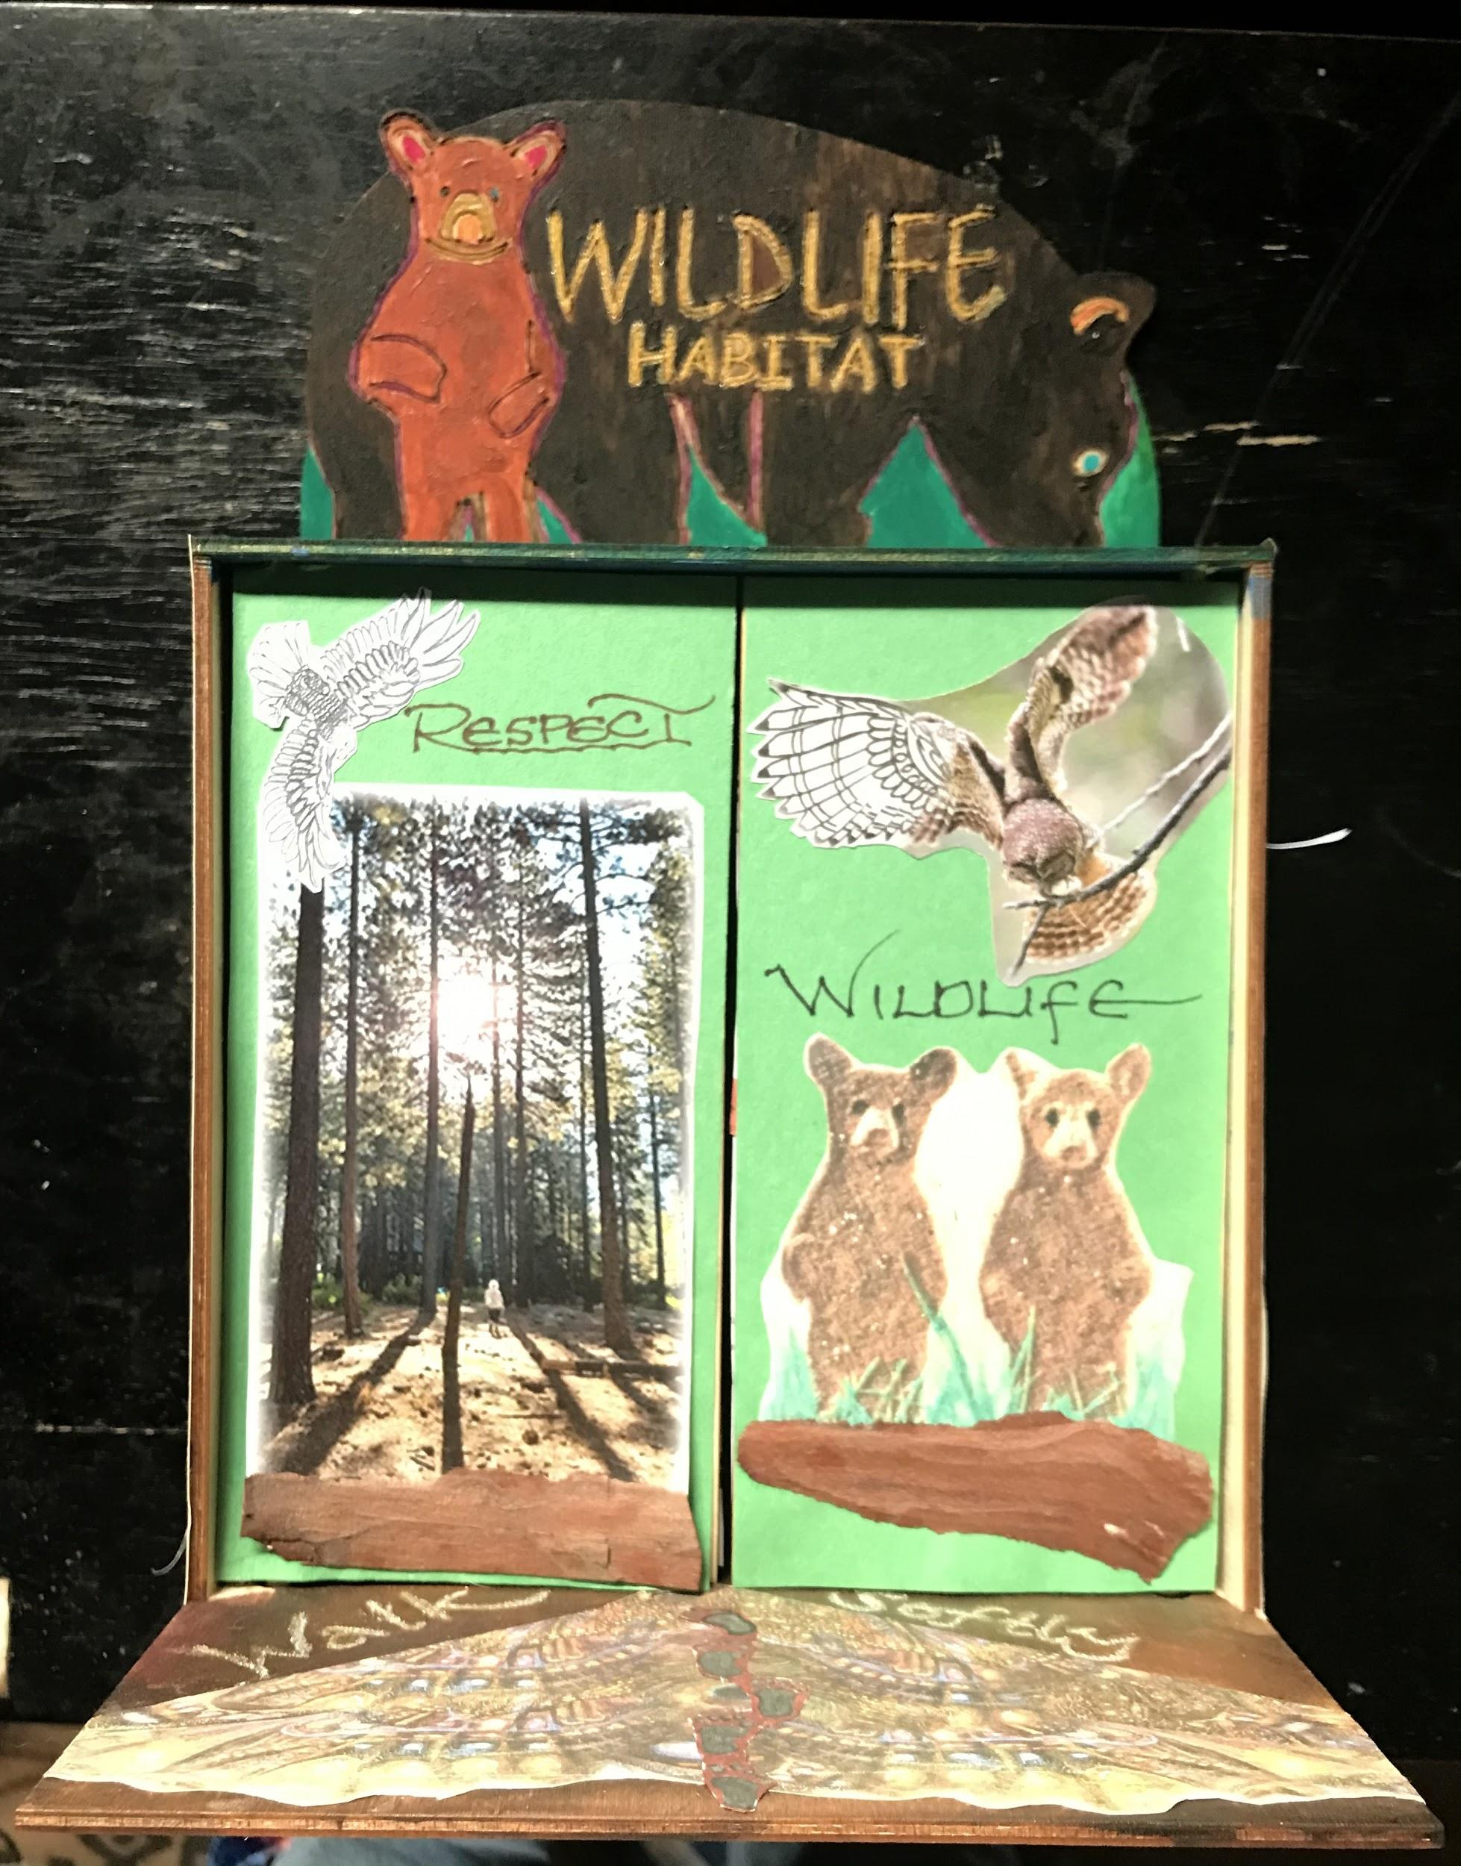
Notes:
In order to visualize how you want your shrine to create the outside picture moving into the shrine, you can follow the alphabet guide letters & tape the shrine pieces in place. Now think about what the outside front is going to look like to become your Earth Walk art piece.

Slide 11
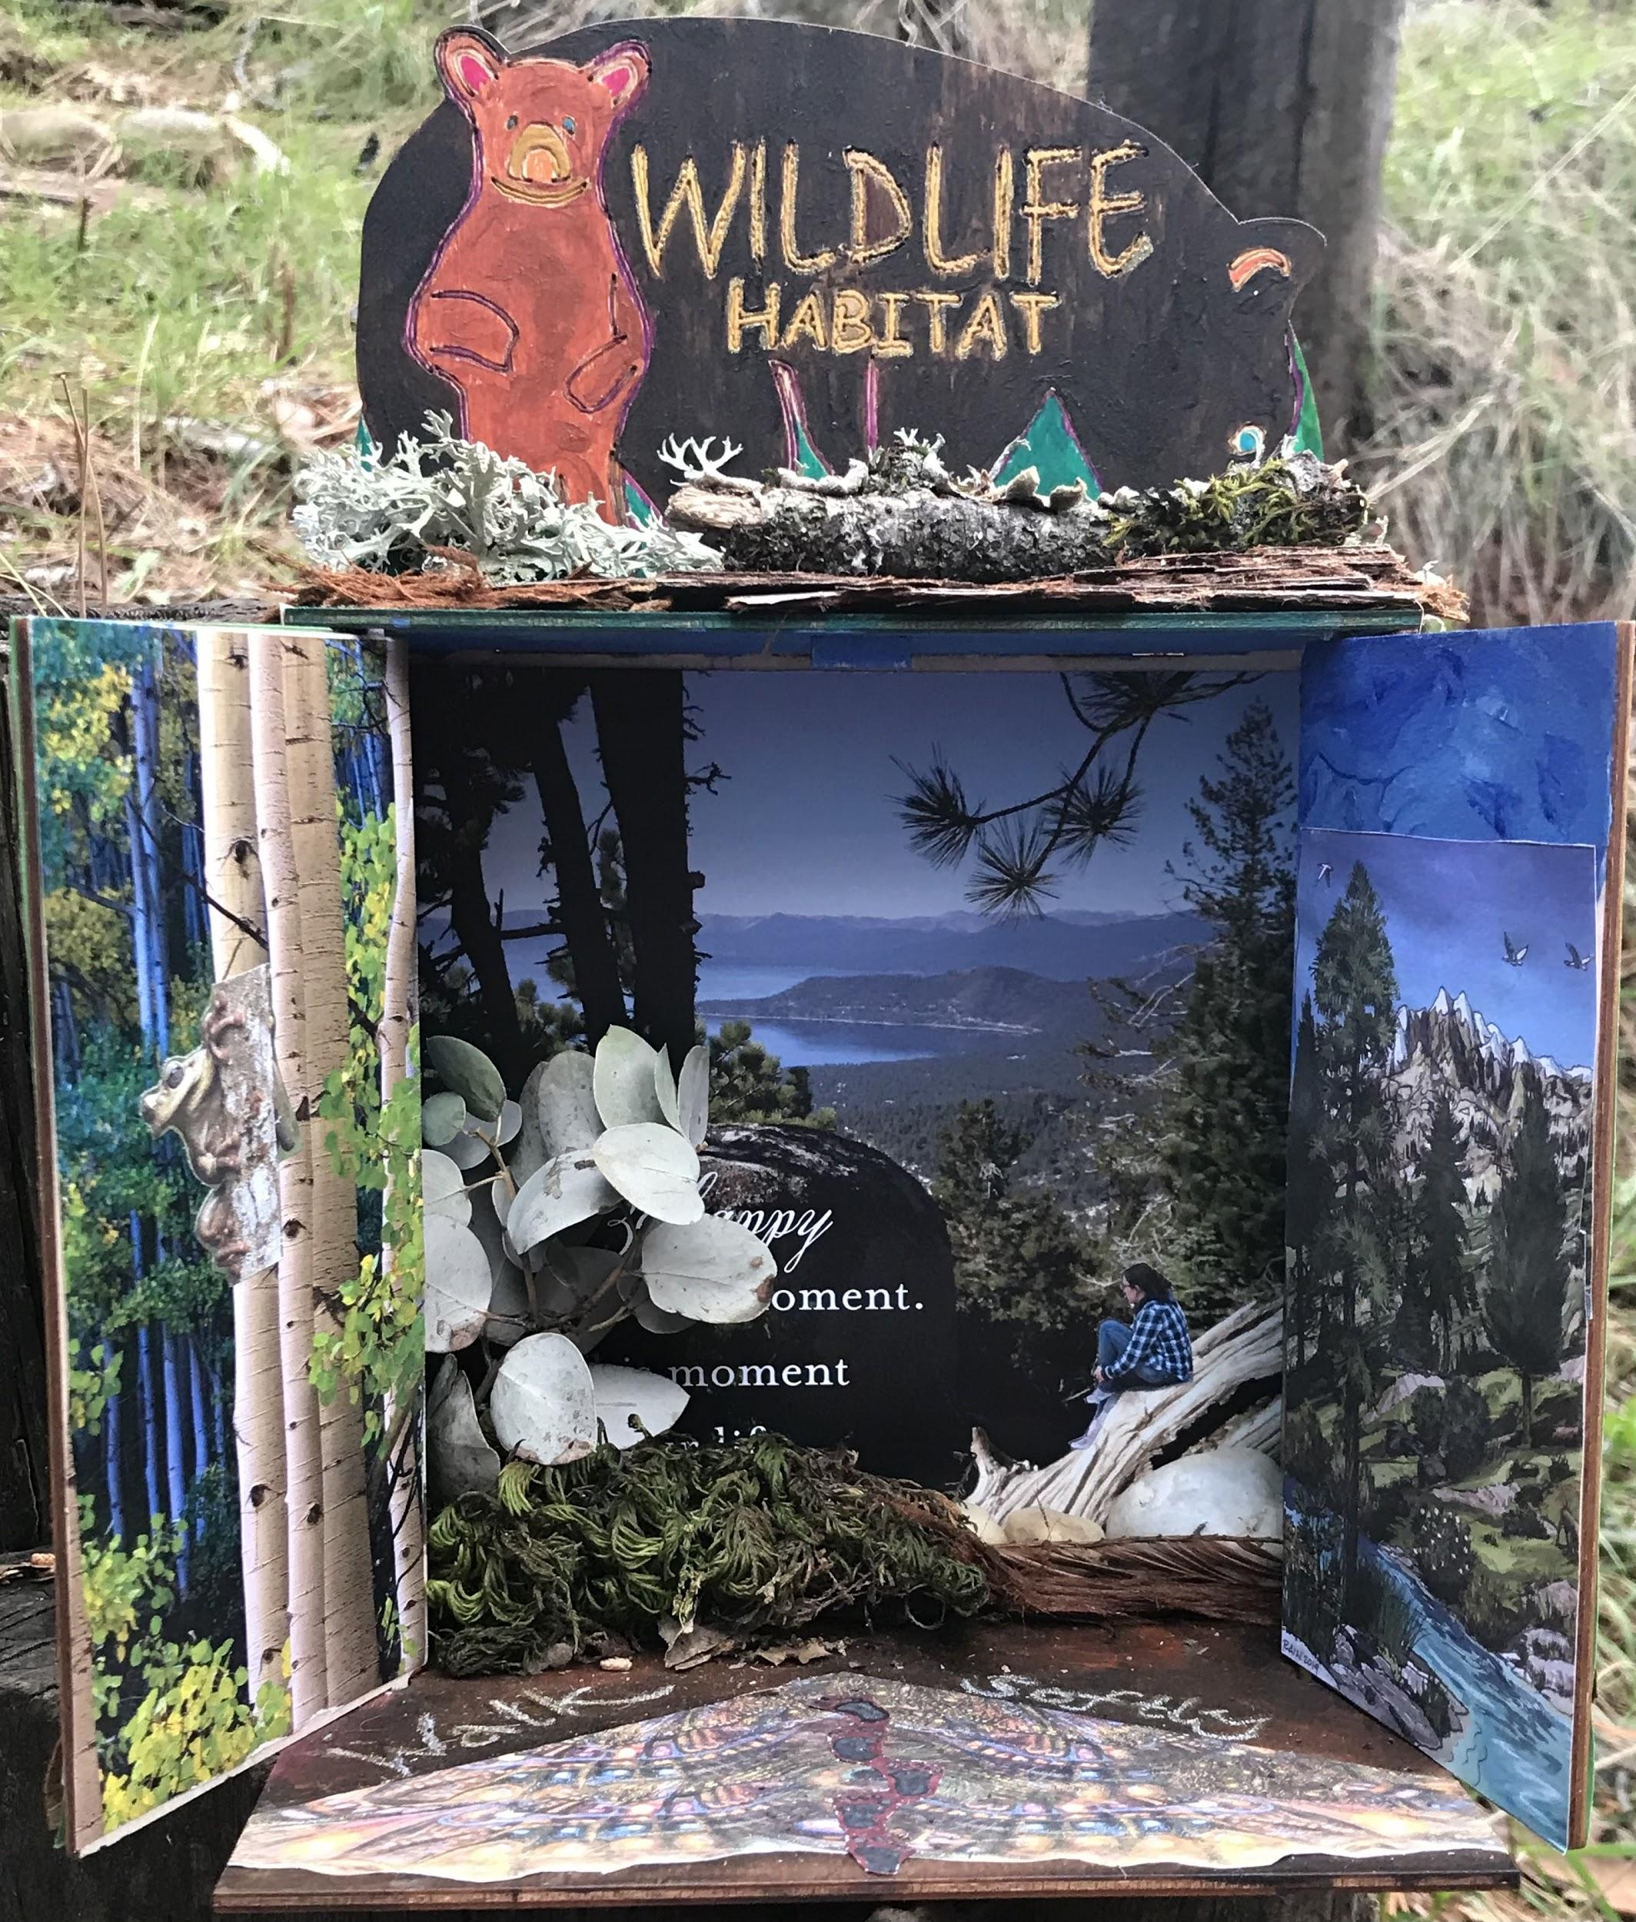
Notes:
Open the doors gently & think about how your interior picture is going to look. Do you want to paint the pieces or paste in pictures?

Slide 12
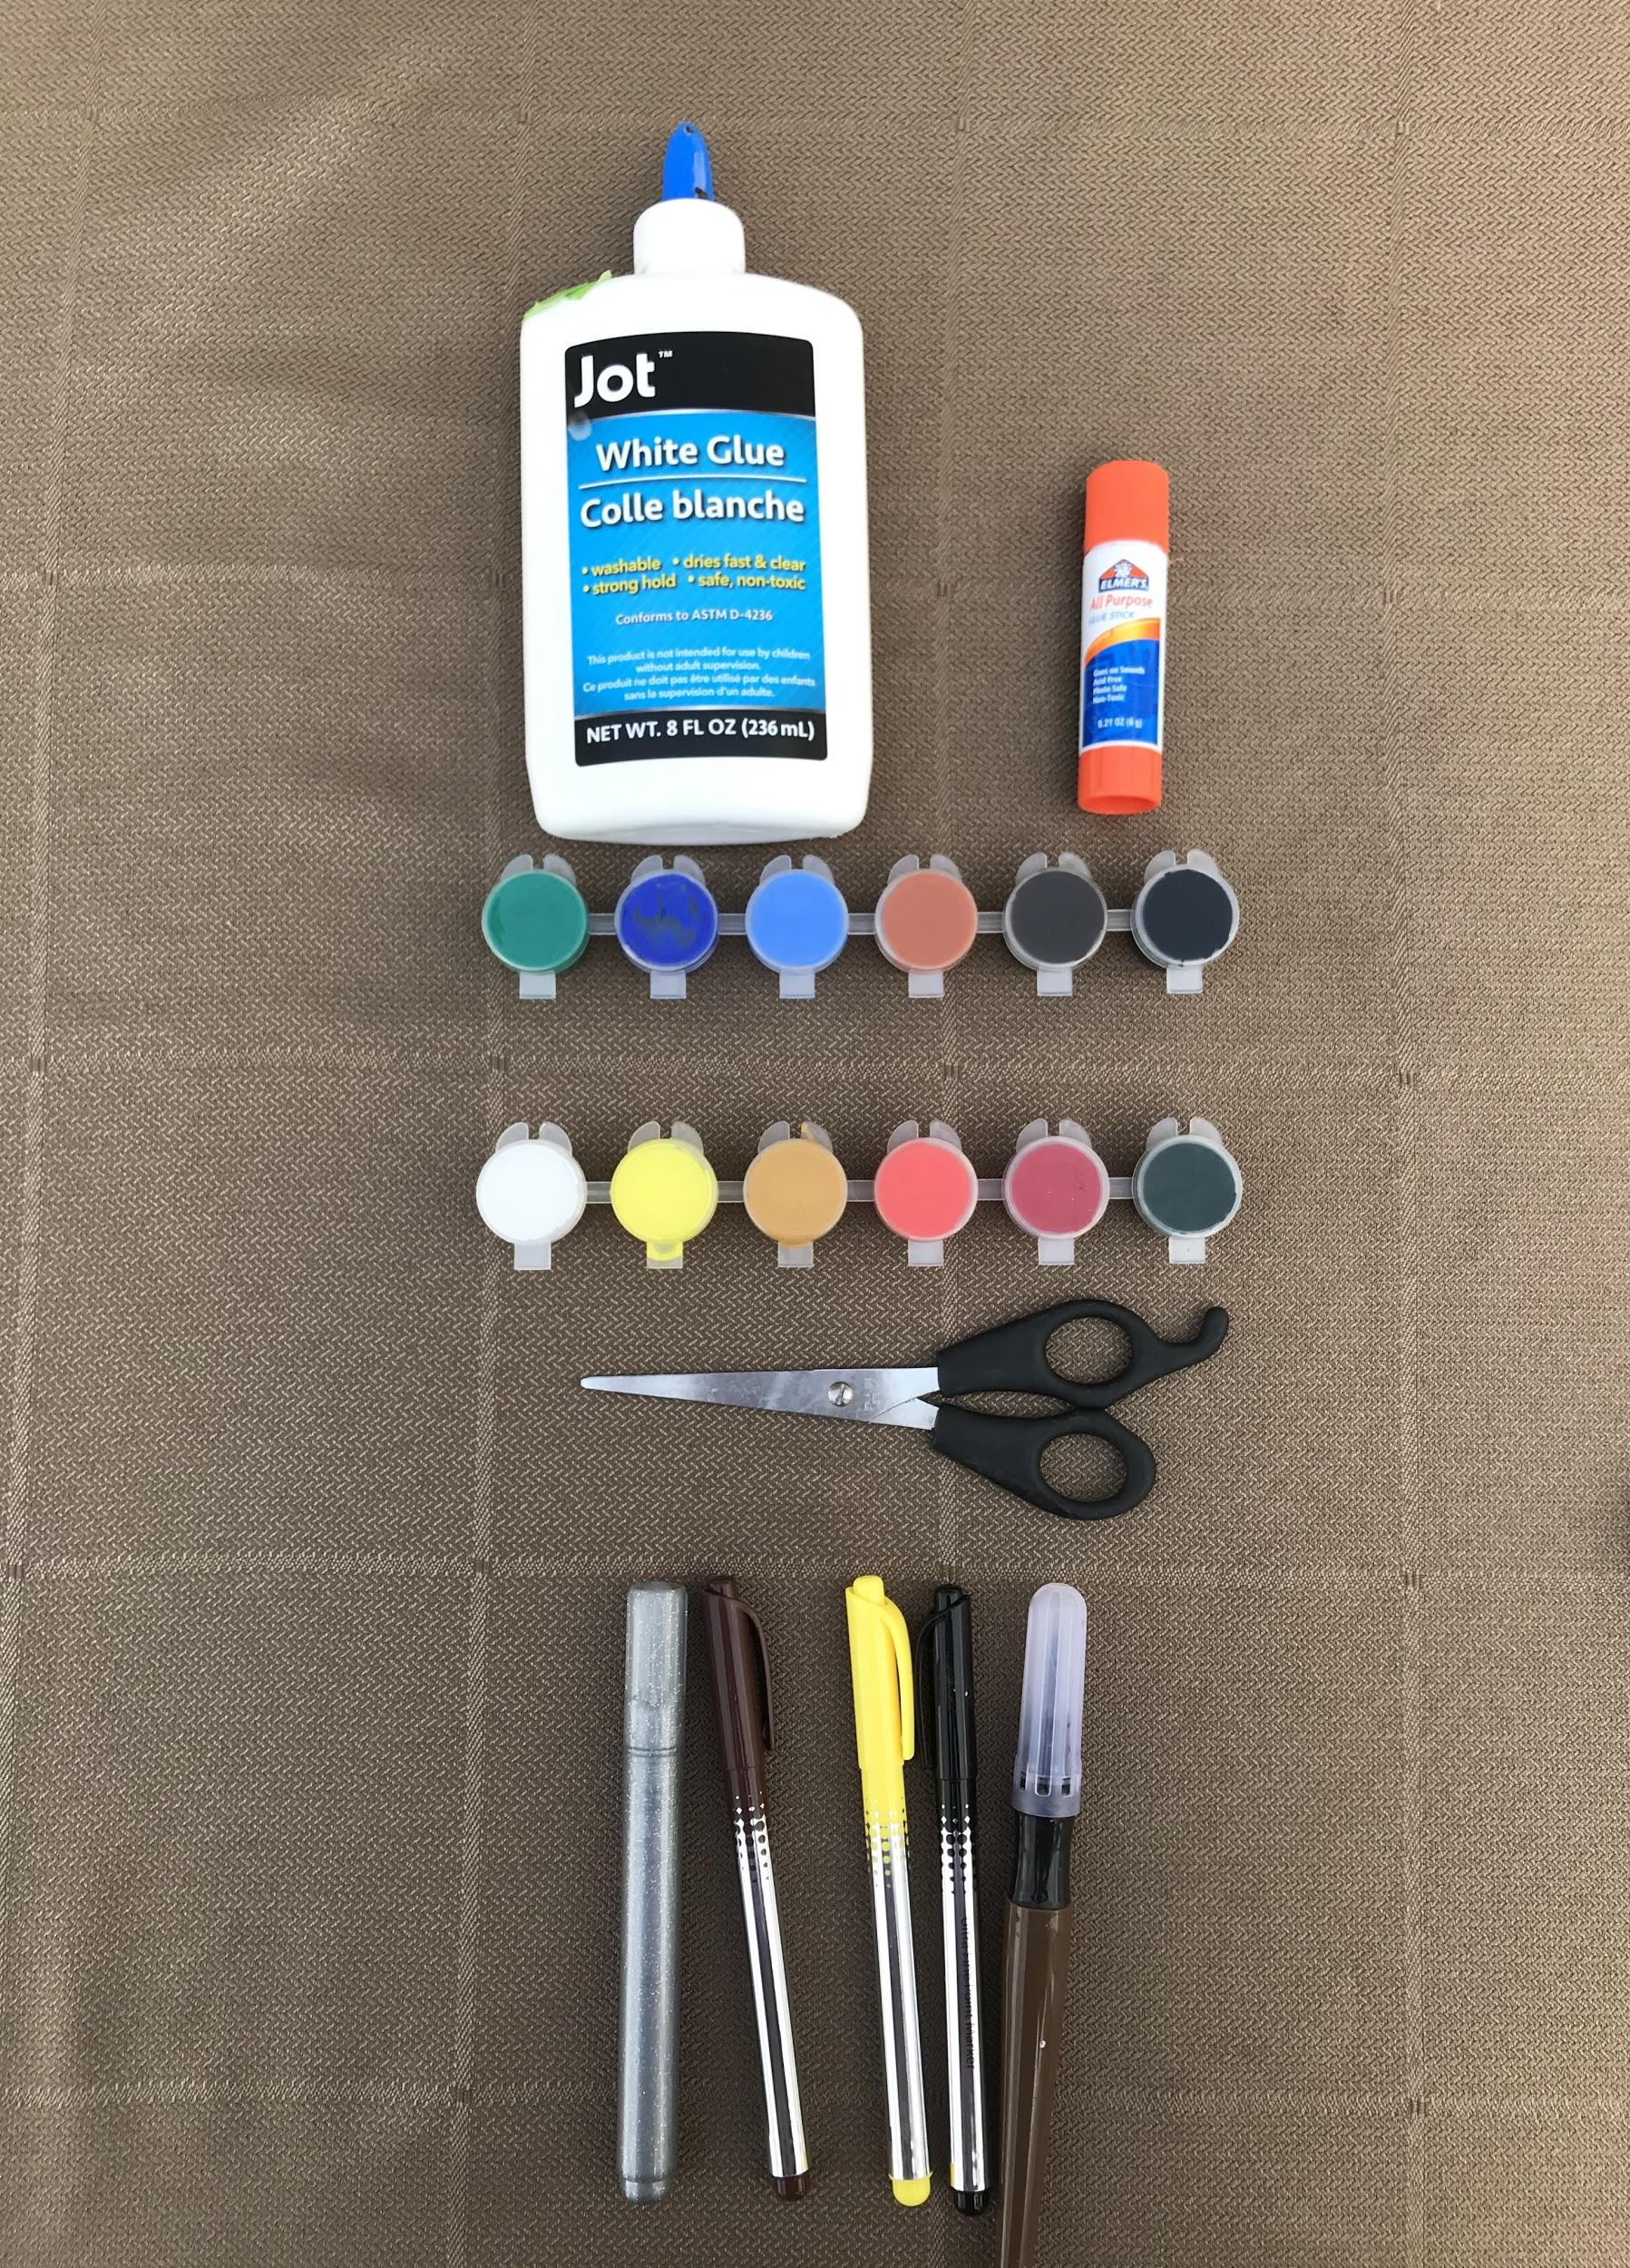
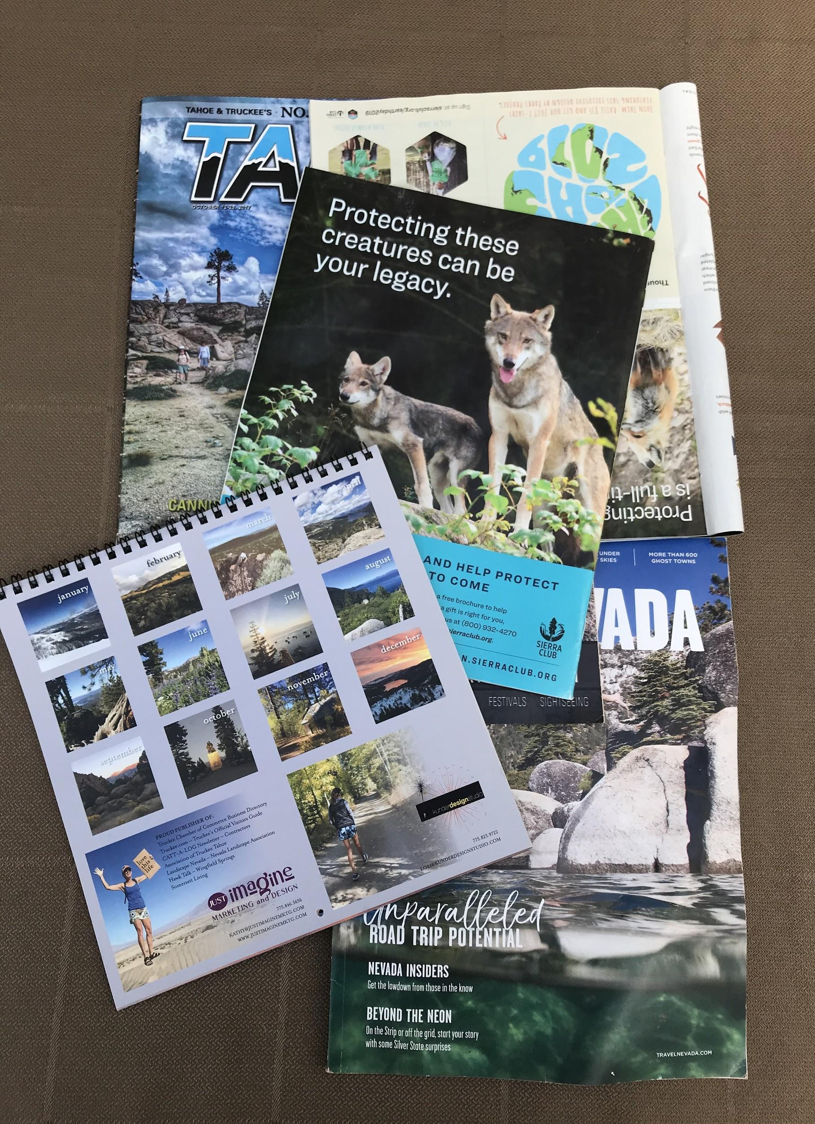
.
Notes:
Items you will need if you do not already have them.
Glue/glue stick
Acrylic paint (can be purchased at the dollar store)
Scissors
Pens/Paint Brushes
Then get old magazines, calendars to look for interesting photos for your walls

Slide 13
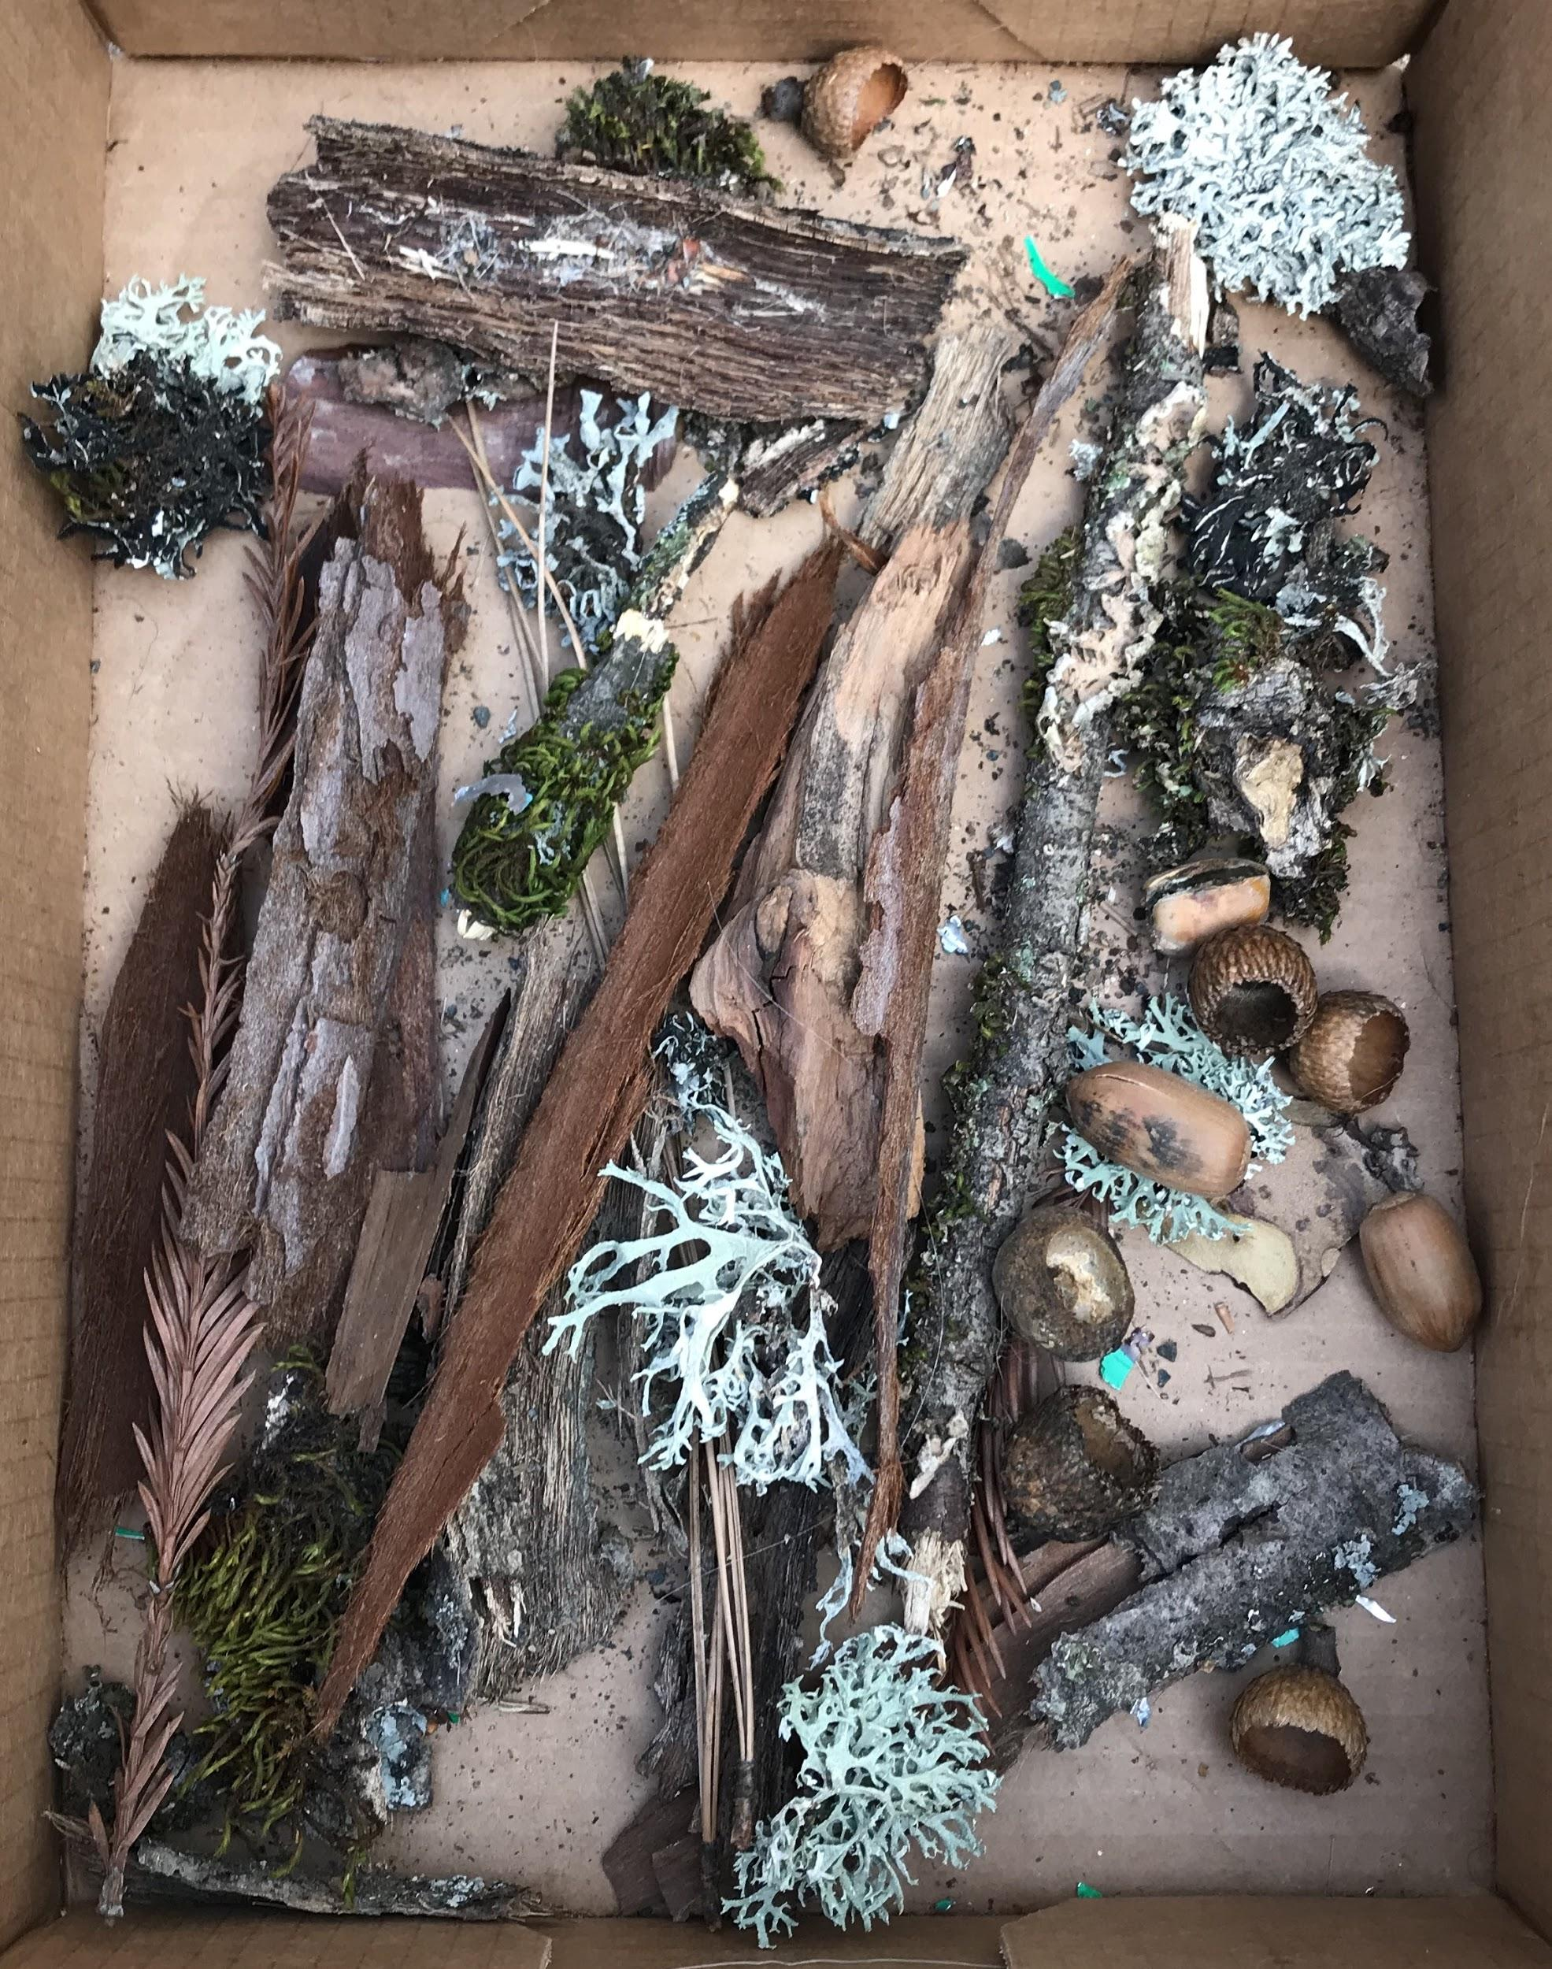
Notes:
Now it's time to head back into the forest for a few more Earth Walks where you can pick up items that will finish off your shrine after all the sides have been painted or pasted with your artwork.

Slide 14
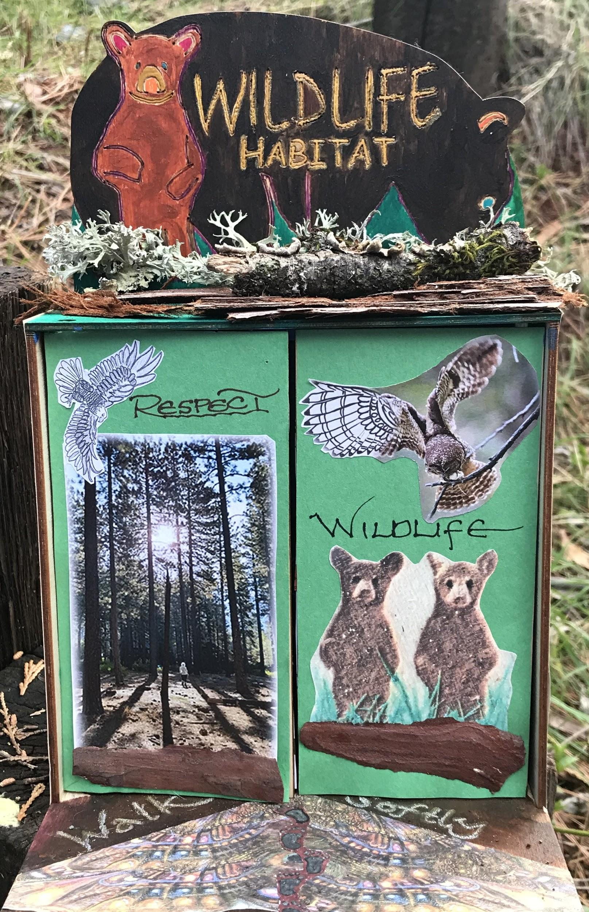
Your Earth Shrine can be your artist collage expression of your healthful Earth Walk!

Slide 15
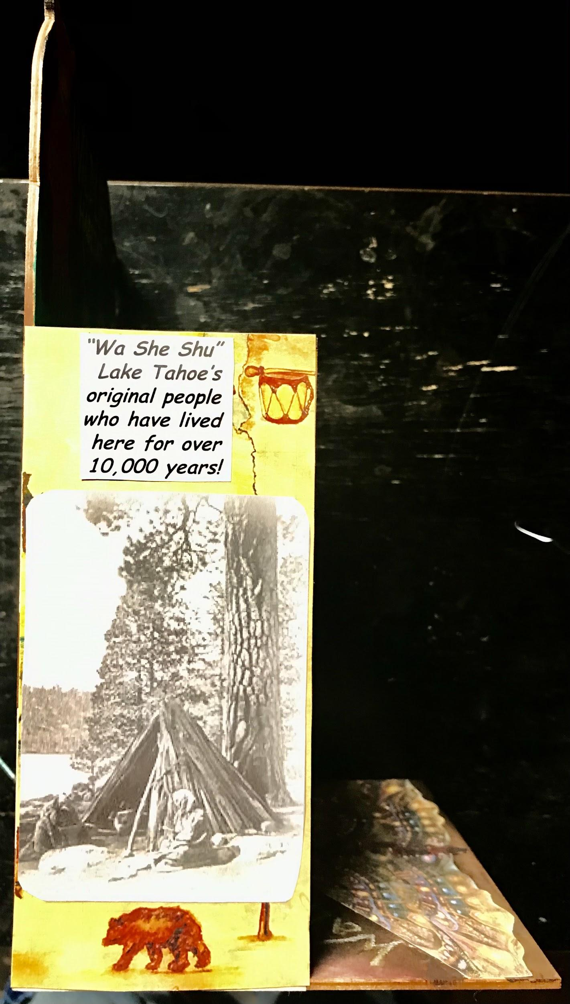
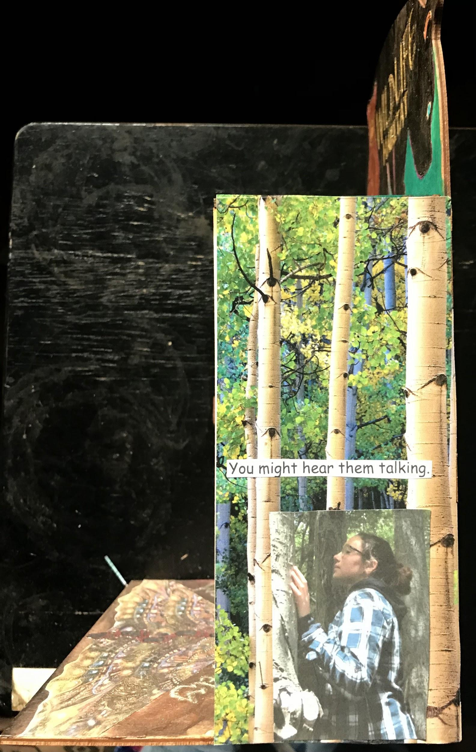
The sides of your shrine can also reflect aspects of your Earth Walk experiences and intention.

